Slide 1
Introduction to Corneal Transplantation
Jamie Choi, MD
Fellowship-Trained Cornea and Cataract Surgeon
Levin Eye Care

Slide 2
Key Discussion Points
Function of the Cornea
Reasons for Corneal Transplantation
Process of Corneal Donation
Types of Corneal Transplants
Risks and Benefits
Questions

Slide 3
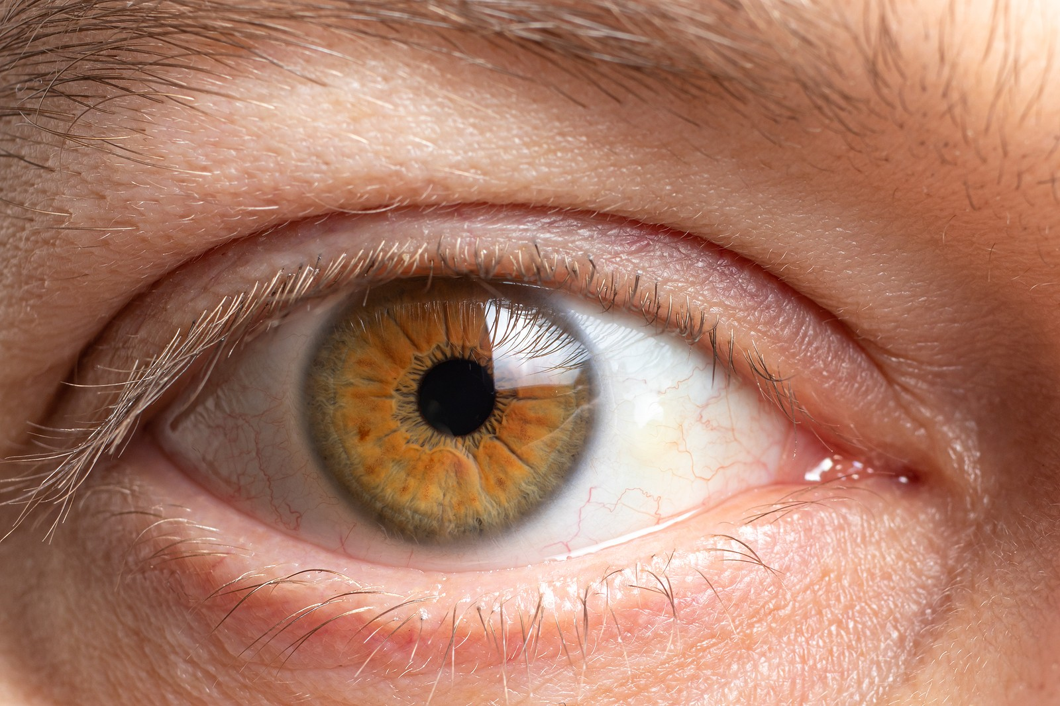
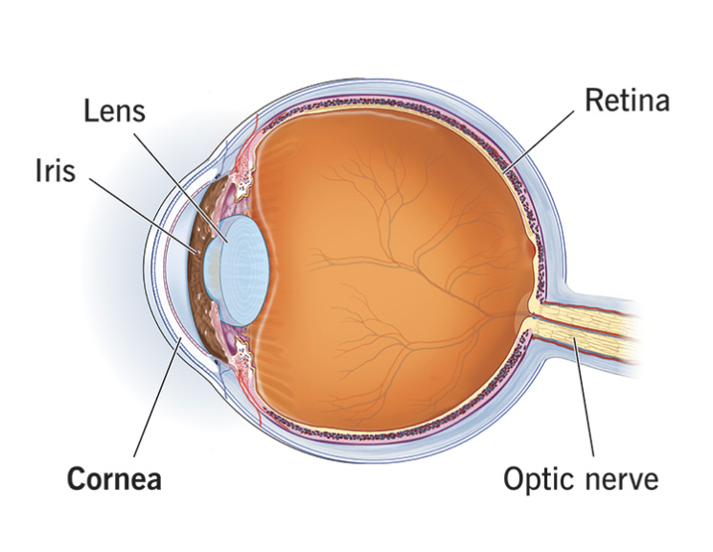
What is the Cornea?
Clear, dome-shaped, outermost layer of the eye
Helps to focus light to the back of the eye
Acts as physical barrier to the inner parts of the eye
Must remain clear for good vision

Slide 4
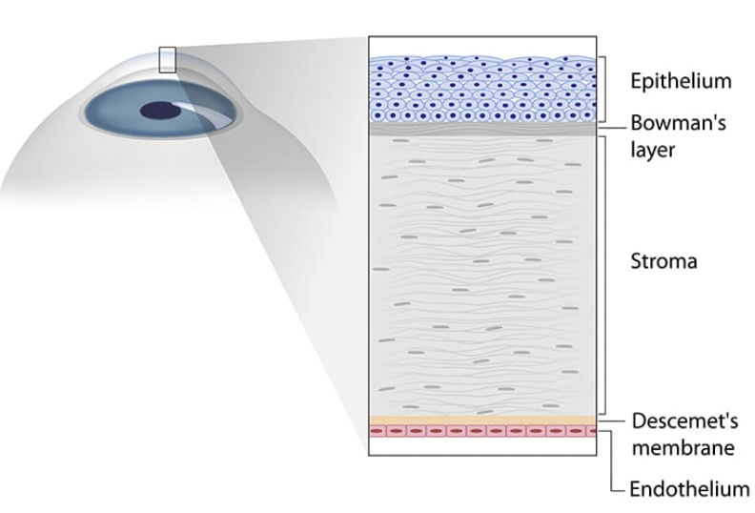
Corneal Anatomy

Slide 5
Reasons for Corneal Transplantation
Scarring
Perforation
Infections
Trauma
Corneal Diseases
  Common
    Fuchs Endothelial Dystrophy
    Keratoconus

Slide 6
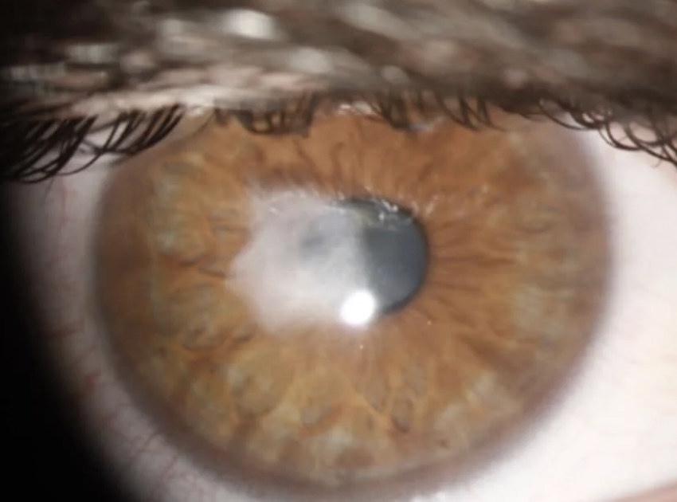

Slide 7
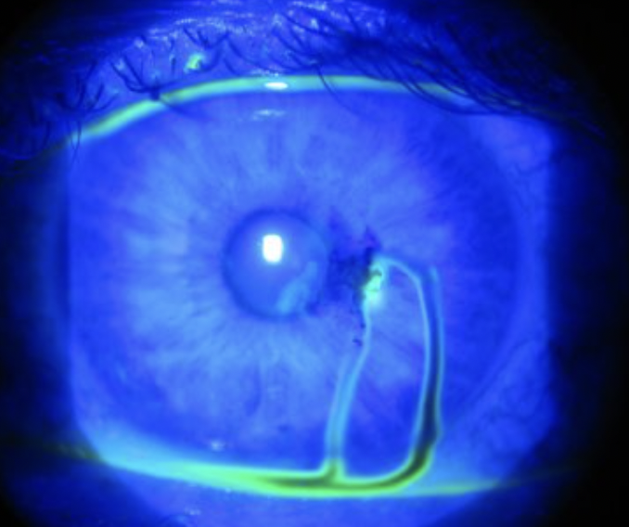

Slide 8
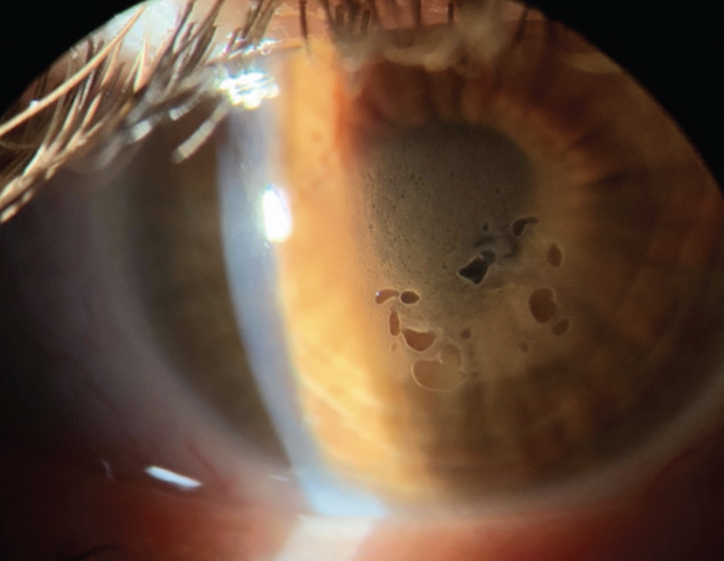
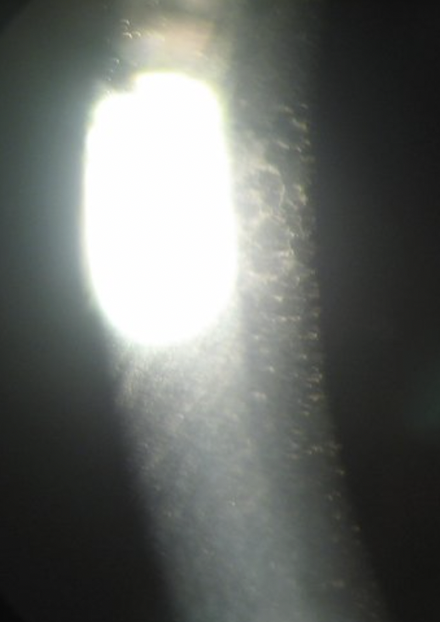

Slide 9
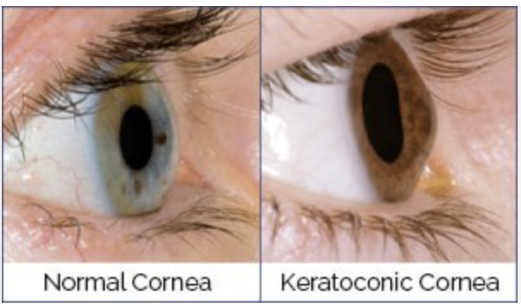

Slide 10
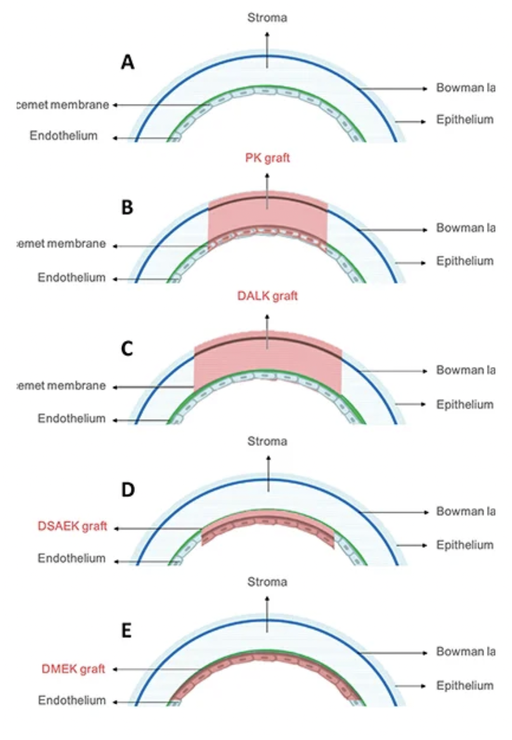
Type of Transplant Depends on the Layer of Cornea Affected
Range from partial to full thickness

Slide 11
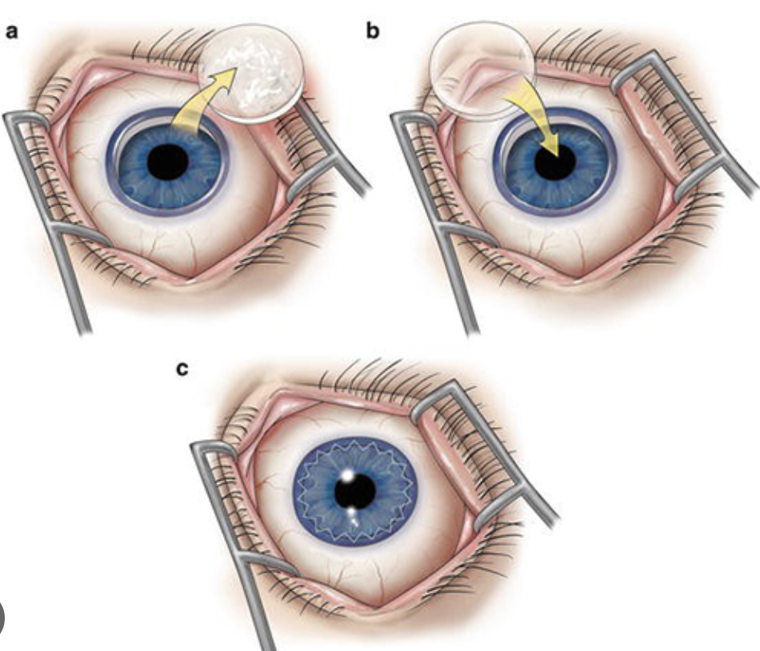
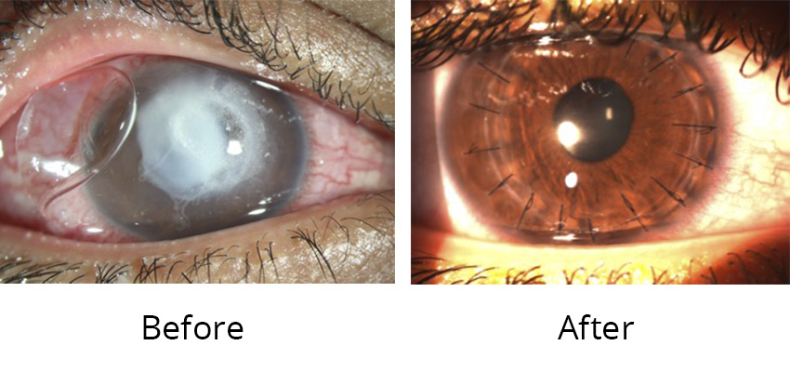
Penetrating Keratoplasty (PK)
= Full thickness
Notes:
-Longest visual recovery
-Sutures removed over time
-Lasts about 10-15 years potentially, but can vary

Slide 12
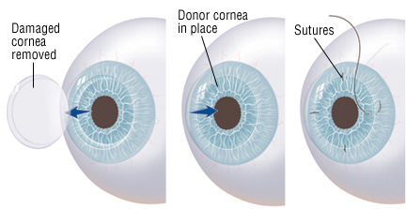
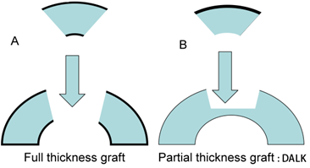
Deep Anterior Lamellar Keratoplasty (DALK)
Notes:
Benefits of the DALK over the PK include lower rates of rejection. Donor endothelium, or the innermost layer, remains intact. This is where immune cells occupy. Can be technically more challenging to perform.

Slide 13
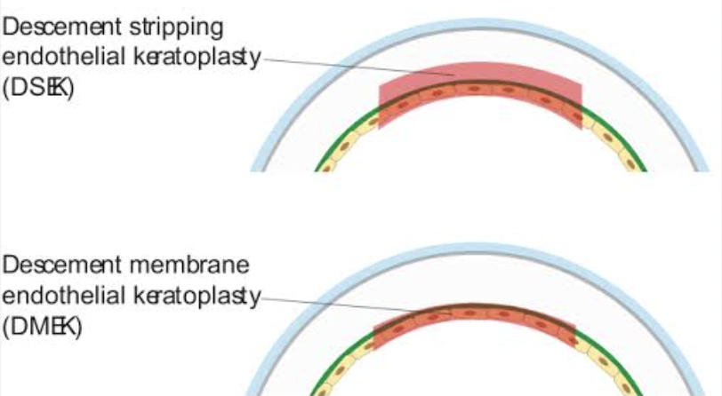
Lamellar (Partial) Transplants
DMEK and DSEK
Notes:
-Decision to perform either DSEK versus DMEK also depends on which layer is being affected.
-Faster visual recovery than DALK or PK, give or take about 3 months

Slide 14
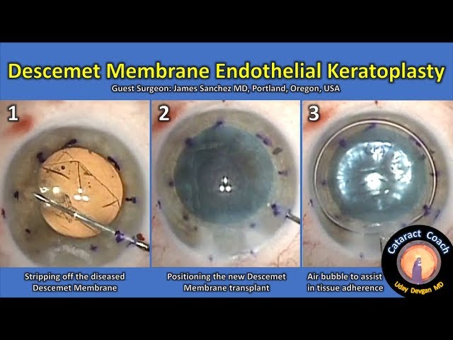
Notes:
Air or gas bubble, lie flat for 24-48 hours

Slide 15
Where do Donor Corneas Come From?

Slide 16
Donation Process
Included with universal organ donor consent
Harvested at eye banks throughout the country
Harvesting occurs within 12-24 hours of death
Undergo extensive safety testing
  Infectious disease panel
  Endothelial cell counts
  Overall quality
Immune privileged*
  Does not need Rh or ABO matching like other transplants
Delivered to recipient within 2 weeks of death

Slide 17
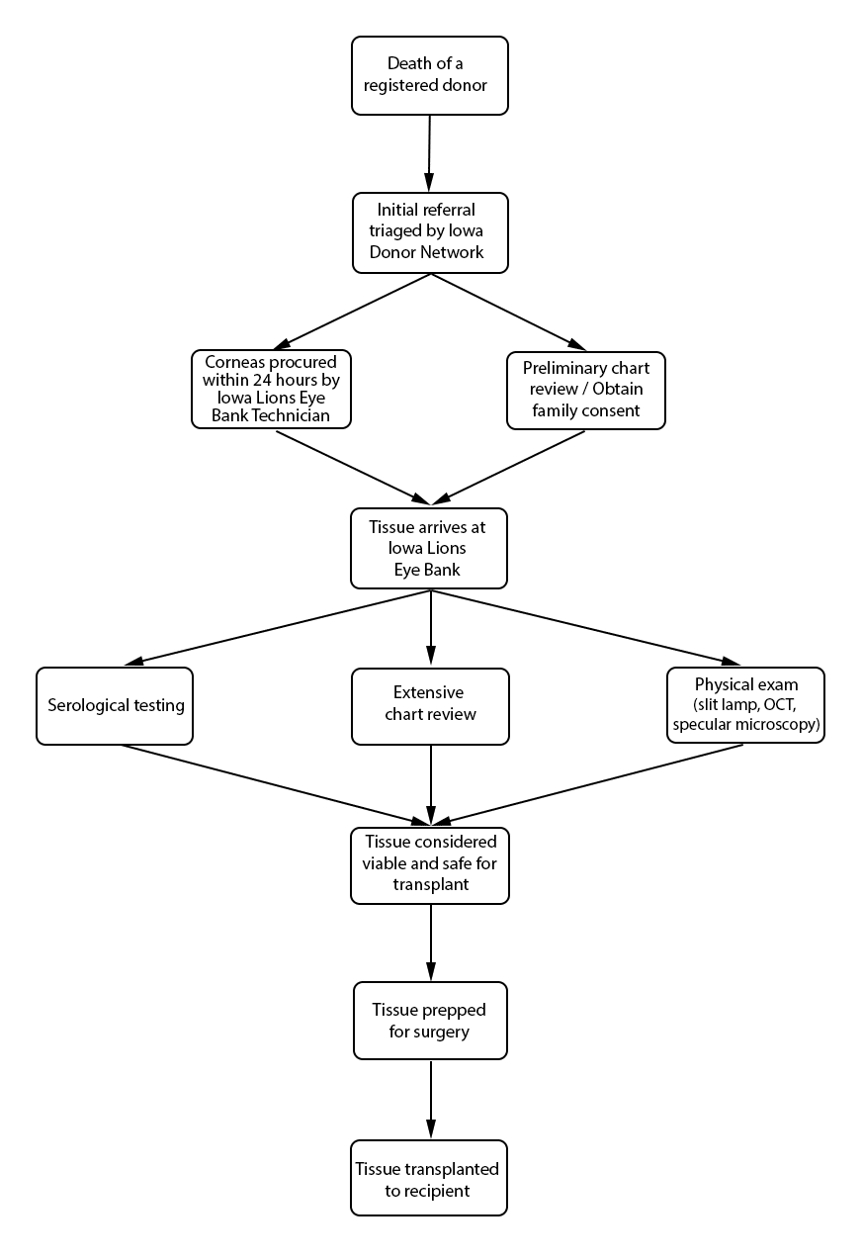

Slide 18
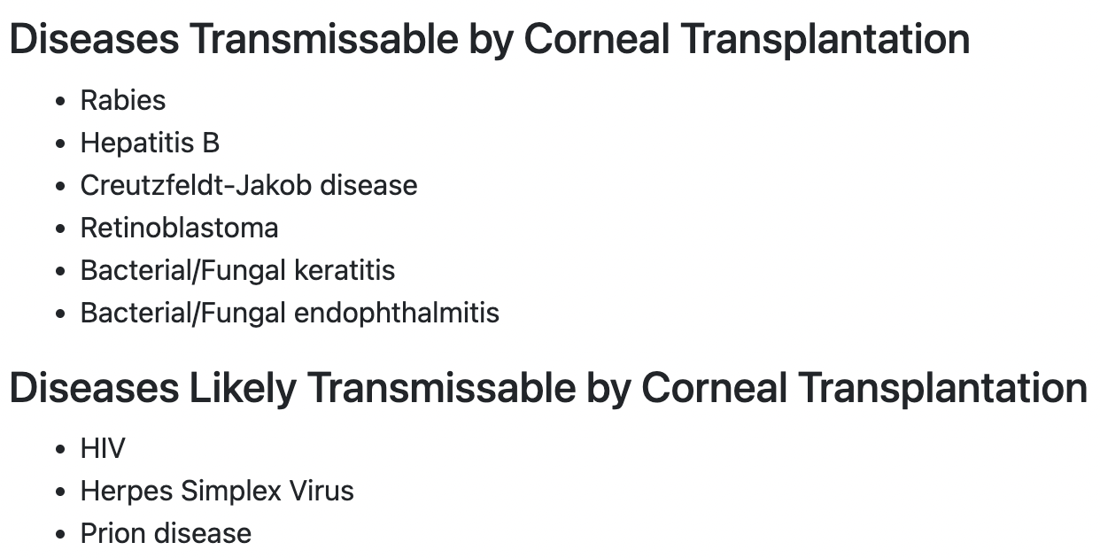

Slide 19
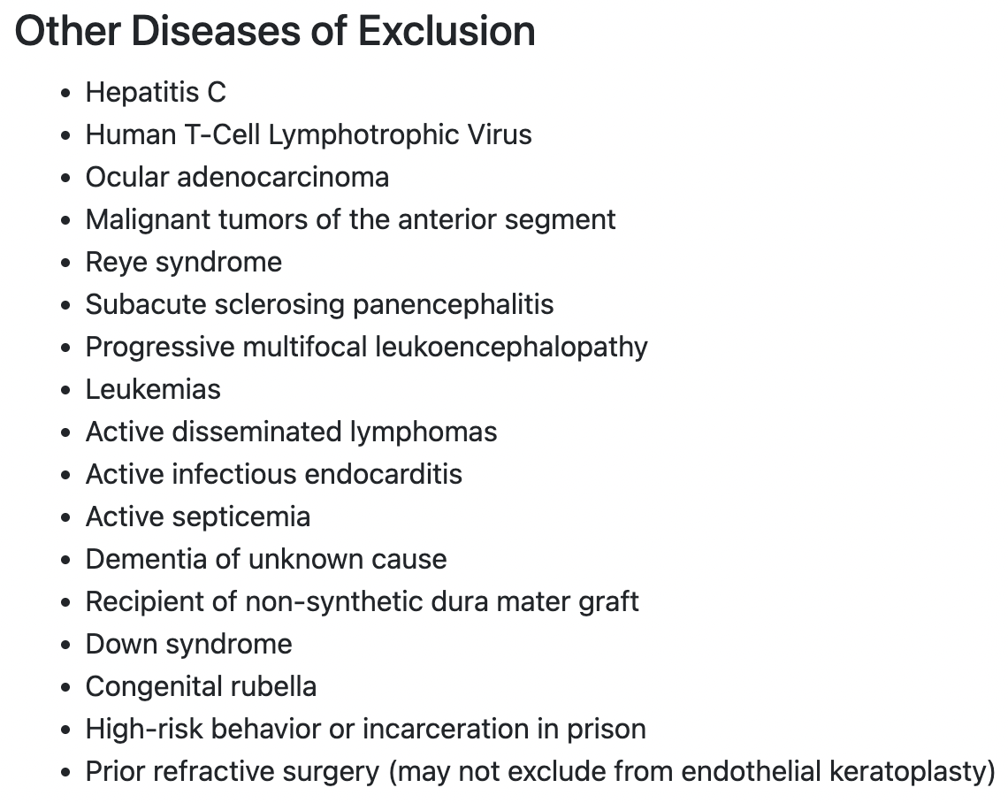

Slide 20
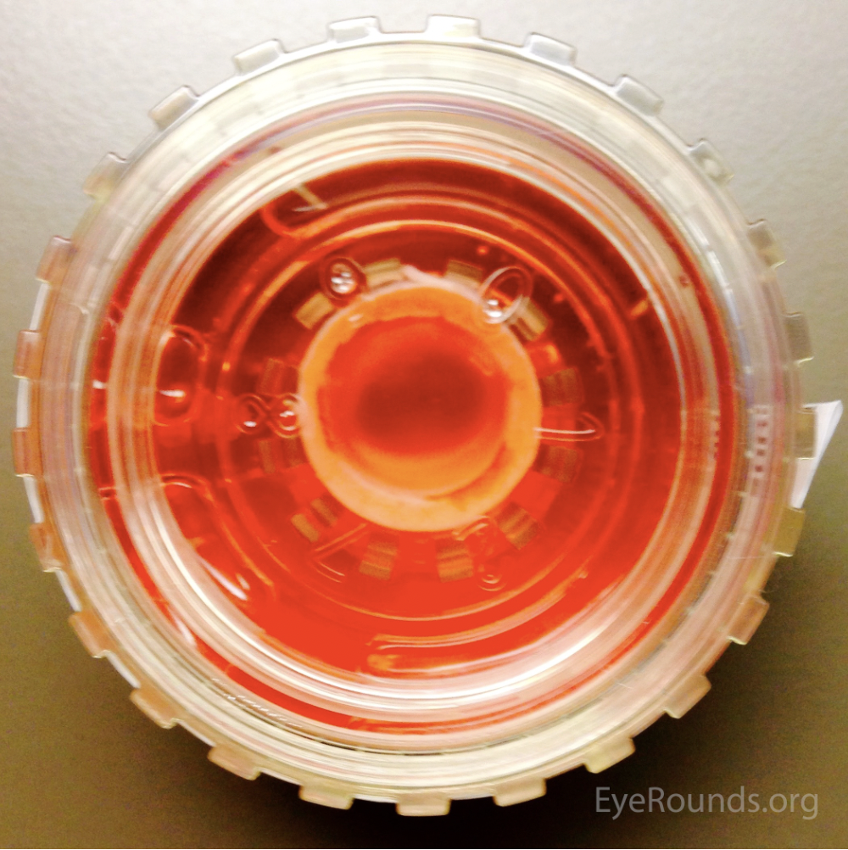
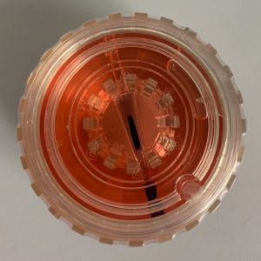

Slide 21
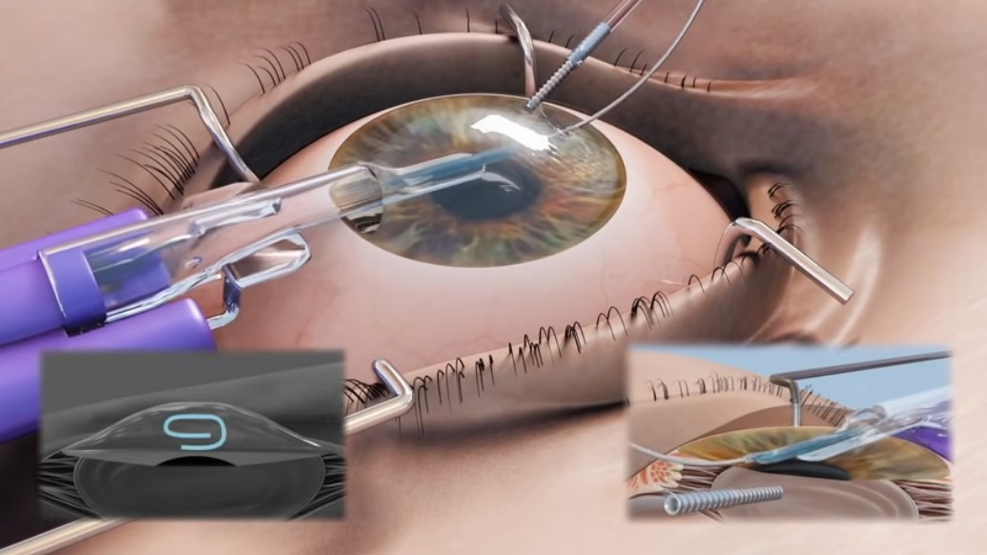

Slide 22
Potential Risks and Complications
Risk of rejection (varies between 2-20%)
  Much higher with full thickness grafts (PK)
  Higher in repeat transplants
Risk of failure
  Partial thickness grafts (10-20 years)
  Full thickness grafts (about 10 years)
Development of glaucoma
  Associated with chronic steroid use
Risk of infection (<1%)
Other: Bleeding, cataract formation, retinal detachment, astigmatism

Slide 23
Goals of Transplantation
Depends on the underlying disease process
Ultimately to restore vision, but may not be “perfect”
May still require glasses and/or contact lenses afterwards

Slide 24
Questions

