Slide 1
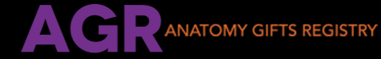

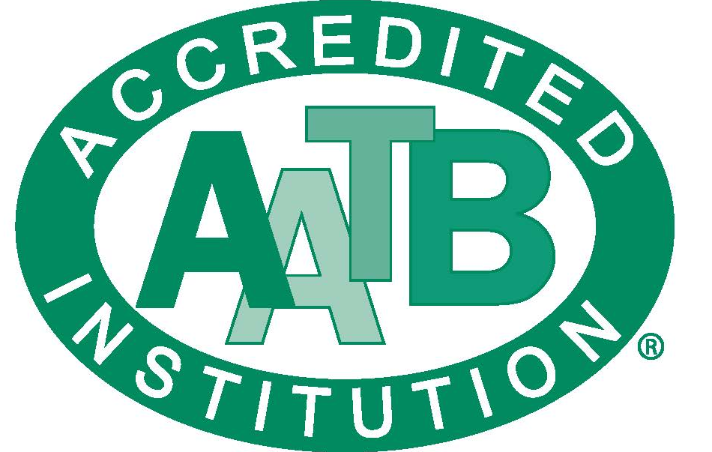
Give with Your Whole Being.

Slide 2
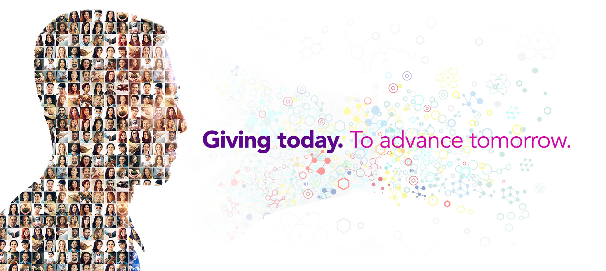
Who are we?
Anatomy Gifts Registry (AGR) is an independent, non-profit, anatomic donation organization that supports advancements in scientific research and medical education. AGR provides a no-cost alternative to the traditional funeral or cremation service.

Slide 3
About Us
Founded in 1994
501 (c)(3) nonprofit corporation
Over 20,000 pre-registered donors
Permitted Maryland Crematory
Licensed Non-Transplant Anatomic Bank by NY Department of Health
Accredited by American Association of Tissue Banks (AATB)
Management Staff are AATB-Certified Tissue Bank Specialists

Slide 4
What Is
Whole-Body Donation?
Whole-body (anatomical) donation is:
the donation of a whole body after death for the purposes of medical research and education
a way to leave a legacy of helping humanity by advancing studies that aim to identify better ways to treat a comprehensive range of illnesses and conditions
a no-cost alternative to traditional funeral/cremation arrangements

Slide 5
Whole-Body Donation VS Organ/Tissue Donation: What’s the difference?
The heart on your ID means you have consented to organ/tissue donation – NOT whole-body donation
Organ/tissue donation is when organs or tissues are recovered and transplanted to another living human in a life-saving or life-enhancing procedure (such as heart transplant, skin graft, cornea transplant, etc.)
Whole-body Donation is when a deceased persons body is utilized for medical education and research (such as cadavers for a medical school, extremities to practice joint replacement surgeries, etc.)

Slide 6

More Good Can Be Done!
Whole body donation allows for additional humanitarian benefit after transplant recovery! Our program fully supports shared organ, eye, and tissue donations with both local and national OPOs. This allows AGR donors to provide life-saving options while also helping advance medical education and research
When transplant is not an option, whole-body donation provides another opportunity to be a donor and to make a difference in the lives of others

Slide 7




Exponential Impact on
Research, Education, & Training
Each whole-body donor, on average, participates in 4-5 studies and/or training events
Each study, each research and development project, each surgeon being trained, has the potential to impact immeasurable lives – perhaps even saving them

Slide 8


Research Endeavors
New organ/tissue recovery & transplantation techniques
Surgical Training & Advancing Techniques
Medical Device Research & Development
Biomechanical Studies
Hearing & Vision Impairment Studies
Neurodegenerative Diseases
Psychiatric Disorders
Cancer & Effects of Metastasis, Early Detection, & Resection
Diabetes
Life Saving Procedures (EMS)
Drug Delivery Improvements
& Many more

Slide 9
Why Do Individuals
(or their Families) Choose Whole-Body Donation?
Financial Availability: There is no cost for whole body donation, unlike traditional funeral/cremation arrangements
Educational Advancement: Medical Science and Research cannot move forward in a meaningful way without these generous gifts
Humanitarianism: For those who believe deeply in giving back and making a lasting impression on humankind

Slide 10
What distinguishes Anatomy Gifts Registry from other whole-body donation programs?
Accredited by AATB | There are dozens of whole-body donation programs across the country. Only 7 (including AGR) are AATB accredited.
Nonprofit Status | Of those 7 mentioned above, only 3 (including AGR) are nonprofit.
Posthumous Donation by NOK | In addition to preregistration by oneself, the next-of-kin may also donate after death, following governance of the Uniform Anatomical Gift Act, which sets the regulatory framework for donations of human tissue.
Donation After Transplant Recovery and /or Autopsy | AGR fully supports life-saving and life-enhancing transplant recovery and coordinates seamlessly with such programs. Autopsy whether state or private are not prohibitive.
Timely Return of Cremated Remains | Partial cremated remains are processed swiftly for timely closure; many programs can take 6 months to 2 years to return cremated remains.
Acceptable if death occurs out of state | Except for a few areas; All costs for transportation are covered by AGR, and we partner with mortuary services to file death certificates in the state where the death occurs.
Ability to specify avenue of research | AGR always makes the best effort to honor donor/family wishes for specified research.
Domestic and International Tissue Placement | Because improving knowledge and healthcare outcomes is a global, shared effort.
Donor Follow Up Letters | Each family is offered a follow up letter which describes how the donation specifically impacted medical research and education – families often read aloud this letter during memorial services, or frame as a testament to the gift made by the donor.

Slide 11

AGR Donor Family Services
Caring Staff
  Donor and Family Service Coordinators are available 24/7; we invite and encourage families to reach out to us with any questions or concerns whatsoever
  Coordinators are well versed in handling sensitive situations with compassion and understanding
  Each family is walked through the entire donation process and kept well informed from start to finish, and beyond
Special Requests
  AGR makes best efforts to accommodate special requests made by families, such as cremating personal items with a donor, returning donor thumb prints or a lock of hair, transfer of ashes to an urn or piece of jewelry, etc.
  In some cases, family can direct donation toward a particular area of research

Slide 12
About Cremated Remains
Donation can be with or without the return of cremated remains
Cremated Remains are ONE person
Cremation is performed at our facility
AGR returns partial cremated remains which means only a portion of the donor’s body is cremated; this allows AGR to optimize the gift and facilitate timely closure for loved ones

Slide 13



Becoming a Donor
An interested person/family must contact AGR
Speak with Donor & Family Services
Confirm Donor Eligibility
Complete Donor Registration Packet
  Includes medical history and legal authorization
Individuals registering for the future will be mailed an acceptance letter and 2 donor cards
For those who are terminally ill/under hospice, registration is expedited for rapid turn-around
For an at-need donation (a loved one has passed on) all required documentation is completed on the spot with the appropriate person

Slide 14

Take the Next Step:
Give with Your Whole Being

Slide 15

Questions or Comments?

