Slide 1
Navigating Transplant-Related Diabetes
Empowering Patients through Education and Prevention
Presented by: Nestoras Mathioudakis, MD MHS
Co-Medical Director, Johns Hopkins Diabetes Prevention & Education Program

Slide 2
What is diabetes?
Definition:
Diabetes mellitus is a chronic condition characterized by high levels of glucose (sugar) in the blood.
Mechanism:
Insulin Resistance: The body's cells do not respond effectively to insulin.
Insulin Deficiency: The pancreas does not produce enough insulin.

Slide 3
Symptoms and Complications
retinopathy
stroke
urination
blurry vision
thirst
heart
kidney
foot sores
hunger
circulation
nerves
Notes:
f

Slide 4
Types of Diabetes
Type 1
Type 2
Gestational
Notes:
Type 1 Diabetes: The body does not produce insulin. Typically diagnosed in children and young adults.
Type 2 Diabetes: The body either doesn't produce enough insulin or the cells resist insulin. Often associated with obesity and lifestyle factors.
Gestational Diabetes: Develops during pregnancy and usually disappears after giving birth but increases the risk of type 2 diabetes later in life.

Slide 5
Types of Diabetes
Type 1
Type 2
Gestational
Post-transplant

Slide 6
3 Patients with history of Liver Transplants
Case 1
69 yo man
Case 2
48 yo woman
Case 3
51 yo man

Slide 7
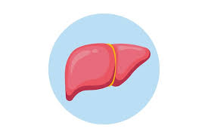
Case 1
CGM: TIR: 79%
Average Glucose: 151 mg/dl
Omnipod 5 pump
Lifestyle, Metformin, Januvia, Victoza
Insulin, Ozempic, Libre 3 CGM
69 yo man
2005: T2D
2012: Liver tx (cirrhosis due to hepatitis C)
A1C 7.4%-7.7%;
Hgb 10.8-11.9 (12.0-15.0)
2024
Complications: Retinopathy, Peripheral Neuropathy
Prednisone, Tacrolimus
(not an actual patient)

Slide 8
Case 2
3 months later
Metformin, Ozempic (not tolerated)
T2D: insulin in hospital 🡪 diabetes resolved, no medications
Prediabetes: A1C 5.8%🡪 6.4%
48 yo woman
2021: Liver tx
(alcoholic cirrhosis)
Weight gain of 80 lbs
2022
Dexcom G7 CGM
Average: 144
GMI: 6.7%
TIR: 88%
2024
A1C 6.2%
Metformin only
Prednisone, Tacrolimus
Complications: Neuropathy
(not an actual patient)

Slide 9
Case 3
2 years later
Sudden onset hyperglycemia (A1C 9.3%), started insulin
51 yo man
2019: Liver tx
(HCC, HCV, alcoholic cirrhosis)
2021
2022
2024
Metformin + Ozempic + Lifestyle --> Stopped insulin
Complications: None
A1C: 5.4% (normal)
Tacrolimus
(not an actual patient)

Slide 10
3 Patients with history of Liver Transplants
Different journeys with transplant-related diabetes, but all received
Diabetes Self-Management Training
Case 1
69 yo man
Case 2
48 yo woman
Case 3
51 yo man

Slide 11
Post-transplant diabetes
Post-transplantation diabetes mellitus (PTDM) is a common complication following solid organ transplantation (SOT)
Contributes significantly to morbidity and mortality in transplant recipients
Previous consensus reports in 2003 and 2013; with recently published 2024 update

Slide 12
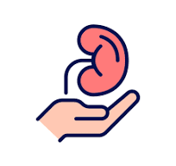
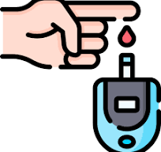
Diabetes & Solid Organ Transplantation
Post-transplant
Solid-organ Transplant
Diabetes Mellitus
Pre-transplant
Notes:
Diabetes itself is a risk factor for kidney and heart disease, and some patients with long-standing diabetes require organ transplantation.
Solid-organ transplantation is commonly associated with the onset of diabetes.

Slide 13
Definition and Nomenclature
“Steroid Diabetes” in Kidney Transplant Recipients
Transplant-associated hyperglycemia (TAH)
2014
New-onset diabetes after transplantation (NODAT)
Misleading since up to 10% of patients may have undiagnosed diabetes before transplant
Post-transplant diabetes (international expert consensus) to include patients with undiagnosed pretransplant diabetes
1964

Slide 14
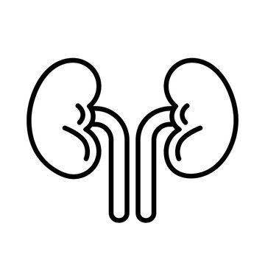
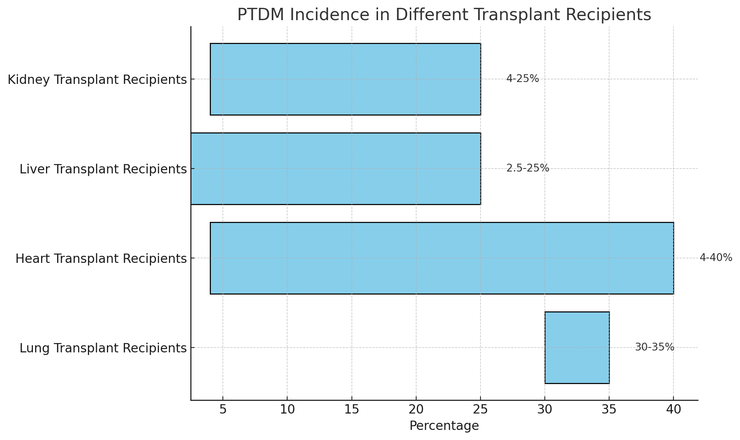
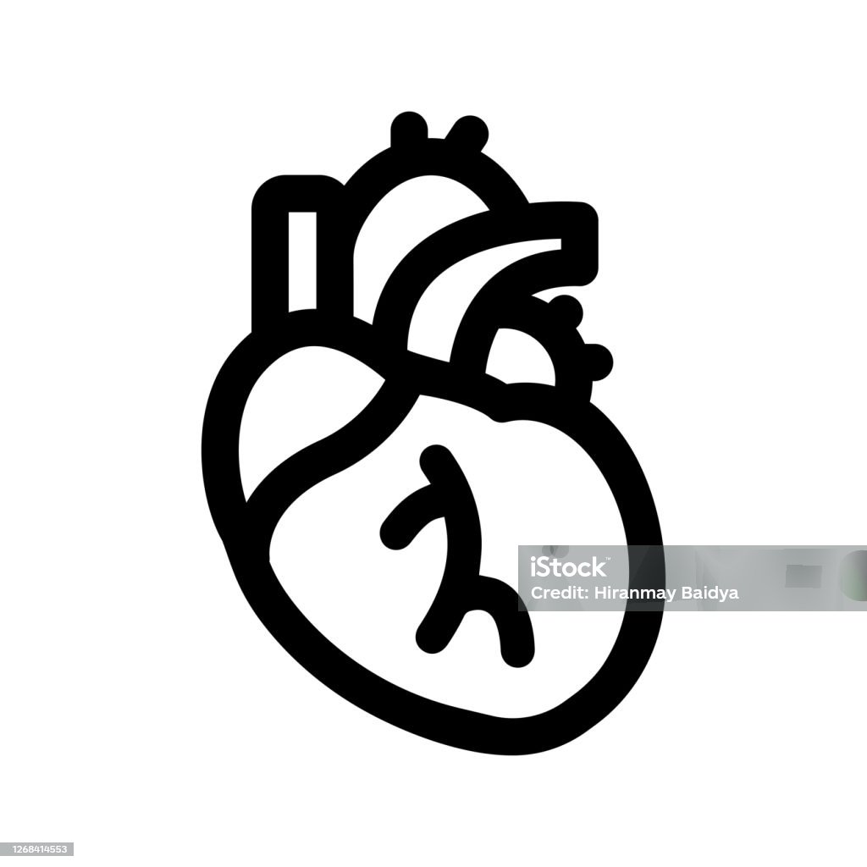
Incidence Rates of PTDM
Phuong-Thu Pham et al. Diabetes Mellitus After Solid Organ Transplantation. Endotext. Updated July 8, 2022
Notes:
TDM has been reported to occur in 4% to 25% of kidney transplant recipients, 2.5% to 25% of liver transplant recipients, 4% to 40% of heart transplant recipients, and 30% to 35% of lung transplant recipients (9, 12-15). Higher incidences have also been reported. Variations in the reported incidence may be due in part to the prior lack of a standard definition, presence of both modifiable and nonmodifiable risks factors, duration of follow-up, type of organ transplants, and primary diagnostic indications for transplant. In one retrospective cohort study of 415 liver transplant recipients, PTDM occurred in 34.7%, 46.9%, and 56.2% of patients at 1, 3, and 5-year follow-up, respectively (15). The 33rd International Society of Heart and Lung Transplantation database demonstrated that approximately 29% of lung transplant recipients who survived 5 years post-transplantation developed PTDM, with the highest incidence occurring among those whose primary diagnosis for lung transplantation was cystic fibrosis. (16).

Slide 15
Risk Factors for PTDM
Non-Modifiable Factors:
Age, ethnicity, family history of diabetes
Potentially Modifiable Factors:
Obesity, hepatitis C infection, CMV infection.
Modifiable Factors:
Immunosuppressive medications:
Corticosteroids reduce peripheral insulin sensitivity and increase hepatic gluconeogenesis.
Tacrolimus and cyclosporine decrease insulin secretion
Sirolimus increases insulin resistance.

Slide 16
Risk Factors for PTDM
End-Organ Diagnosis:
End-stage kidney disease due to polycystic kidney disease
End-stage lung disease due to cystic fibrosis
End-stage liver disease due to hepatitis C infection
Metabolic-associated fatty liver disease (MAFLD)
Additional Risk Factor:
Donor liver steatosis (fat) is associated with increased incidence of PTDM

Slide 17
Health Implications of PTDM
Increased Risks:
Cardiovascular disease, infection, graft rejection
Independent predictor of mortality
Microvascular complications less studied
Other Complications:
High blood pressure, high cholesterol/triglycerides, kidney complications

Slide 18
Immunosuppression Regimens
Tailored therapy
Immunosuppression should be personalized based on patient-specific factors
Steroids
Steroid avoidance/withdrawal linked to lower PTDM risk, but:
Increased risk of rejection
Balancing immunosuppression to minimize PTDM without compromising graft survival

Slide 19
Diagnostic Criteria for Diabetes
Criteria: | Normal | Prediabetes | Diabetes
Random glucose |  |  | 200 mg/dl or higher with symptoms
Fasting glucose | Less than 100 mg/dl | 100-125 mg/dl | 126 mg/dl or higher
Oral glucose tolerance test | Less than 140 mg/dl | 140-199 mg/dl | 200 mg/dl or higher
A1C | 5.6% or less | 5.7% to 6.4% | 6.5% or higher

Slide 20
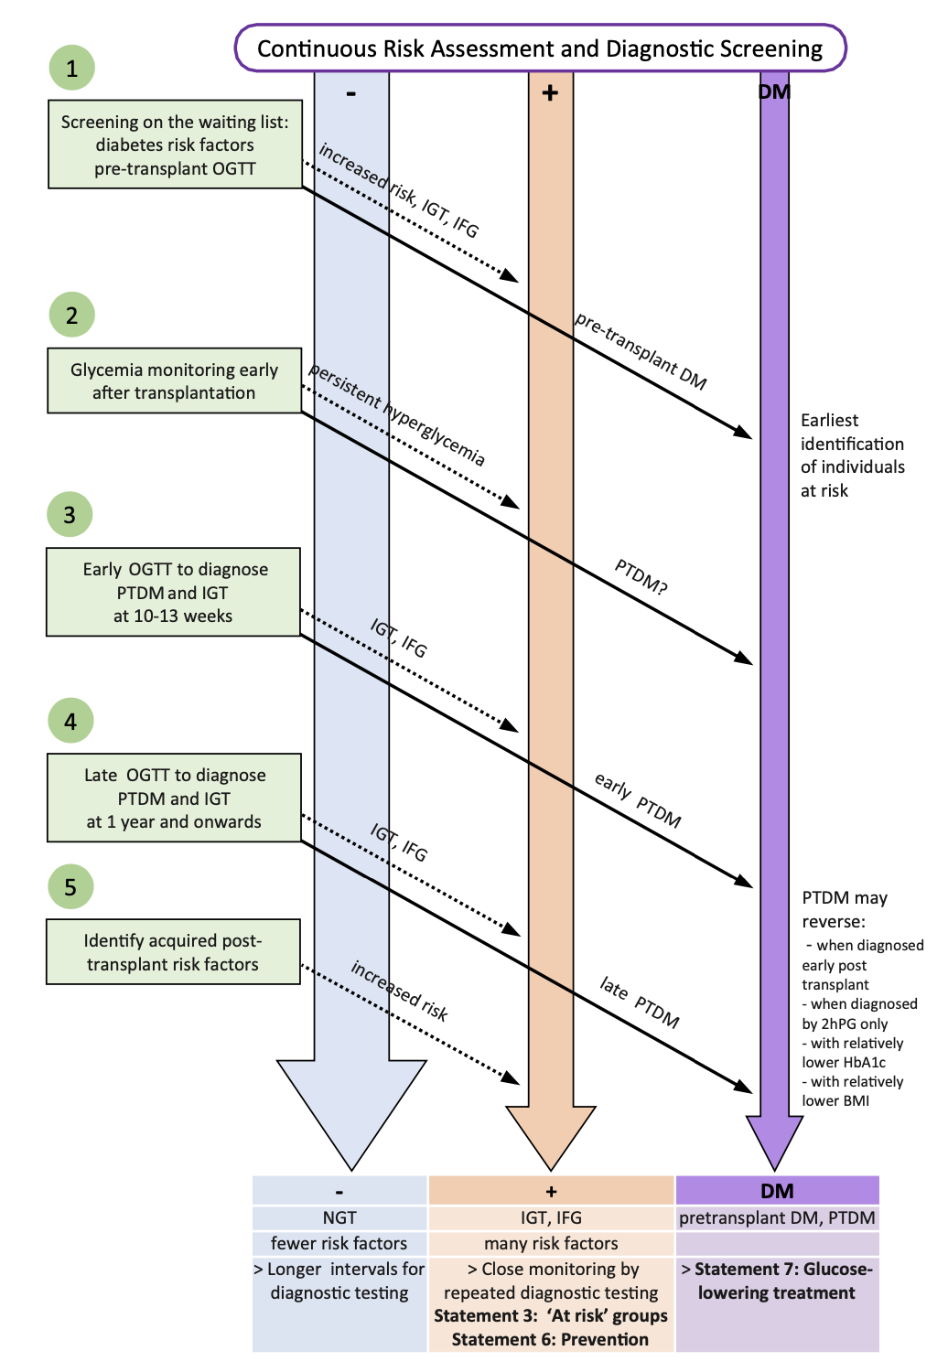
Normal
Prediabetes
Diabetes
Oral glucose tolerance test (OGTT) is essential for diagnosis and screening.
A1C lacks diagnostic sensitivity (susceptible to false readings with anemia)

Slide 21
Lifestyle Modifications
Dietary interventions
Mediterranean diet and increased vegetable intake recommended
Physical Activity
Exercise programs can reduce PTDM incidence and improve overall health
Behavioral Factors
Emphasis on patient motivation and adherence to lifestyle changes
Notes:
Crucial to identify high-risk patients for PTDM early

Slide 22
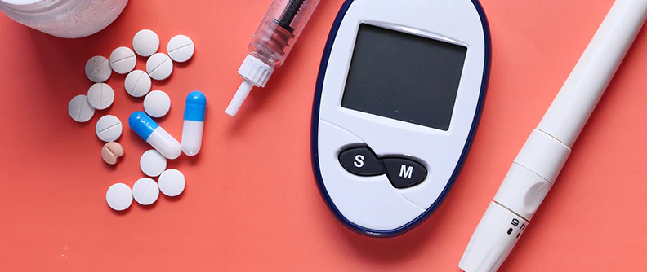
Pharmacological Management

Slide 23
Pharmacological Management
Basal/bolus

Slide 24
Johns Hopkins Diabetes Prevention & Education Program
https://www.hopkinsmedicine.org/population-health/dpep

Slide 25
Diabetes Prevention & Education Program
DPP
DSMT
Diabetes Prevention Program
CDC recognized
Standard of care for all patients with prediabetes
Diabetes Self-Management Training Clinical Service
American Diabetes Association accreditation
Standard of care for all patients with diabetes

Slide 26
Background
DPP and DSMT
Established and offered by Johns Hopkins Medicine
Actively expanded from 2021 to 2024
2021-2024 Expansion:
Supported by State of Maryland funding
Collaborative partnership with University of Maryland Medical System
Goal: Significantly broaden service availability across the state

Slide 27
Diabetes Prevention Program
Diabetes Prevention Program
ADA Standard of Care for all patients with prediabetes

Slide 28
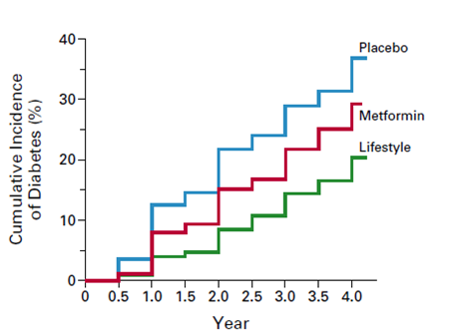
Diabetes Prevention Program Randomized Trial N=3,234 persons at risk for diabetes
Goals of Intensive Lifestyle Intervention
7% weight loss
150 min/week moderate intensity exercise
Intervention approach
Trained interventionists
Weekly to monthly contacts
Goal-setting
Self-monitoring
Motivational interviewing
NEJM.2002;346(6):39-403.

Slide 29
DPP
Benefits
Lower diabetes risk
Weight loss
Improve healthy behaviors
Improve quality of life
Improve blood pressure
Improve sleep
Decreased healthcare costs

Slide 30
DPP
Program Elements
Prediabetes AND BMI ≥25 kg/m²
CDC-certified DPP coaches
CDC curriculum
Group
In-person or telemedicine
Nutrition
Physical activity
Self-monitoring
Calorie balance
Stress/triggers
Healthy habits
Diabete & CVD
Eligibility
Instructors
Format
Topics

Slide 31
DPP session overview 31 sessions over 12 months
1:1 check-in (5 min)
Group check-in (10 min)
Facilitated group session (40 min)
Action plan (10 min)
Discussion with coach
Weight, physical activity
Progress
Group feedback
Consolidation
Session content
Group discussion
Group discussion
Homework
SMART goals
Consolidation

Slide 32
Brancati Center DPP participants 12 months
Retention: 157/221 (71%)
Session Attendance: 92%
Average Weight Loss: 5.2%

Slide 33
DPP participant testimonials
“The Diabetes Prevention Program was very helpful to me. I learned new strategies for healthy long term behavioral changes. I have struggled with my weight for most of my life. I found the weekly meetings very important. The coursework was structured; there was a warm comradery from both the participants and the coaches. The coaches created a year long non-judgmental place to work on changes in habits and returning to healthy practices. I progressed from 10 minute walks to joining the gym and swimming again. The bad cholesterol dropped, and the good cholesterol increased. Most importantly, my A1C is normal again without medication!”
“I would like to talk about how the DPP has changed my life. I was hesitant about joining but I am so glad that I did. First off, this program opened my eyes about so many things like portion control, calories, fat intake, servings as well as eating healthy overall. I can truly say that I have made a lifestyle change forever and this was the best decision I could have ever made!! I have lost over 40 pounds and counting. Thank you for allowing me to be a part of such a wonderful program.”

Slide 34
Diabetes Self-Management Training
Diabetes Prevention and Education Program (DPEP) | Johns Hopkins Medicine

Slide 35
Diabetes Self-Management Training
Diabetes Self-Management Training
ADA Standard of care for all patients with diabetes

Slide 36
DSMT
Program Elements
Diabetes
Certified Diabetes Care and Education Specialists
Individual
Group
In-person
Telemedicine
Nutrition
Physical activity
Diabetes general info
Medications
Glucose monitoring
Healthy coping skills
Prevention diabetes complications
Eligibility
Instructors
Format
Topics

Slide 37
DSMT
Expanded Offerings in Johns Hopkins Medicine

Slide 38
DSMT
Evidence and Benefits
Improve hemoglobin A1C
Improve BP and cholesterol
Improve medication adherence
Decrease diabetes complications
Decreased all-cause mortality
Increased healthier lifestyle behaviors
Improved self-efficacy
Decreased healthcare costs

Slide 39
DSMT
Current Utilization Rate (Nationally)
5%
Percentage of Medicare Beneficiaries with diabetes
who receive DSMT

Slide 40
DSMT
Current Utilization Rate (Nationally)
6.8%
Percentage of commercially insured patients with diabetes who receive DSMT

Slide 41
Diabetes Medications
Role and Scope of the Certified Diabetes Care and Education Specialist
Teach administration method, injection technique
Explore medication access issues
Inquire about side effects
Discuss medication adherence
Adjust medications (e.g. basal insulin) when co-managed by provider in the practice

Slide 42
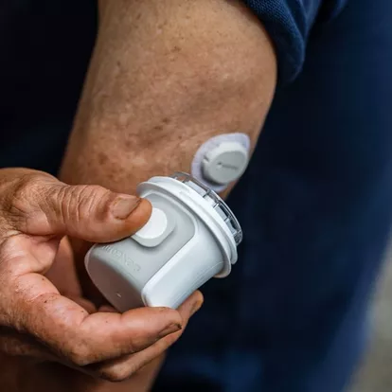
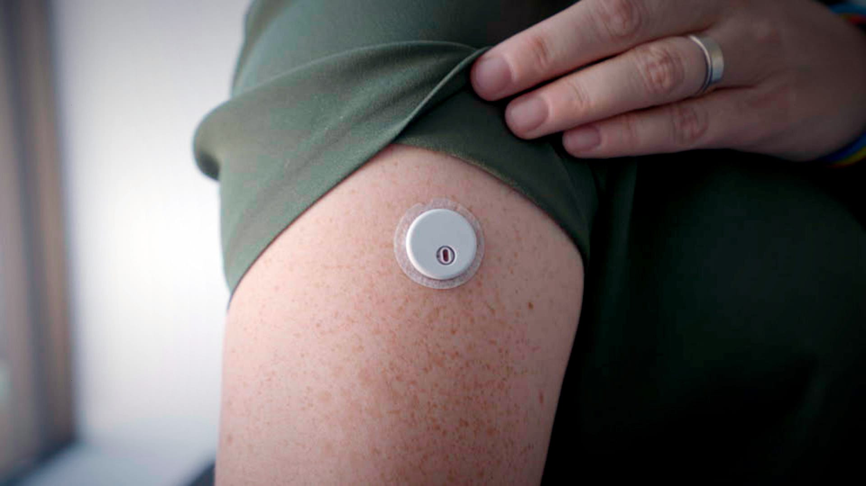
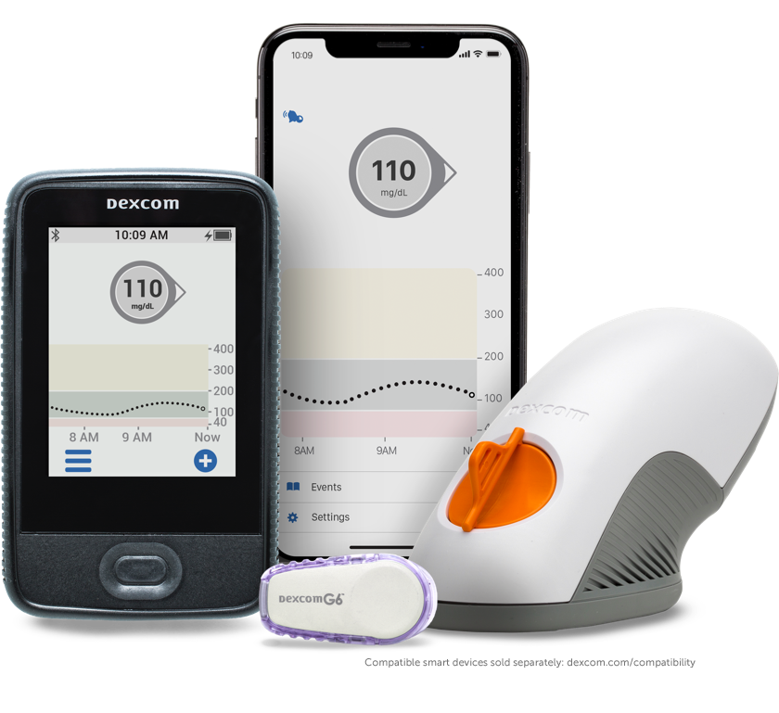
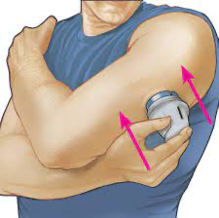
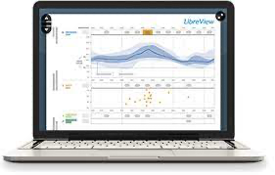
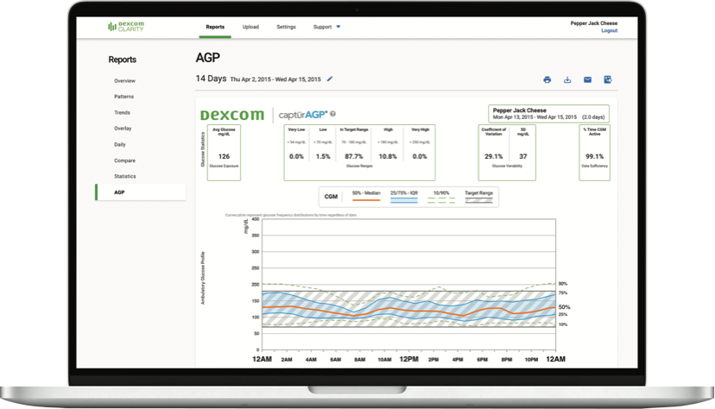
Diabetes Technologies
Continuous Glucose Monitors
Freestyle Libre 3 CGM
Dexcom G7 CGM
LibreView
Clarity

Slide 43
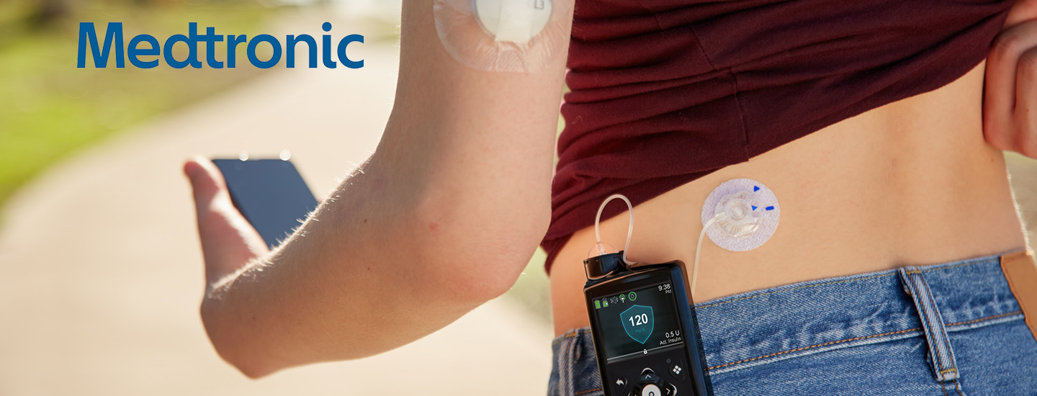
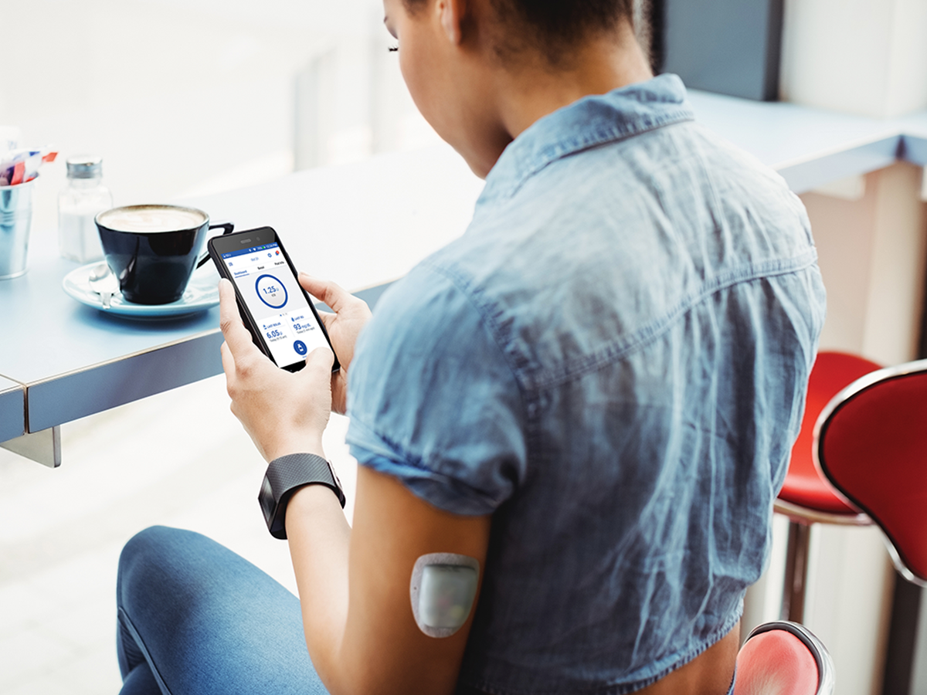
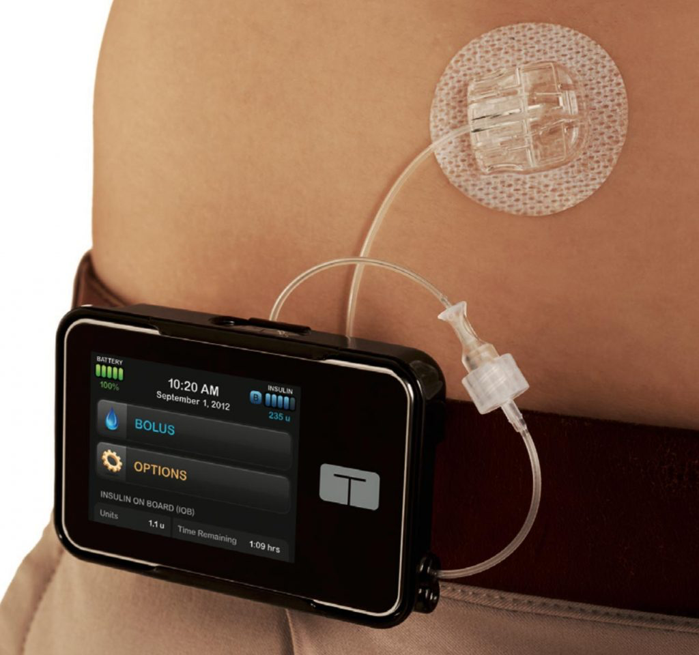
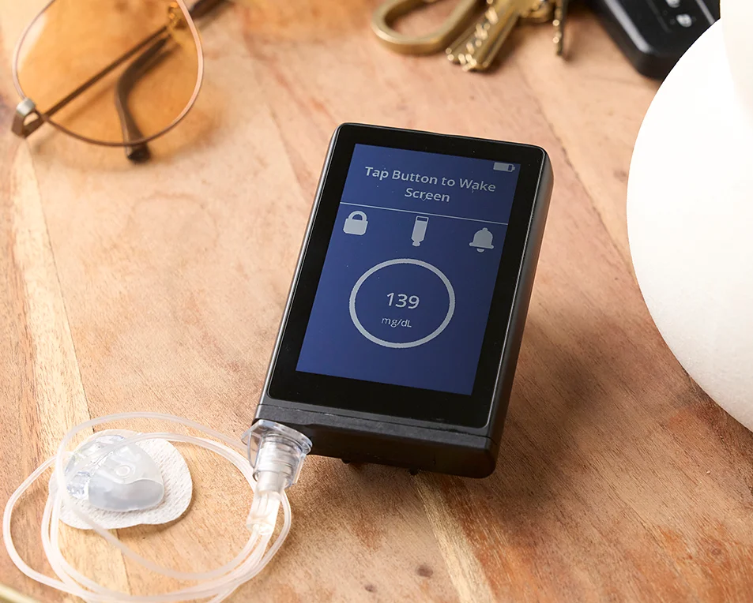
Diabetes Technologies
Insulin Pumps

Slide 44
DSMT: Total Encounters
52% of patients had more than one encounter
~50% of encounters are virtual
22,978

Slide 45
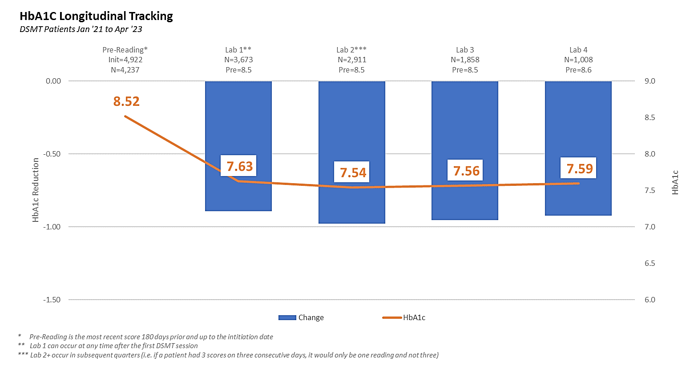
DSMT: Clinical Outcome
~1% A1C reduction across all sites
Notes:
Participation in DSMT has been shown to:
Improve hemoglobin A1c levels
Improve control of blood pressure and cholesterol levels
Improve medication adherence
Decrease severe diabetes-related complications
Increase healthier lifestyle behaviors, such as better nutrition, increased physical activity, and use of primary care and preventive services
Enhance self-efficacy
Decrease health care costs, including fewer hospital admissions and readmissions

Slide 46
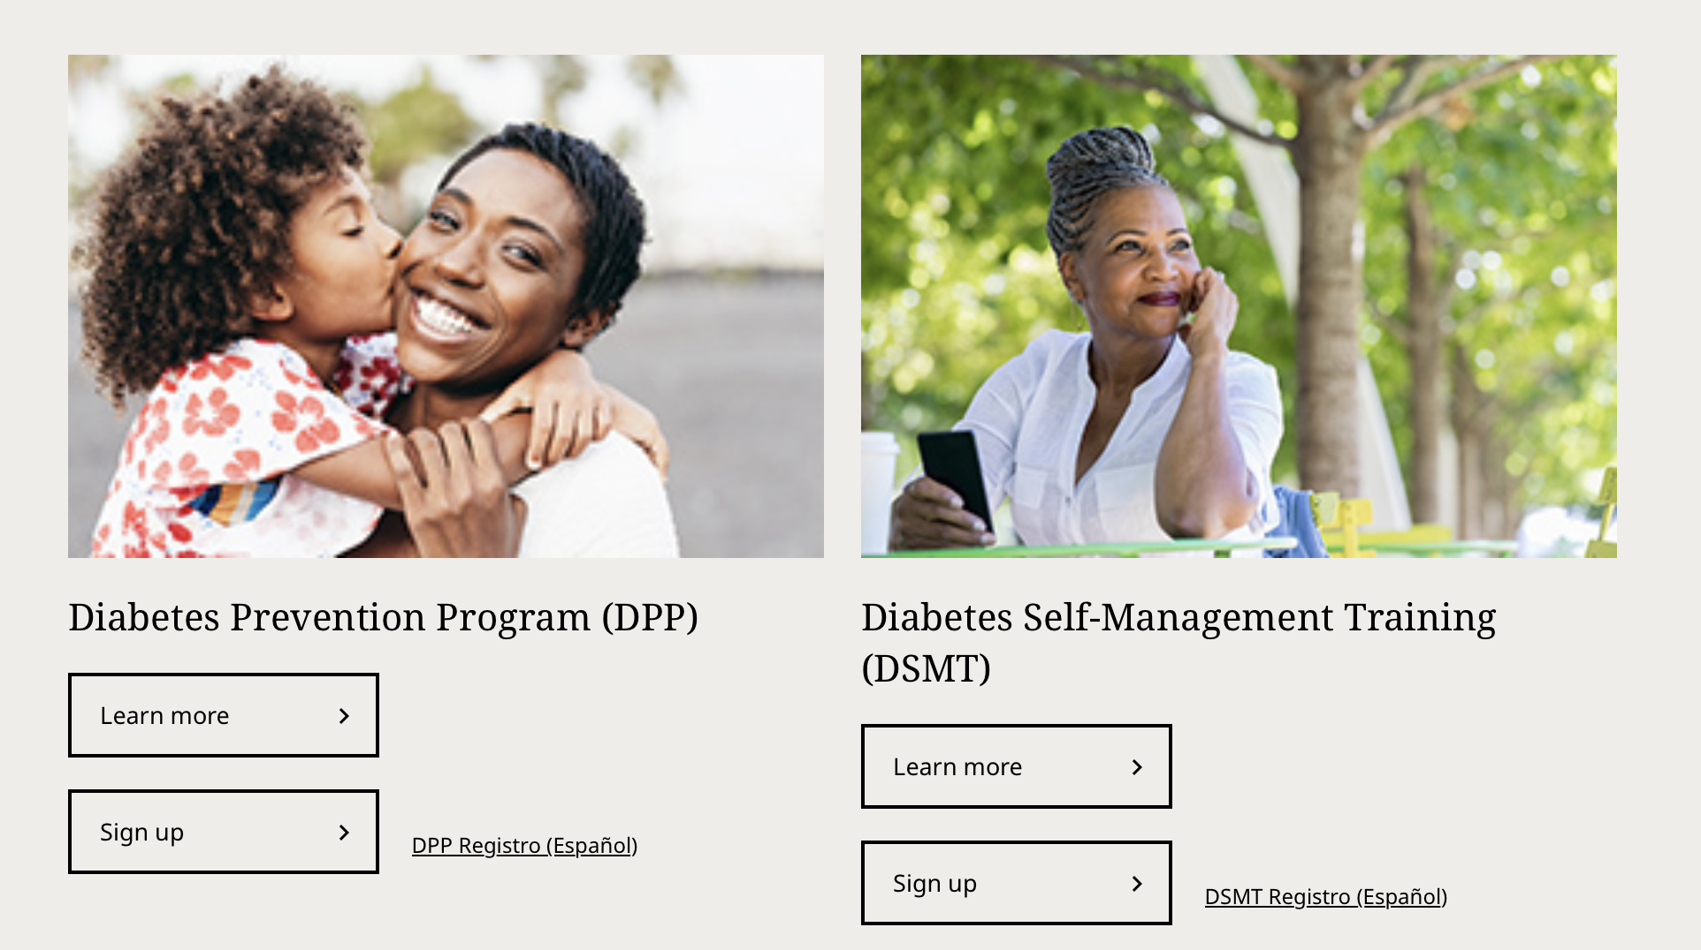

Slide 47
Thank you!

