Slide 1
Caregivers, our overlooked patients

Slide 2
Definition of a caregiver
Caregivers provide assistance to a family member or friend with tasks of daily living and/or emotional support.
play a critical role in our healthcare system. According to a recent AARP survey (2020) - there are 50 million unpaid caregivers in our country.
make a significant difference in the quality of someone’s life.
allows many people to remain in their homes in the community.

Slide 3
There are only four kinds of people in this world: Those who have been caregivers, those who are currently caregivers, those who will be caregivers and those who will need caregivers. Caregiving is universal. -Rosalyn Carter, former First Lady of the U.S.

Slide 4
Caregiving is a public health issue
Caregivers often go unrecognized and are under appreciated despite benefits to economy.
The COVID 19 Pandemic heightened the need for caregiving.
Ability to maintain employment may be impacted.
Family Medical Leave Act – often unpaid.
Not enough awareness about available programs and resources to assist caregivers.

Slide 5
Critical role of caregivers during transplant process
A care plan is required in order to be approved for a transplant.
Caregivers are often already providing support prior to the transplant (going to appointments, picking up more responsibilities).
After transplant provide help with managing multiple medications, meals, housekeeping and general support (child care, pet sitting, other caregiving responsibilities).
Providing transportation to follow up appointments and labs.
Advocacy and communication with the transplant team.

Slide 6
Normal responses to caregiving
Feeling overwhelmed
Fear, anxiety, restlessness
Anger and frustration (why is this happening to my loved one? To me?)
Guilt (I’m healthy but my loved one is ill).
Resentful (this wasn’t how I envisioned my life).
Feeling a sense of loss or grief (for my old life).

Slide 7
Caregiver stress or burnout
A condition that strongly manifests exhaustion, anger, rage or guilt resulting from unrelieved caring for a chronically ill patient.
- Wikipedia

Slide 8
“it becomes the absence of emotion – a feeling of being beaten down by circumstances so thoroughly, or so often, that you aren’t able to get back up”. -Laurel Wittman, President of Well Spouse Assiocation

Slide 9
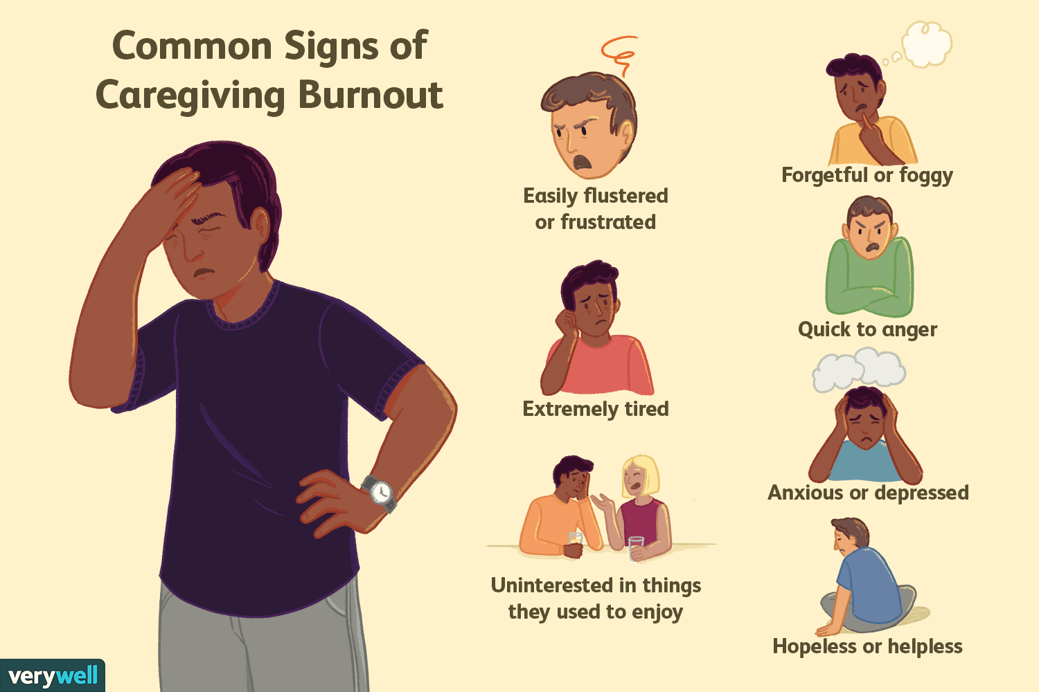
Signs of caregiver stress

Slide 10
Suggestions for coping
Ask for help - talk to the social worker at the transplant center or hospital, pastor or rabbi, physician, relative or friend.
Seek support through established programs: National Family Caregiver Support Program.
Join a support group
Inquire about employer programs (FMLA,
work accommodations, flexible schedule, etc.)
Allow yourself to feel emotions, even the negative ones.

Slide 11
More tips for coping
Consider talking to a counselor or therapist.
Look into outside help to assist with caregiving such as hiring help (if you have the resources).
Be able to say ‘no’.
Allow others to help.
Appoint someone to provide updates or set up an online tool such as Lotsa Helping Hands.
Take time for yourself every day (go for a walk, exercise, talk to a friend, listen to music).

Slide 13
Resources for Caregivers
Called to Care, National Caregivers Association, Caregiver Action Network, Department on Aging
Offers information about grants, support groups, respite care, housing modification and repairs,
legal services, counseling, meals.
Caregiver compensation – contact your local Medicaid Office, Veterans Department. Some Long Term Care Insurance policies will pay caregivers.
Lotsa Helping Hands – online tool to assist caregivers and patients with coordinating care.
National Kidney Foundation, TRIO

Slide 14
Local Maryland Resources
The Maryland Family Caregiver Support Program (through MD Department of Aging)
Must meet specific eligibility criteria to qualify
Available services:
Legal and/or financial guidance
Home modifications or repairs
Transportation services
Personal Care
Nutritional services
Assistive Equipment and/or supplies
Grants (respite care or reimbursement for expenses)

Slide 15
‘Called to Care’ through Johns Hopkins Bayview Hospital
Program that supports the needs of caregivers through support groups and events, legal consultation, referral to resources, education, meals, counseling, benefits check.

Slide 16
Resource Guide
TRIO: Trioweb.org
National Kidney Foundation: kidney.org, 800-622-9010
The National Family Caregiver Support Program: Maryland Department of Aging –aging.maryland.gov, 410-767-1100
Called to Care: 410-550-1660
Gift of Life Howie’s House: Caregiver of Lifeline Program: giftoflifehowieshouse.org, 267-546-9800
Lotsa Helping Hands: lotsahelpinghands.com, contactus@lotsahelpinghands.com
Caregiver Action Network: caregiveraction.org, 855-227-3640
Meals on Wheels: mealsonwheelsamerica.org, 1-888-998-6325
211 – www.211.org

