Slide 1
Understanding Medications and Insurance Options for Transplant
Ian A. Booth, PharmD
Solid Organ Transplant Pharmacist
University of Maryland Medical Center

Slide 2
Describe the common medications to prevent rejection and infection after transplant
Explain the basics of health insurance and coverage
Compare and contrast different insurance options available to patients

Slide 3
Describe the common medications to prevent rejection and infection after transplant
Explain the basics of health insurance and coverage
Compare and contrast different insurance options available to patients

Slide 4
Types of Immunosuppressants
Class of Medication | Generic Names
Calcineurin Inhibitors | Tacrolimus
 | Cyclosporine
Anti-Proliferatives | Mycophenolate
 | Azathioprine
Steroids | Prednisone
mTOR Inhibitors | Sirolimus
 | Everolimus
Co-Stimulation Blocker | Belatacept
Notes:
Now before we go any further I will say that terms like calcineurin inhibitor or antiproliferative might seem confusing to you and that’s okay. We just use these names to group similar medications together based on how they work on the immune system. For our purposes today I want you to focus on the names of the medication and think about the medicines that you are on or that your loved one is on instead of the name of the class of medication.

Slide 5
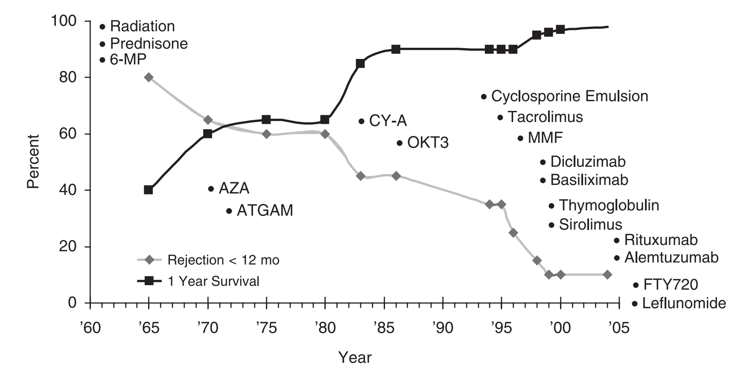
The Effect of Immunosuppression
Prednisone
Azathioprine
Tacrolimus
Mycophenolate
Sirolimus
Tacrolimus XL
Everolimus
Cyclosporine
Notes:
Looking at this graph you can see going up and down on the left hand side we have percentages. And then going across the bottom we have years spanning from the 1960s until around 2005. then we see two lines that seem to cross. Now the black line is the percentage of patients that survived 1 year after their transplant. Thinking about that we want all our patients to survive so the fact that this line is increasing over time is a good thing. Looking at the grey line that shows the percentage of rejection in the first year. Knowing that we want as little rejection as possible we see that we are also doing better at keeping that line down as time has gone on. Now what I as the pharmacist on the team think is really cool is that each time you see big changes in theses lines it centers right around the time a new medication was developed. So here in the 1970s, again in the 1980s you see another big change and finally again in the early 2000s we get even better. Likely in large part to the new medications that were developed.

Slide 6
Considerations for Immunosuppression
More Immunosuppression
- ABO incompatible
Less Immunosuppression
- Infection history
- Donor specific antibodies
- Younger age
- African American
- HIV
- History of organ transplant/rejection
- History of malignancy
- Older age

Slide 7
All Organs Are Not Created Equal
Lung
Heart
Pancreas
Liver
Small Bowel
Kidney
More Rejection = Greater Immunosuppression Needs
Less Rejection = Lower Immunosuppression Needs

Slide 8
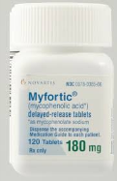
Balance of Immunosuppression
Rejection
Graft Loss
Side Effects
Infection
Malignancy

Slide 9
Infection Prevention
Weakened immune system
More likely to get infections
Fewer signs and symptoms of infection
Longer time to heal and recover
Anti-infective medications used after transplant when infection risk is highest
Rejection Risk
Infection Risk

Slide 10
Types of Infections
Bacteria
Viruses
Fungus

Slide 11
Bacteria Prevention
Sulfamethoxazole/trimethoprim (Bactrim)
Helps prevent pneumonia and urinary tract infections
Duration: depends on organ type/transplant center protocol
Side effects:
Rash
Hematologic effects (Low white blood cells/platelets)
High potassium
Alternatives in case of allergy/intolerance:
Dapsone
Atovaquone (Mepron)
Inhaled pentamidine

Slide 12
Virus Prevention
Valganciclovir (Valcyte)
Helps prevent cytomegalovirus (CMV)
Duration: depends on CMV risk status and organ type
Side effects:
Hematologic effects (Low white blood cells/platelets)
Alternatives in case of intolerance:
Valacyclovir (Valtrex)
Acyclovir (Zovirax)
Letermovir (Prevymis)

Slide 13
Fungal Prevention
Common medications used:
Nystatin suspension
Do not eat or drink for 30 minutes after taking
Clotrimazole lozenge
Fluconazole (Diflucan)
Voriconazole (Vfend), posaconazole (Noxafil, Posanol), isavuconazole (Cresemba)
Side effects: blurred vision, hallucinations, increased liver enzymes
Helps prevent thrush and other fungal infections
Medication used/duration: depends on organ type/transplant center protocol

Slide 14
Describe the common medications to prevent rejection and infection after transplant
Explain the basics of health insurance and coverage
Compare and contrast different insurance options available to patients

Slide 15
Describe the common medications to prevent rejection and infection after transplant
Explain the basics of health insurance and coverage
Compare and contrast different insurance options available to patients

Slide 16
Insurance Terminology
Notes:
More discussion on this later on

Slide 17
Insurance Terminology
Primary Insurance: pays first for medical bills
Secondary Insurance: pays after primary insurance
Explanations of Benefits (EOB): summary of prescriptions drug claims and costs
Out-of-pocket costs: expenses for medical care that aren’t paid by insurance
Examples on next slide

Slide 18
Insurance Terminology
Premium: monthly amount paid for coverage
Deductible: yearly amount paid for covered services before plan begins paying
Copayment: fixed amount paid after the deductible is met
Coinsurance: percentage (%) of cost paid

Slide 19
Insurance Terminology
Coverage Gap: period of time where costs are higher, until enough is spent to qualify for catastrophic coverage
Also called “Donut Hole”
Catastrophic Coverage: automatically occurs once a set out-of-pocket amount is reached
No longer responsible for copayment or coinsurance for the rest of the year
Notes:
More discussion on this later on

Slide 20
Insurance Terminology
Claim: A request to your insurance company to pay for a health care service you received
Denial: An insurance company's decision to withhold a claim payment
Formulary: A list of drugs an insurer will pay for
Pre-Authorization, Pre-Approval, or Prior Approval: A process where your health plan must approve coverage for the service requested

Slide 21
Describe the common medications to prevent rejection and infection after transplant
Explain the basics of health insurance and coverage
Compare and contrast different insurance options available to patients

Slide 22
Describe the common medications to prevent rejection and infection after transplant
Explain the basics of health insurance and coverage
Compare and contrast different insurance options available to patients

Slide 23
Insurance Types
COBRA
Retiree
Federal Employee
TRICARE
Veterans Affairs
Medicaid
Medicare
Private
Notes:
Make this into a graphic with different circles, then just explain each one? Then just highlight Medicare, Medicaid, Private
-Job-based/Private: offered by an employer or union for current employees
-COBRA: a federal law that lets you keep your group health plan when your job ends or your hours are cut
-Retiree: provided to former employees who have retired
-Federal Employee Health Benefits (FEHB): current and former government employees
-TRICARE: provided by the federal government to active duty and retired military personnel
-Veterans Affairs (VA) Benefits: provided by the federal government to veterans

Slide 24
Medicare
Federal health insurance
For people 65 or older
Some people under 65 with certain disabilities or conditions (ESRD requiring HD or transplant, or ALS)
Run by the Centers for Medicare & Medicaid Services (CMS)
Coverage is the same no matter what state you live in
Open enrollment Oct. 15th – Dec 7th each year
Changes go into effect January 1 of the following year

Slide 25
Four (4) Parts of Medicare
A
Hospital Insurance
B
Medical Insurance
C
Medicare Advantage Plans
D
Prescription Drug Coverage

Slide 26
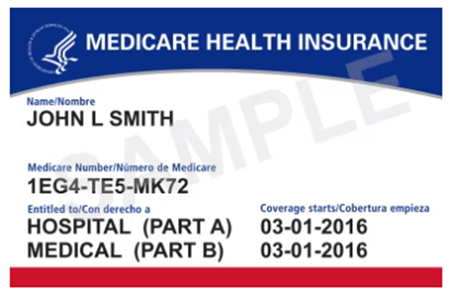
Medicare Card
Your card has a Medicare number that’s unique to you
The card shows:
You have Medicare Part A (listed as HOSPITAL), Part B (listed as MEDICAL), or both
The date your coverage begins
Notes:
Medicare number is not your Social Security Number (helps protect your identity)

Slide 27
Medicare Part A – Hospital
Coverage:
Inpatient hospital care
Skilled nursing facility care
Nursing home care
Hospice care
Home health care
Most people don’t pay a premium
Called “premium-free Part A”
Notes:
Add more here?

Slide 28
Medicare Part B – Medical
Helps cover the cost of other medical services:
Mental health services
Outpatient care
Other medical services that Part A doesn't cover
Certain prescription medications
Part B is optional
You’ll pay a premium every month, even if you don’t get any Part B-covered services
Premium will depend on income
Premium can change each year

Slide 29
Medicare Part C – Advantage Plans
Offered by approved private companies
Provide all of Part A (Hospital Insurance) and Part B (Medical Insurance) coverage
May offer extra coverage: vision, hearing, dental, and/or health and wellness programs
Most include prescription drug coverage (Part D)
Monthly premiums vary based on plan
Premium amount can change each year
Premium will depend on income
Notes:
- Like whether you need a referral to see a specialist or if you have to go to only doctors, facilities, or suppliers that belong to the plan for non‑emergency

Slide 30
Medicare Part D – Prescriptions
Optional and offered to everyone
Must have Medicare Part A (Hospital Insurance) and/or Medicare Part B (Medical Insurance) to join a drug plan
Monthly premiums vary based on plan
Premium will depend on income
Premium can change each year

Slide 31
Medicare Part D – Prescriptions
How to join a plan:
Medicare drug coverage
Complete a paper enrollment form
Call the plan
Call 1-800-MEDICARE (1-800-633-4227)
Before you make a decision, learn how prescription drug coverage works with your other drug coverage
The coverage you already have may change because of Medicare drug coverage

Slide 32
Medicare Part D – Prescriptions
A plan’s list of covered drugs is called a “formulary”
Each plan has its own formulary
Look at plans that include your prescription drugs on their formulary and compare costs
Plans place drugs into different “tiers" on their formularies
Drugs in each tier have a different cost
Tier 1: lowest copayment - most generic drugs
Tier 2: medium copayment: preferred - brand-name drugs
Tier 3: higher copayment: non-preferred - brand-name drugs
Specialty tier: highest copayment - very high cost drugs

Slide 33
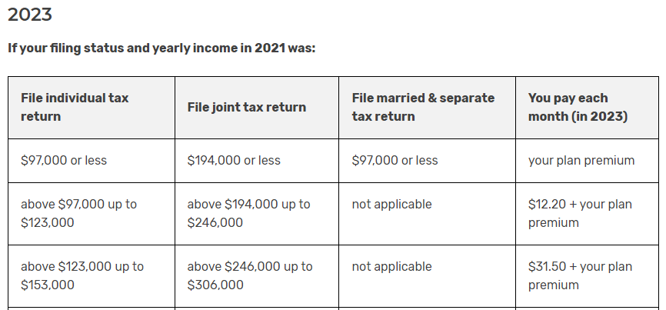
Medicare Part D – Costs
Premium: monthly amount paid for coverage
May have additional cost depending on income

Slide 34
Medicare Part D – Donut Hole
Notes:
-Although you'll pay no more than 25% of the price for the brand-name drug, almost the full price of the drug will count as out-of-pocket costs
-For generic drugs, only the amount you pay will count toward getting you out of the coverage gap

Slide 35
Medicare Part D – Prescriptions
Medicare drug plans have contracts with "network pharmacies"
Services and supplies at a discounted price
In some plans, prescriptions are only covered if you get them filled at network pharmacies
Plan might include a mail-order program, or an option for retail pharmacies to supply a 2- or 3-month supply
Notes:
Make sure pharmacy can bill Medicare part B correctly for IS medications.

Slide 36
Medicare Part D – Prescriptions
Ways to lower prescription drug costs:
Compare Medicare drug coverage
Check if company offers help paying for it
Extra Help Program: Helps people with limited income pay Medicare Part D costs
You'll get Extra Help automatically if you get:
Full Medicaid coverage
Help from your state paying your Part B premiums (from a Medicare Savings Program)
Supplemental Security Income (SSI) benefits from Social Security

Slide 37
Medicaid
Federal/state program to help cover costs for people with limited income/resources
Federal government has general rules that all state Medicaid programs must follow
Each state runs its own program
Eligibility requirements and benefits vary from state to state
Typically no costs for covered medical expenses
May owe a small co-payment for some items or services
Notes:
Offers benefits that Medicare doesn’t normally cover, like nursing home care and personal care services

Slide 38
Medicaid
Eligible patients: all with limited income/resources
Pregnant women
Children and Teenagers ≤ 18 years old
≥ 65 years old, blind or disabled
How to apply:
Directly with your state
Through the Health Insurance Marketplace®
Visit HealthCare.gov to create a Marketplace account and complete an application
Call the Marketplace Call Center at 1-800-318-2596
Notes:
Offers benefits that Medicare doesn’t normally cover, like nursing home care and personal care services

Slide 39
Maryland Medicaid
Open enrollment Nov. 1st – Jan. 15th
Certain life events qualify you to enroll outside of this time
Renewal is NOT automatic
Renewals will take place over 12 months
What you need to do:
Make sure contact information is updated
Renew your coverage or enroll in a private plan/Medicare within 45 days from receiving notification
Notes:
-Life events: getting married, having a child, moving to Maryland, etc
-Private plans: CareFirst, Kaiser Permanente and UnitedHealthcare, etc

Slide 40
Medicaid Special Programs
Each State Medicaid program has a special program for patients with end-stage renal disease
Maryland: Kidney disease program
Delaware: Chronic disease program
Pennsylvania: Chronic renal disease
These plans help supplement primary insurance
Anyone can apply for these programs

Slide 41
Private Insurance
Often provided by employers or other organizations
Group or individual basis
Many different options available
Examples: BlueCross BlueShield, Aetna, Cigna, United Healthcare, etc
All options will vary by cost and services available

Slide 42
Patient Assistance
Patient Assistance Programs (PAPs)
Provides low-cost/free product to low-income patients to augment prescription drug coverage
Check with manufacturer/transplant team for availability
Copay Cards
Help lower out-of-pocket prescription drug cost
Typically for expensive, brand-name medications
GoodRx is a great resource to check if available
Medicare patients are not eligible
Notes:
Both sponsored by drug manufacturers

Slide 43
Key Points
Medications after transplant are extremely important → adhere to all team recommendations for best outcomes
Many different insurance options available → need to find out what plan works best for YOU
Contact your transplant team/local pharmacist for any questions
Notes:
Both sponsored by drug manufacturers

Slide 44
References
https://www.hhs.gov/
https://www.medicare.gov/basics/costs/help/drug-costs
https://www.cms.gov/
https://www.medicareinteractive.org/
https://www.medicaid.gov/
https://health.maryland.gov/mmcp/pages/home.aspx
https://www.marylandhealthconnection.gov/
https://www.singlecare.com/blog/medicare-donut-hole/
https://secure.ssa.gov/i1020/start
https://www.goodrx.com

Slide 46
Understanding Medications and Insurance Options for Transplant
Ian A. Booth, PharmD
Solid Organ Transplant Pharmacist
University of Maryland Medical Center

Slide 47
References
VectorStock. Stop bacterium sign with cute cartoon germs in flat vector image. Published 2019. Accessed April 9, 2019. https://www.vectorstock.com/royalty-free-vector/stop-bacterium-sign-with-cute-cartoon-gems-in-flat-vector-10554156.
Open Clipart. Bacteria. https://openclipart.org/detail/284321/bacteria. Published 2017. Accessed April 5, 2019.
UnixTitan. Virus Clipart #9. https://unixtitan.net/explore/virus-clipart-black-and-white/#gal_post_3303_virus-clipart-black-and-white-9.png. Published 2018. Accessed April 5, 2019.
UnixTitan. Virus Clipart #1. https://unixtitan.net/explore/virus-clipart-black-and-white/#gal_post_267_virus-clipart-black-and-white.png. Published 2018. Accessed April 5, 2019.
UnixTitan. Virus Clipart #2. https://unixtitan.net/explore/virus-clipart-black-and-white/#gal_post_267_virus-clipart-black-and-white-2.png. Published 2018. Accessed April 5, 2019.
UHN Research. http://pie.uhnresearch.ca/~michaelcorrin/TMITT.
MyMedSchedule Plus. Phone. https://secure.medactionplan.com/mymedschedule/images/phone-today.png. Published 2018. Accessed April 5, 2019.
Masters, M. Prevention. The best alarm clocks for heavy sleepers. https://www.prevention.com/health/a20485882/loudest-alarm-clocks-for-heavy-sleepers. Published November 4, 2018. Accessed April 5, 2019.

Slide 48
Calcineurin Inhibitors
Most common post-transplant immunosuppressant
Increased survival and decreased rejection
 | Tacrolimus |  | Cyclosporine
Brands | Prograf | Astagraf/ Envarsus XR | Neoral/ Gengraf | Sandimmune
How it works | Prevents the activation of various immune cells
Dosing | Twice Daily | Once Daily | Twice Daily
Monitoring | 12-hour trough | 24-hour trough | 12-hour trough
Special Considerations | NOT INTERCHANGEABLE |  | NOT INTERCHANGEABLE
 | Do NOT crush, cut, chew or open capsule
Notes:
So our first two medications we’ll talk about are Tacrolimus and cyclosporine. These are the most common post-transplant medications used and most combinations will include one of these. The reason most combinations include on these medications is because when cyclosporine first came out in the 1980s we saw the biggest jump in improvement of transplant success.

Slide 49
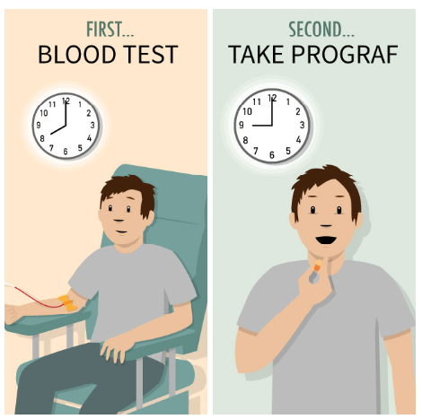
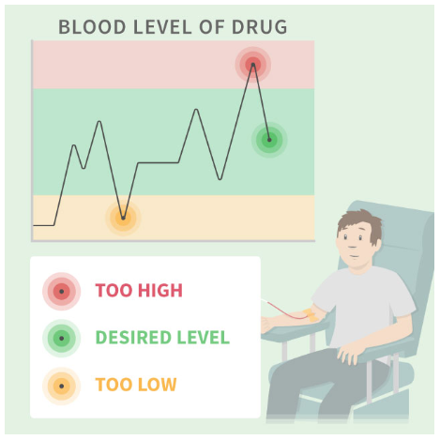
Why do I have to hold calcineurin inhibitors prior to getting labs?
Levels should be drawn before the morning dose

Slide 50
Calcineurin Inhibitor Monitoring
Goal level is dependent on:
Time since transplant
Type of transplant
Transplant center protocols
Other medical conditions
Higher concentrations during the 1st year
following transplant then lowered depending on
rejection episodes, side effects, and infections

Slide 51
Side-Effects of Tacrolimus and Cyclosporine
Both Medications
Kidney damage ↓ Magnesium ↑ Potassium
Close monitoring of
lab work
Minimizing high levels
Notes:
In terms of specific differences between the two tacrolimus can lead to diabetes and cyclosporine can cause an increase in your cholesterol and blood pressure. One opposite side-effect is tacrolimus can cause some hair loss while cyclosporine can cause hair gain. So how do help prevent these side-effects. Well for diabetes or high blood sugar, high cholesterol and blood pressure we optimize and use medications to prevent or treat those things. And in terms of tremor hair loss or growth or growth of gum tissue we look out for these side-effects and can possibly switch from tacrolimus to cyclosporine or vice-versa if needed. Overall we do a lot of monitoring and we keep a very close eye out for these different side effects.

Slide 52
Side-Effects of Tacrolimus and Cyclosporine
Both Medications
Kidney damage ↓ Magnesium ↑ Potassium
Tacrolimus | Cyclosporine
↑ Blood sugar Hair loss Tremors | ↑ Cholesterol ↑ Blood pressure Hair growth Gum swelling
Close monitoring of
lab work
Minimizing high levels
Optimizing other medications
Switching to the other agent
Notes:
In terms of specific differences between the two tacrolimus can lead to diabetes and cyclosporine can cause an increase in your cholesterol and blood pressure. One opposite side-effect is tacrolimus can cause some hair loss while cyclosporine can cause hair gain. So how do help prevent these side-effects. Well for diabetes or high blood sugar, high cholesterol and blood pressure we optimize and use medications to prevent or treat those things. And in terms of tremor hair loss or growth or growth of gum tissue we look out for these side-effects and can possibly switch from tacrolimus to cyclosporine or vice-versa if needed. Overall we do a lot of monitoring and we keep a very close eye out for these different side effects.

Slide 53
Calcineurin Inhibitor Drug Interactions
There are a LOT!!
Always contact your transplant team/coordinator or local pharmacist before starting any new medication!!

Slide 54
A few to be aware of
Paxlovid (nirmatrelvir & ritonavir)
Use: treats certain viruses, most recently COVID-19
Effect: significant increase in tacrolimus/cyclosporine levels
St. Johns Wart
NSAIDs
Common agents: aspirin, ibuprofen, naproxen, Advil®, Aleve®
Effect: increased risk of kidney damage with tacrolimus/cyclosporine
Effect: decrease in tacrolimus/cyclosporine levels
Use: can help treat depression
Grapefruit Juice
Effect: increase in tacrolimus/cyclosporine levels
AVOID
Baby aspirin okay

Slide 55
Anti-proliferatives
Second most common post-transplant immunosuppressant
 | Mycophenolate |  | Azathioprine
Brands | Cellcept | Myfortic | Imuran
How it works | Prevents the replication of immune cells
Dosing | Twice Daily | Twice Daily (slow release) | Once Daily
Monitoring | Not needed for these medications
Special Considerations | NOT INTERCHANGEABLE Contraindicated in pregnant women |  | NOT INTERCHANGEABLE
 | Do NOT crush, cut or chew |  | CAN cut or crush

Slide 56
For women who may become pregnant
Mycophenolate increases the risk of birth defects and pregnancy loss in the first trimester
Prevention and planning are key!
If you become pregnant or are thinking of becoming pregnant, let your transplant team/coordinator know immediately!

Slide 57
Side-Effects of Anti-proliferatives
Both Medications
Low White Blood Cells Low Platelets
dose

Slide 58
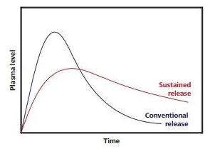
Side-Effects of Anti-proliferatives
Both Medications
Low White Blood Cells Low Platelets
Mycophenolate | Azathioprine
Diarrhea Nausea & Vomiting | Hair loss Upset stomach
dose
Change to slow release tablets (Myfortic)
Take smaller doses more frequently
- Ex: 360 mg 2x/day → 180 mg 4x/day
Decrease dose
Change to azathioprine
Notes:
Azathiaprine can cause some hair loss and also some upset stomach which can sometimes be helped by taking it with food. But overall aside from the upset stomach these two medications are generally well tolerated

Slide 59
Side-Effects of Anti-proliferatives
Both Medications
Low White Blood Cells Low Platelets
Mycophenolate | Azathioprine
Diarrhea Nausea & Vomiting | Hair loss Upset stomach
dose
Take with food
Decrease dose
Change to slow release tablets (Myfortic)
Take smaller doses more frequently
- Ex: 360 mg 2x/day → 180 mg 4x/day
Decrease dose
Change to azathioprine
Notes:
Azathiaprine can cause some hair loss and also some upset stomach which can sometimes be helped by taking it with food. But overall aside from the upset stomach these two medications are generally well tolerated

Slide 60
Steroids
The first used immunosuppressant in organ transplant
A part of most immunosuppression regimens
Prednisone, Prednisolone, Methylprednisolone
How they work | Affects almost every part of the immune system
Dosing | Once Daily High doses post-surgery and then decreased over time
Monitoring | Not needed for these medications
Special Considerations | CAN crush or cut tablets Taking with food can help prevent stomach upset

Slide 61
Side-Effects of Steroids
Notes:
Over time as you are on steroids they can cause your cholesterol to increase, they can decrease your bone growth and cause some weight gain. To prevent these we add medications to lower your cholesterol, help your bones grow and stay strong by adding calcium and vitamin D, and reduce the dose the further out from transplant you are.

Slide 62
Side-Effects of Steroids
Short-term
↑ Blood pressure ↑ Blood sugar Trouble sleeping Confusion Face swelling Stomach ulcer
Long-term
↑ Cholesterol Growth suppression ↓ Bone growth Weight gain
Remove excess fluid
Insulin therapy
Optimize other medications
Reduce dose if able
Acid reducing medications
Cholesterol lowering medications
Vitamin D + Calcium
Reduce dose or stop medication
Notes:
Over time as you are on steroids they can cause your cholesterol to increase, they can decrease your bone growth and cause some weight gain. To prevent these we add medications to lower your cholesterol, help your bones grow and stay strong by adding calcium and vitamin D, and reduce the dose the further out from transplant you are.

Slide 63
mTOR Inhibitors
Primarily used to decrease the kidney effects of calcineurin inhibitors
 | Sirolimus | Everolimus
Brands | Rapamune | Zortress
How it works | Prevents the replication of the immune cells
Dosing | Once Daily | Twice Daily
Monitoring | 24-hour trough | 12-hour trough
Special Considerations | Do NOT crush, cut or chew May reduce the risk of certain cancers
Notes:
Simlar to tacrolimus and cyclosporine these medications can not be crushed cut or chewed.

Slide 64
mTOR Inhibitor Monitoring
Goal level is dependent on:
Time since transplant
Type of transplant
Transplant center protocols
Other immunosuppression medications being used
Other medical conditions

Slide 65
mTOR Inhibitor Drug Interactions
There are a LOT!!
Always contact your transplant team/coordinator or local pharmacist before starting any new medication!!

Slide 66
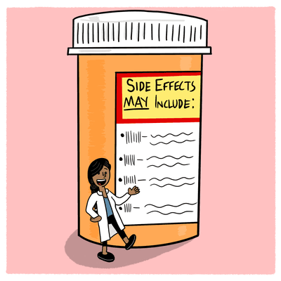
Side-Effects of mTOR Inhibitors
Both Medications
↑ Cholesterol Impaired wound healing Mouth sores Acne Swelling/Edema ↑ Protein in the urine ↓ White Blood Cells/Platelets
Cholesterol lowering medications
Decrease dose
Decrease goal level
Limit use in certain patients
Switch to alternate medication
Notes:
In addition to those precautions sirolimus and everolimus can cause increased cholesterol which we’ve seen before, mouth sores or ulcers, acne, increased protein in the urine and some lung damage. we help prevent these side-effects by prescribing medications that lower cholesterol, we monitor the dosing using levels and we don’t use them in patients that already have protein in the urine or lung damage.

Slide 67
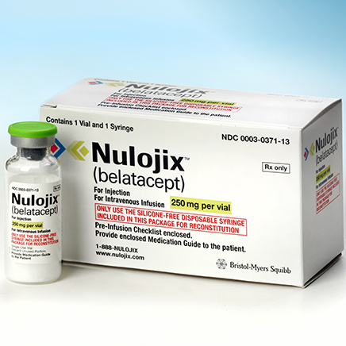
Co-Stimulation Blocker
Newest immunosuppressant on the market
Also used to decrease the kidney effects of calcineurin inhibitors
 | Belatacept
Brands | Nulojix
How it works | Prevents the activation of various immune cells
Dosing | Once Monthly infusion (after initial loading doses)
Monitoring | Not needed for this medication
Side Effects | Very well tolerated
Special Considerations | Increased risk of certain cancers Helps improve adherence
Notes:
Simlar to tacrolimus and cyclosporine these medications can not be crushed cut or chewed.

Slide 68
Final Reminders on Immunosuppression
Talk with your transplant team or pharmacist if you are experiencing any side-effects
NEVER stop taking your medications on your own!!
Immunosuppressive medications have increased the life of the organ and patient
Notes:
If you are experiencing side-effects and having trouble tolerating your medications please talk with your transplant team and let us know so we can adjust your medications. And finally please please please never stop taking any of these medications on your own. Always talk to a transplant coordinator, pharmacist, or doctor when having issues with any of your medicines.

Slide 69
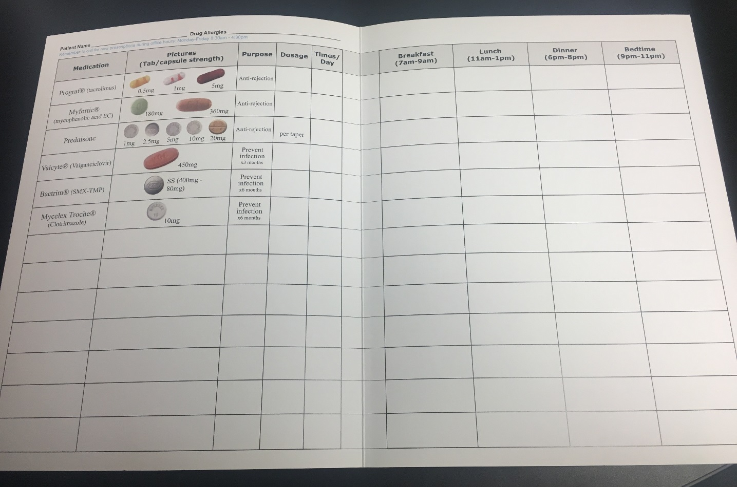
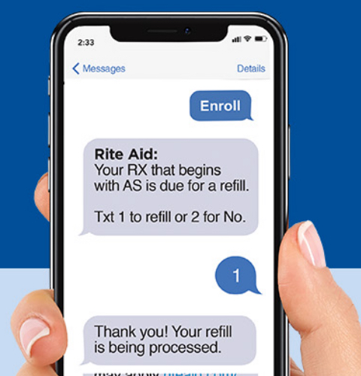
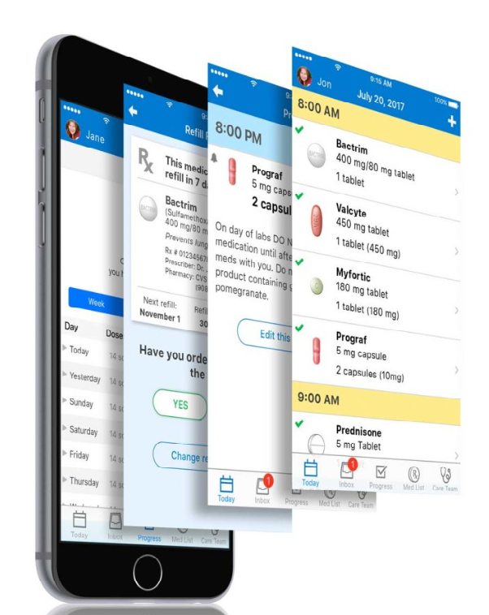
Tools to Help You Succeed

Slide 70
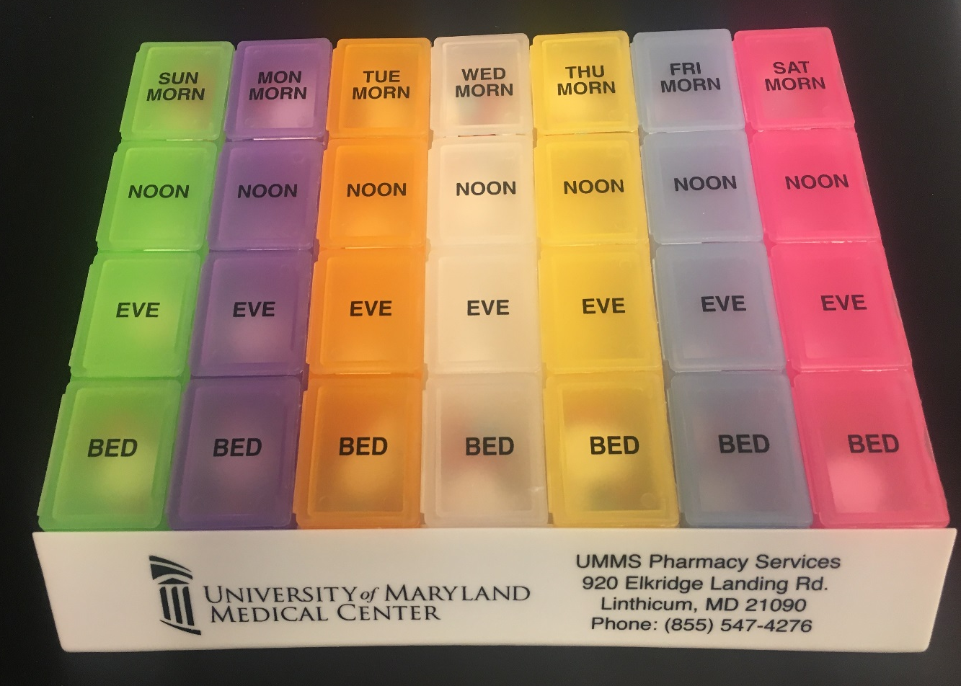
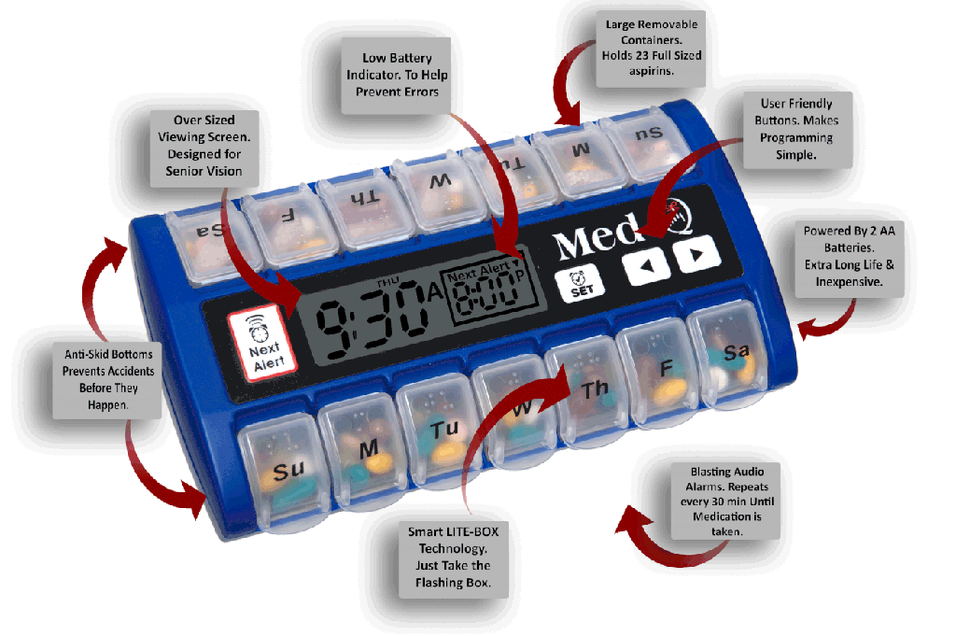
More Tools to Help You Succeed

Slide 71
Take an Active Role
KNOW your medications
Names, doses, indication
Common side effects
Questions to ask about your medicines:
Do I take it with or without food?
What if I forget to take a dose?
What happens if I run out of my medication?
What if I cannot afford my medication?
Can I take certain medicines at the same time?

Slide 72
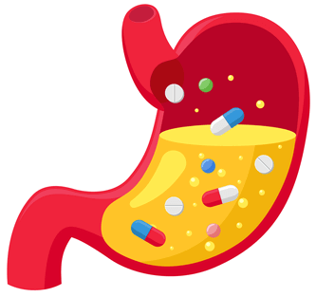
Do I take my medication with or without food?
Why??
Lower/Slowed absorption: Food can lower the amount/delay the time it takes for certain medications to be absorbed by your body
Faster or slower break down: Some food/juices can cause certain medications to get broken down faster in your body
If an empty stomach is needed, take medication 1 hour before or 2 hours after a meal
Always check with your local pharmacist!!
Be consistent!!

Slide 73
What happens if I forget to take a dose?
Take the missed dose as soon as you remember, unless the next dose is due within a few hours
If medication is taken once a day: forgotten dose should be taken as soon as you remember
If medication taken twice a day: forgotten dose can be taken if it is within 6 hours after it was due
General rule: Do not double up a dose!

Slide 74
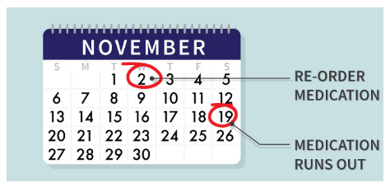
What happens if I run out of medication?
Contact your pharmacy and transplant team immediately so that they can help!
Prevent this from happening by requesting refills in advance

Slide 75
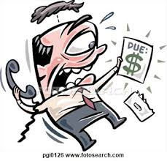
What if I cannot afford my medication?
Pharmacy and social work can help!
Patient assistance programs
Copay cards
Grants to help pay for medications
Generic medications may be available
Your transplant team may be
able to change your medication
to a similar alternative

Slide 76
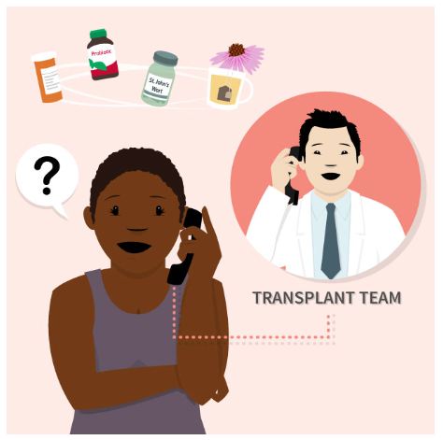
Are other medications safe with my transplant medications?
Contact your transplant team with questions
Ask your local pharmacist - make sure they know you have a history of transplant!
Let your doctor know if your symptoms last longer than 48 hours

Slide 77
Other Medications After Transplant
Pain control
Blood pressure
Blood sugar
Cholesterol
Acid reducer
Multivitamins
Keep your team informed if you are starting or stopping any medications
New medication prescribed by another doctor
Herbals/supplements
Over the counter medications

Slide 78
Key Points
A successful transplant is highly dependent on YOU!!
Immunosuppressant medications have increased the life of organ transplants and patients
Talk with your transplant doctor or pharmacist about side effects
Know your medications and ask questions
Take your medications as prescribed to protect your new organ

