Slide 1
Finding Your ReLeaf
What to Know About Medical & Adult Use Cannabis

Slide 2
Tracey Lancaster Miller
Executive Vice President
tracey@peakereleaf.com

Slide 3
What Conditions Can Cannabis Treat?
Anxiety
Depression
Chronic & severe pain
Insomnia & sleep disorders
Muscle spasms & tremors
GI conditions
Nausea & vomiting
Diabetes
Multiple sclerosis
Symptoms from cancer treatments
Fibromyalgia
Migraines
PTSD
Be cautious and consult a medical professional with heart conditions, including high blood pressure

Slide 4
Side effects tend to be mild but can be more severe
Disorientation
Euphoria
Red eye
Dizziness
Racing heart
Always speak with a medical professional about drug interactions
Notes:
Plug clinical directors here

Slide 5
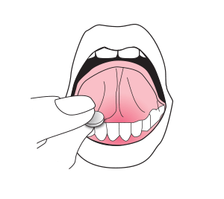
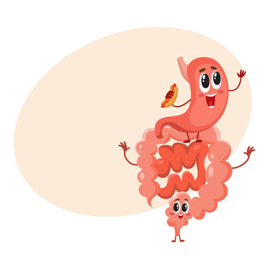
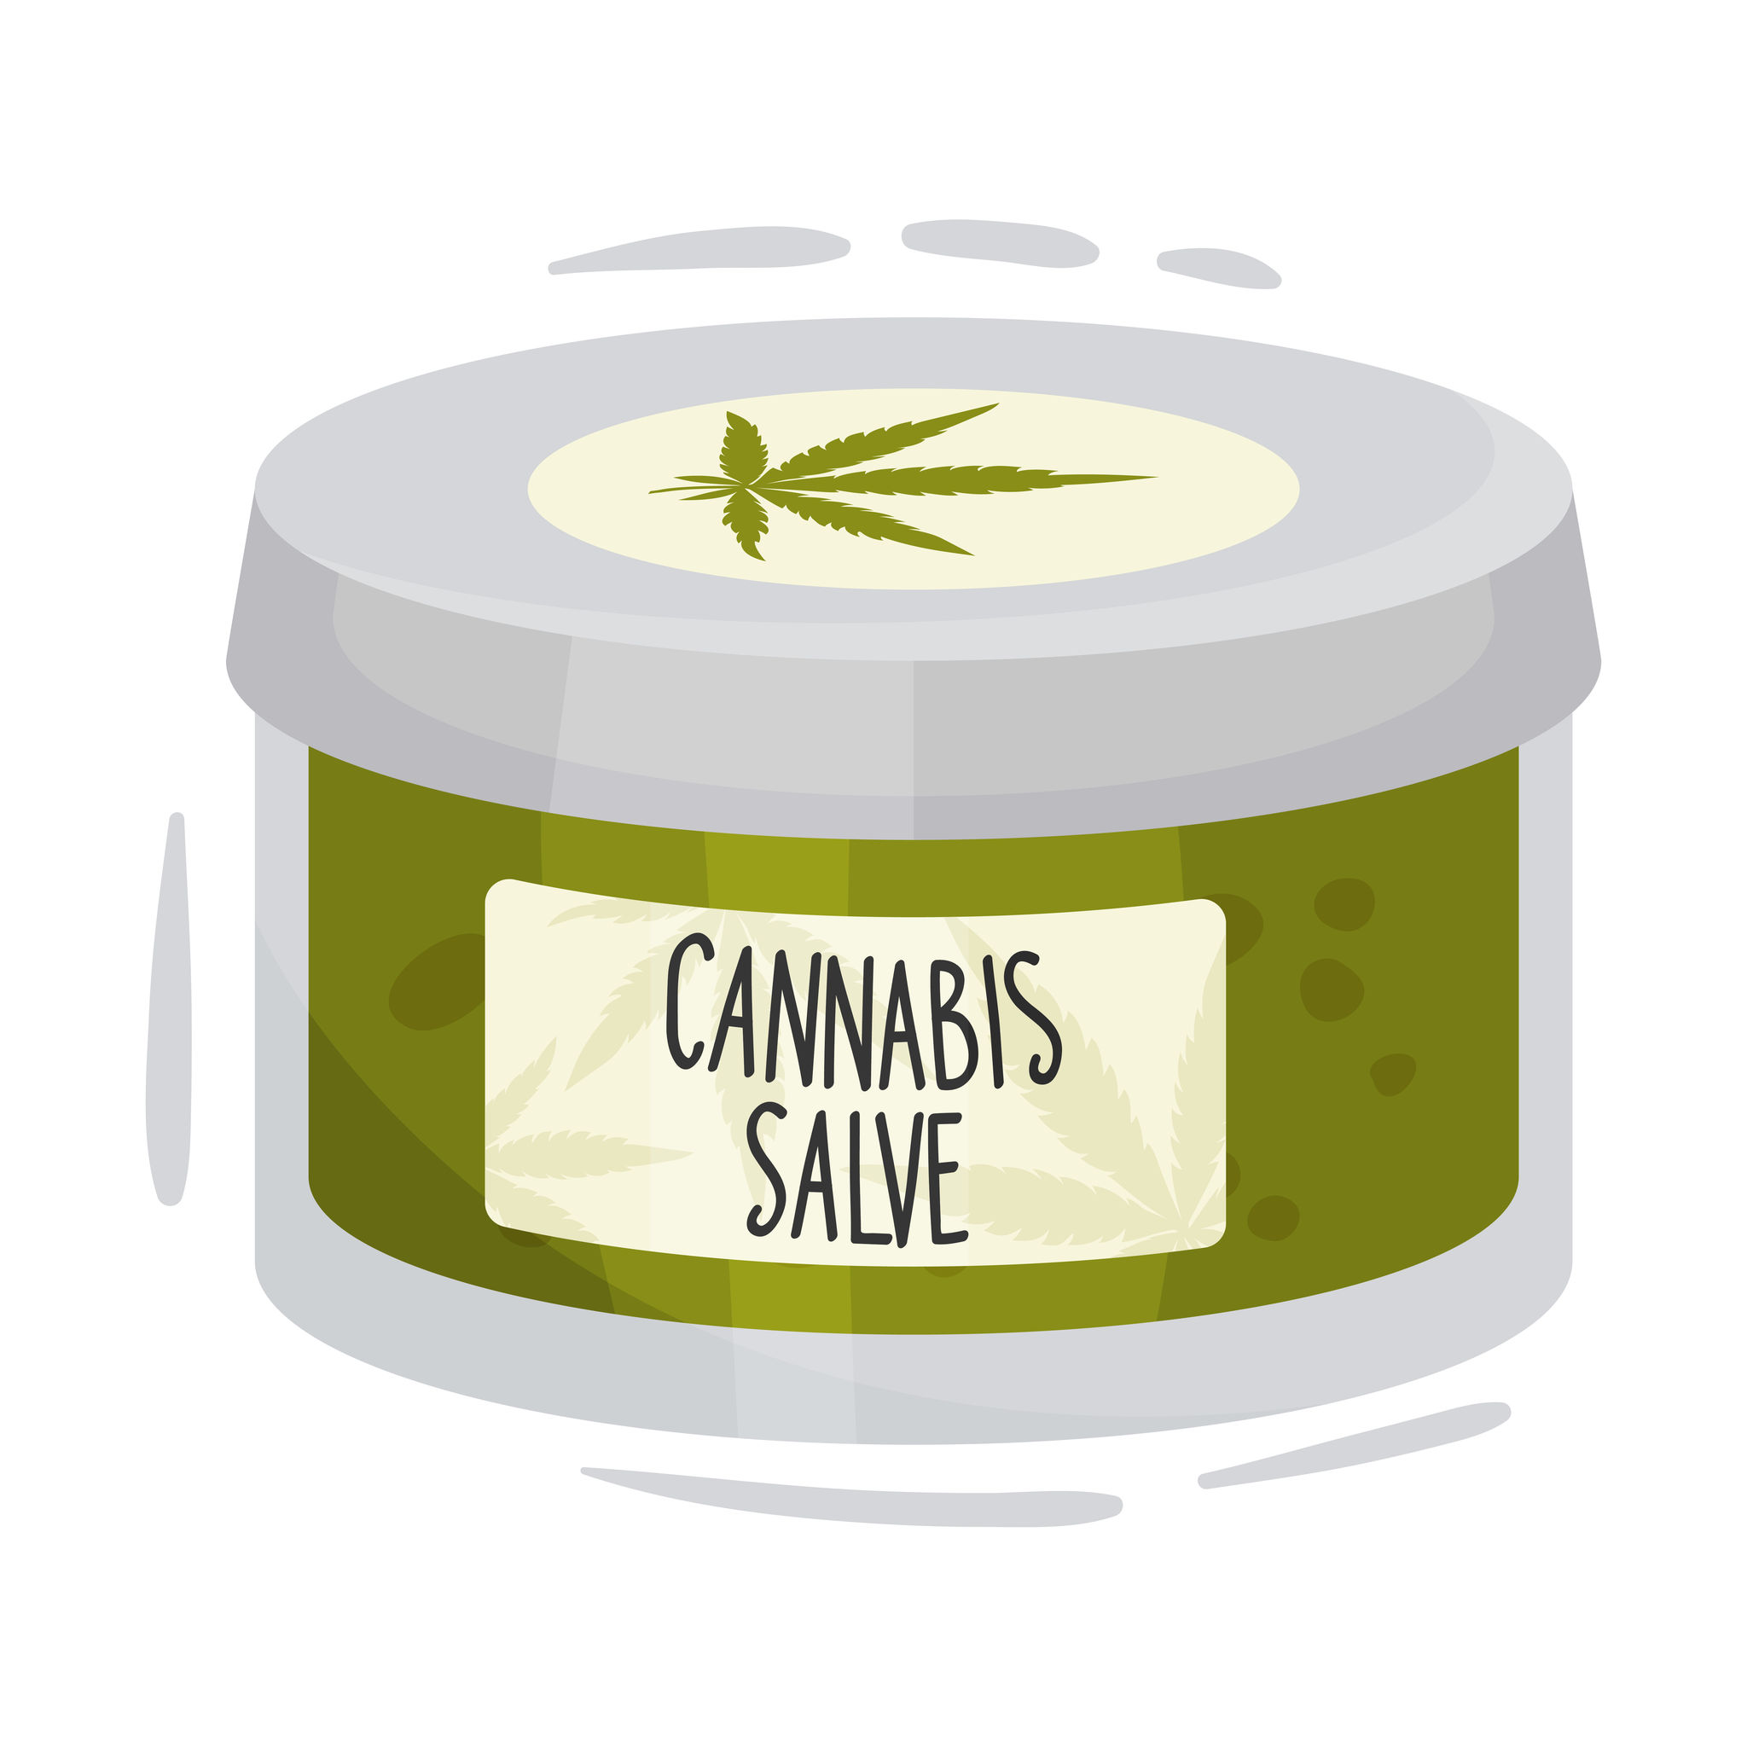
Routes of Administration
Oral
Sublingual
Topical/transdermal
Inhalation
Rectal & vaginal
Notes:
Picture credits: https://oralair.com/images/taking-oralair/how_to_02.png
https://www.google.com/url?sa=i&url=https%3A%2F%2Fstock.adobe.com%2Fsearch%3Fk%3Dcartoon%2Bdigestive%2Bsystem&psig=AOvVaw0P019c7V05eMM_x8O6rKN3&ust=1697314424271000&source=images&cd=vfe&ved=0CBEQjhxqFwoTCOD074_r84EDFQAAAAAdAAAAABAd
https://www.google.com/url?sa=i&url=https%3A%2F%2Fndnr.com%2Funcategorized%2Ftopical-cannabis-research-review%2F&psig=AOvVaw17GJVB2gLixHkMhz0oAkPg&ust=1697314586493000&source=images&cd=vfe&opi=89978449&ved=0CBIQjhxqFwoTCNjpz9zr84EDFQAAAAAdAAAAABAD
https://www.google.com/url?sa=i&url=https%3A%2F%2Fwww.flaticon.com%2Ffree-icon%2Fsuppository_2770298&psig=AOvVaw3P20oeYoNfiH3neICeCRa3&ust=1697314662531000&source=images&cd=vfe&opi=89978449&ved=0CBIQjhxqFwoTCOik-Yjs84EDFQAAAAAdAAAAABAN

Slide 6
Common Cannabinoids
THC
Pain, appetite stimulant, nausea & vomiting, sleep, PTSD
CBD
Anxiety, depression, pain, seizures
CBN
Sleep, muscle spasms
CBG
GI conditions, anti-tumoral
THC-a
Appetite stimulant, neuroprotectant
THC-v
Regulates blood sugar, suppresses appetite

Slide 7
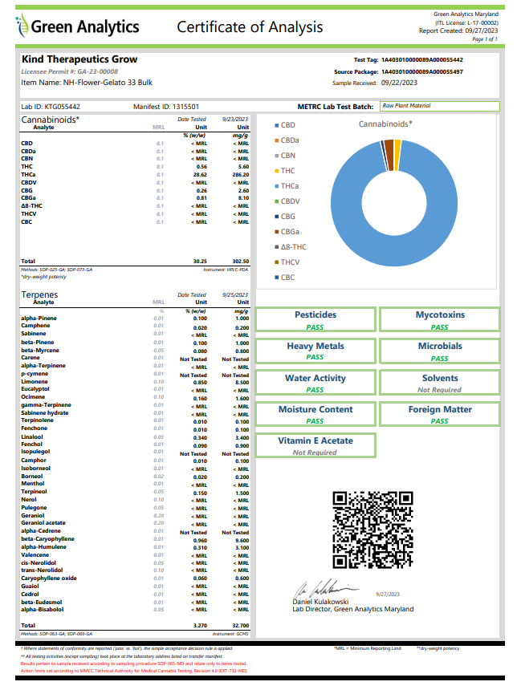
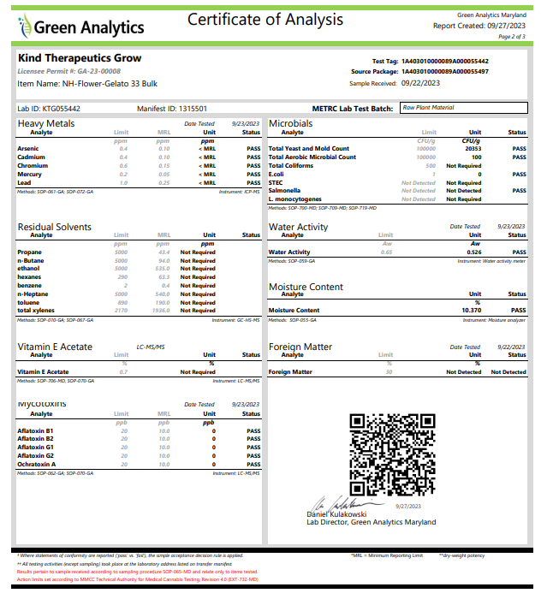

Slide 8
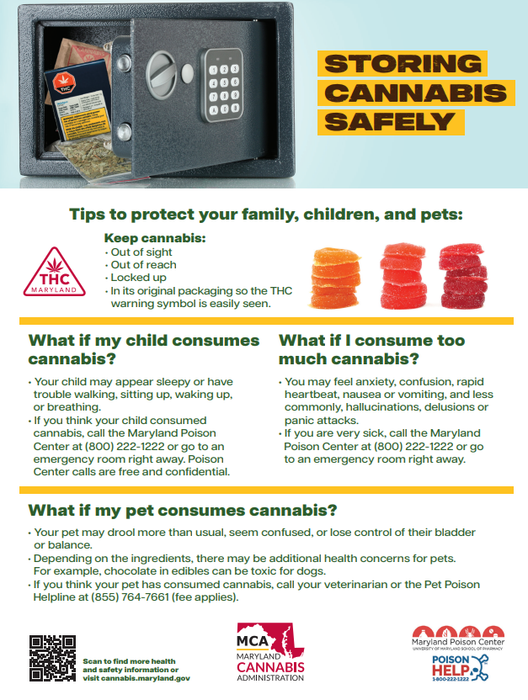
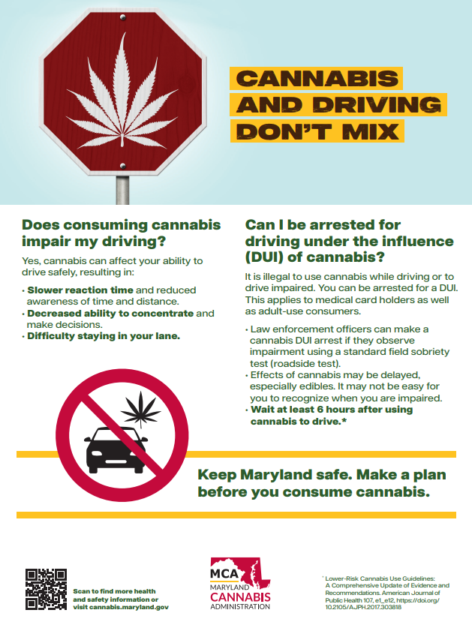

Slide 9
Questions to Ask Your Budtender
Are these products third party tested and verified?
Can I access the certificate of analysis?
Is the license from state regulatory authority on display?
What products do you recommend for a beginner…
Who does not want to smoke/vape?
That will help with my condition?
That contains this cannabinoid?
How do I know how much to consume?
How do I use this product?

Slide 10
Become a Medical Patient in MD
Visit MMCC.maryland.gov
Register in state portal with
Social security number
Copy of photo ID
Proof of residency
Pay $25 fee
Wait for approval email
Once received, bring approval email to registered medical provider for the annual certification
Certification fees vary

Slide 11
What’s the difference - medical and adult use cannabis?
Generally, products are exactly the same
State level differences
Access to high dose products restricted to medical patients
Always will be accessed inside licensed dispensaries
Most states have state-approved list of authorized dispensaries
Notes:
https://www.google.com/url?sa=i&url=https%3A%2F%2Fwww.istockphoto.com%2Fvector%2Fcartoon-character-of-smiling-black-man-with-medical-cannabis-gm1481337712-508666264&psig=AOvVaw1hx_7_DINyBH9FlJxuT_eG&ust=1697315235136000&source=images&cd=vfe&opi=89978449&ved=0CBIQjhxqFwoTCPDVmZPu84EDFQAAAAAdAAAAABAI

Slide 12
What is Delta-8 THC?
Hemp derived, unregulated, untested cannabinoid products
Exist outside of all regulatory frameworks
No oversight, no accountability
In some states, sold in gas stations, convenience stores and smoke shops
Other unregulated THC isomers include:
Delta-10 THC
THC-0
HHC
THC-B
Be cautious

Slide 13
Additional Resources
MCA patient registration portal
MCA approved dispensary list
What are cannabinoids?
Common conditions to use cannabis

Slide 14
Questions?
tracey@peakereleaf.com

