Slide 1
Vascular Composite Allograft Transplant
Jane Elizabeth Littleton, AG-ACNP, FNP, CCTC
Johns Hopkins Hospital VCA Coordinator

Slide 3
Indications for Transplant
Hand: Burns, Trauma, Birth defects
Face: Burns, Trauma, Birth Defects, Animal attack
Penile: Trauma, Birth defects, IED explosion, Cancer, Micropenis,
Uterus: Born without a uterus (MRKH Syndrome), Cancer, Hysterectomy

Slide 4
Bilateral Hand Transplant

Slide 5
Evaluation
Phone Screen> Information reviewed by the team
Patient may then be scheduled for a visit with the team
Evaluation takes 4-5 days and includes Psych, Social Work, Radiologic Studies, Cardiology, PFTs

Slide 6
Uterus Evaluation
Phone Screen
Visit with Transplant Team
Evaluation
IVF Procedure
Uterus Transplant> JHH will use living donors for our program

Slide 7
Selection Meeting
There will be a selection meeting to review candidates. This will include Surgery, Nutrition, Pharmacy, Psychology, Social Work, and Infectious Disease
If patient is selected to be listed they will need to be within 8 hours travel time of JHH
Waiting times for donor are variable
Need to ask Donor Family or Significant other for consent for donation separately
Often the OPO will tell the family / SO a bit of background on the patient such as wounded warrior or lost hand in a farming accident

Slide 8
Matching Criteria
Exact ABO Match due to bone marrow infusion (Day 14)
CMV and EBV status
Size
Skin Tone
No identifiable Tattoos

Slide 9
Post Op Complications
Bleeding, vessel thrombosis
Tissue Necrosis
Sepsis
Medication Reaction
Transfusion Reaction from Stem Cell Infusion
Direct Trauma to graft

Slide 10
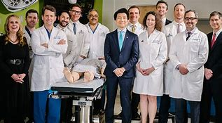

Slide 11
Immunosuppression
Hand, Face and Penile Transplants are given Campath Induction
Reverse Isolation
Oral Prograf initiated post op day 1
Most patients experience on episode of rejection between 3-6 weeks post op. Usually treated with topical steroids.
Bone Marrow infusion around day 14 (except for Uterus Transplant)

Slide 12
Single dose Immunosuppression
Initial T cell depletion with Campath
Donor Bone Marrow Cells are infused as a second stimulus on day 14 post transplantation.
This elicits a host alloimmune response that triggers exhaustion and depletion of the respective host (anti donor) lymphocyte clone
Composite Tissue Allografts are the only type of grafts to include donor bone marrow component as immunocompetent elements. This represents a constant source of donor derived stem cells but also favors an ability for chimerism induction and maintenance.

Slide 13
Single Agent Immunosuppression (Hand , Face, Penis only)
Benefits include reduced risk of hypertension, diabetes, hypercholesterolemia, tremors, osteoporosis, GI side effects and leukopenia.
May also reduce the risk of skin cancer and other malignancies

Slide 14
Uterus Transplant Immunosuppression
Tacrolimus
Steroid
Imuran (MMF is Teratogenic)

Slide 15
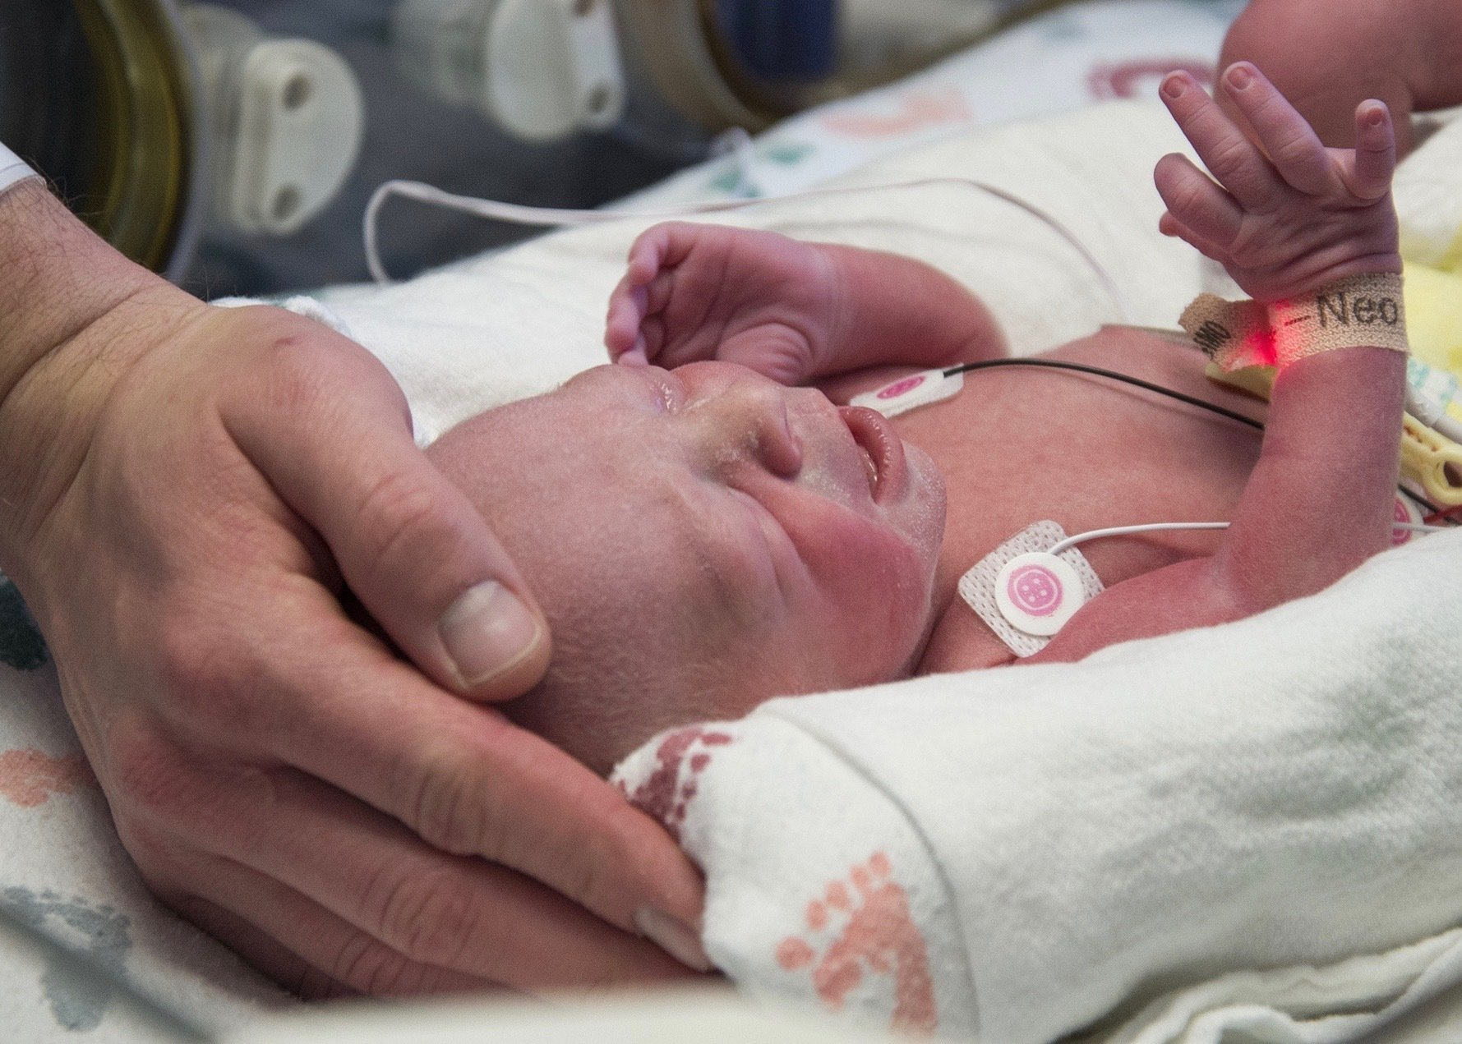
VCA Transplant
Jane Elizabeth Littleton, AG- ACNP, FNP, CCTC
Kate Knott, CRNP

Slide 16
Post Op Care
Maintain Room Temperature at 80-85 degrees
Maintain adequate hydration, dehydration causes vessel thrombosis
Specialty Bed
Contact Isolation with Masks
Flap Checks: Temperature, capillary refill, arterial and venous signals
PT/OT/SLP

Slide 17
Miscellaneous
Very important to maintain patient confidentiality
Please do not discuss with family or friends
Do not mention where the graft was procured as this may inadvertently reveal donor identity
No germline tissue (testes/ sperm/gametes) will be transplanted as part of this protocol

