Slide 1
The Journey of Transplant and Complexities of Nourishment
Presented by: Lance C. Armstrong, RDN, CNSC
Lance C. Armstrong, RDN, CNSC Kathlene Hendon, RDN, CNSC

Slide 2
Objectives of Presentation
Describe nutrition's role in good health, chronic disease and transplant.
Identify the relationship with nutrition in the transplant journey
Review common challenges and possible solutions during the pre and post transplant periods
Open discussion with audience sharing experiences, ideas and support.

Slide 3
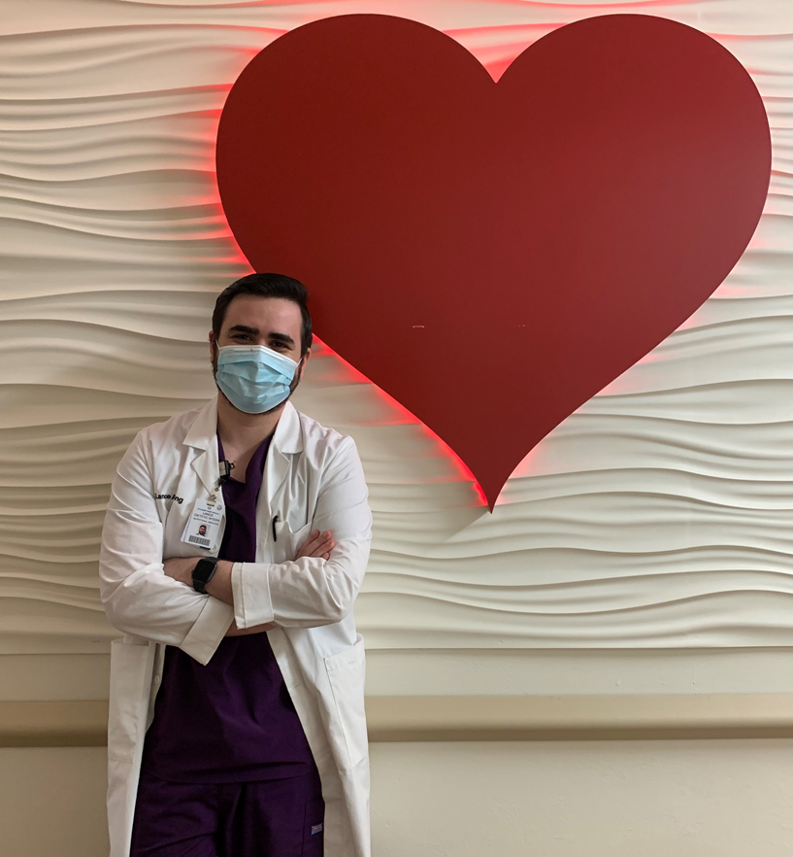
About Me
3 Years experience as a RD
1 year as renal transplant dietitian
Has worked in eating disorders, cardiac stepdown, psychiatry, and general medicine
CNSC certification, working towards CSR and CCTD
Enjoys music, video games, dancing, cooking, my dog

Slide 4
A Little Information About You
Please share a little about your experience:
Pre-transplant or waitlisted?
Post-transplant?
Which organ did you receive?

Slide 5
Live to Eat or Eat to Live?
Energy - essential to life
Social - we tend to enjoy food and eat better with social interaction
Comfort - food provides pleasure and important role in quality of life.
Health - essential to promote healing and maintain optimal health
Notes:
Energy-Essential to life
Social-important to the experience of eating and sharing with others. We tend to enjoy food and eat better with social interaction
Comfort-Food provides pleasure and important role in quality of life.
Health-essential to promote healing and maintain optimal health

Slide 6
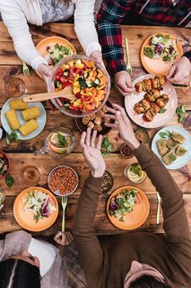
Complexities of Eating
Psychology – memory, experiences, preferences, emotions
Sensation – the 5 senses
Cultural – life experiences, family, religious practice, personal habits
Geography – location impacts our food choices
Convenience – restaurants, food delivery, frozen meals, specialty meal services
Notes:
Psych - memory, experiences, , preferences, emotions
Sense - sight, smell, taste, touch, sound
Culture - life experiences with family and meals, cultural backgrounds and cuisine, religious practices personal habits, geography
Geography - food influences depending on area food source
Convenience - restaurants, food delivery, new delivery systems, frozen meals, specialty meal services

Slide 7
End Stage Organ Failure: New Challenges
Genetics
Environmental
Lifestyle Choices
Trauma
Communicable disease
Obesity

Slide 8
New Complexities Leading to Malnutrition
Therapeutic diets
Polypharmacy
Early satiety
Metabolic derangements
Muscle mass losses
Fluid changes
Vitamin/mineral losses
Weight loss
Procedures
Hospitalizations

Slide 9
Nutrition Pre-Transplant
Limited food choices
Specific nutrient focus
Limited fluids
Learning a new way to eat
Oral nutrition supplements
Unpalatable diets
Apprehension about eating correctly

Slide 10
Nutrition Pre-Transplant (cont.)
Nutrition needs are ever-changing throughout the disease process
Recommendations need to be personalized
Maintaining good nutritional status while waiting for transplant improves outcomes
Notes:
Not every patient needs the same restrictions

Slide 11
Impact of Transplant on Nutrition
Increased needs following surgery
Blood sugars
Potassium
Immune compromised state
Residual symptoms of chronic disease
Multiple medications

Slide 12
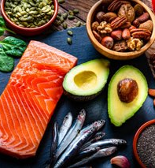
Nutrition Focus
Liberalized Diet
Mediterranean Diet Pattern
6-8 weeks post transplant
8 weeks + post transplant
Food/drug interactions
Food safety
Blood glucose control
Weight management
Lipid management

Slide 13
Resources
Food Safety Resources:
USDA Food Safety | www.FoodSafety.gov
Centers for Disease Control | www.cdc.gov/foodsafety
Food Safety and Inspection Service | www.fsis.usda.gov
Servsafe | www.servsafe.com

Slide 14
Resources
Other Resources:
Alcoholics Anonymous | https://www.aa.org/
Mediterranean Diet | Oldways (oldwayspt.org)
Cronometer Food Tracker | https://cronometer.com/
Meal Assistance Programs
Meals on Wheels | https://www.mealsonwheelsamerica.org/
Moveable Feast | (mfeast.org)
Moms Meals | https://www.momsmeals.com/

Slide 15
The Unique Transplant Experience
Share your personal experiences with nutrition through your journey?
Good strategies
Good experiences
Problems/solutions
Resources
Support

Slide 16
Questions?
Thanks for listening!

