Slide 1
Life After Transplant
University of Maryland School of Medicine
Silke V. Niederhaus, MD, FACS, FAST
Associate Dean for Faculty Affairs and Professional Development
University of Maryland School of Medicine Associate Professor of Surgery
University of Maryland School of Medicine
Member, Board of Directors
National Kidney Foundation of Maryland and Delaware

Slide 2
Learning Topics
Describe variability in patient experience in the first 3 months after transplant
Follow-up timeline
Experience varies
Describe differences in long-term outcomes by donor organ quality
Live donor v deceased donor
KDPI
Graft survival
EPTS scores
Describe differences between different kidney donor options
Compare different donor options and risks/benefits of each with expected graft survival

Slide 3
Disclosures
NKF MD/DE Board Member
Transplant Recipient
Transplant Surgeon
Female, Mother, Wife
Serve as consultant for MemoTherapeutics
No relevance to this talk

Slide 4
Variability in Patient Experience
Kidney disease (CKD) is common
37 Million
1 in 7 people
15% of Americans
More common as people age
38% of Americans 65+ have CKD
In Maryland, there are between
350-550 kidney transplants/year
70-200 living donor transplants/year
10-50 kidney-pancreas transplants/year
https://www.cdc.gov/kidneydisease/publications-resources/ckd-national-facts.html and https://optn.transplant.hrsa.gov/data/view-data-reports/state-data/#

Slide 5
Variability in Patient Experience
Overall Follow-up Timeline:
- 2-5 days in hospital
Weekly visits and blood draws for 1-2 months
Every other week blood draws and visits every 3 months
Monthly blood draws and visits every 3-6 months
After 1-3 years
Blood draws every 2-3 months
Yearly visits

Slide 6
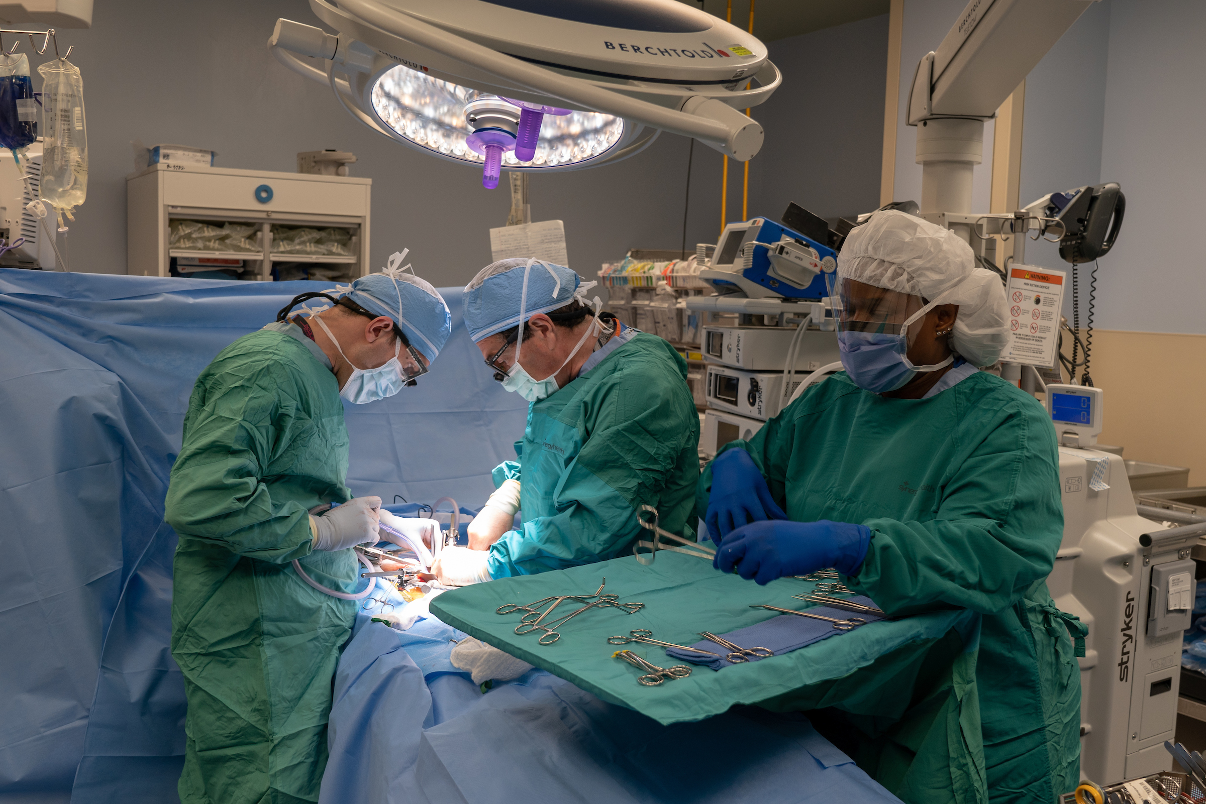
The Operation
Dissection

Slide 7
Recovery
General Anesthesia
Catheter in the bladder
Up to the chair after a few hours
Up walking by the next day
Home 2-5 days later
Blood pressure
Blood sugar
Learning new meds

Slide 8
Postoperative Busy-ness
Check your vitals 4x/day
Record what you drink and how much you pee
Track blood sugars 4x/day or more
Come once or twice a week for labs and a checkup
Twice a month
Monthly
Monthly labs
Every 3-month visits
Make sure you don’t run out of meds☺

Slide 9
Complications
Rejection
10%
No symptoms
Creatinine goes up
Protein in the urine
Ureter
Leak
Stricture
Urinary infection
Wound infection
Leg swelling
Blood clots or lymphocele
Anything that can go wrong, will go wrong

Slide 10
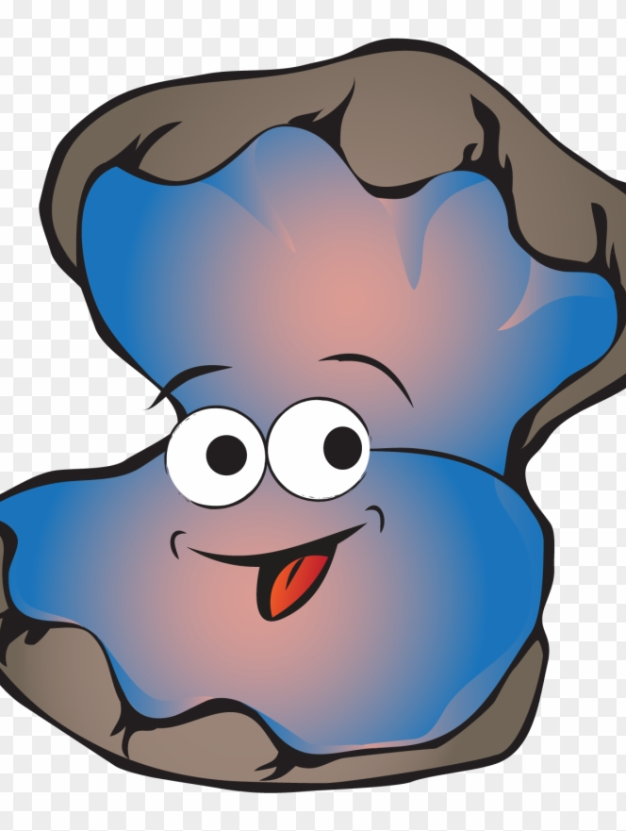
Patient Experience A (“Austin”)
Kidney failure from IgA
Close family
Living donor transplant from his brother
Kidney works immediately
Goes home 2 days after surgery
Follows above pathway
Happy as a clam!

Slide 11
Patient Experience B (“Beaver”)
Kidney failure from diabetes
Family/friends couldn’t donate due to health problems
Doing poorly on dialysis
Transplant from deceased donor
Kidney has delayed graft function (DGF)
Has high blood sugar in hospital
Goes home 6 days later
Gets wound infection, washout, vac
Kidney biopsy at 10 days
ATN
Still not working
Biopsy at 1 month – ATN
IV medication switch made
Still on hemodialysis
Weekly labs
At 7 weeks able to stop dialysis
Kidney works ok
Readmits for heart failure/volume overload

Slide 12
Patient Experience C (“Chriss”)
- Kidney failure from HTN
Living donor from sister
Surgery went well
Doing great POD1
Ultrasound normal
Legs swell POD2
Body swells POD3
Urine with protein
Biopsy with FSGS
Now needs plasma exchange 2x/week

Slide 13
Learning Topics
Describe variability in patient experience in the first 3 months after transplant
Follow-up timeline
Experience varies
Describe differences in long-term outcomes by donor organ quality
Live donor v deceased donor
KDPI
Graft survival
EPTS scores
Describe differences between different kidney donor options
Compare different donor options and risks/benefits of each with expected graft survival

Slide 14
Differences in Outcome by Donor Organ Quality
Living Donor
Deceased Donor

Slide 15
Deceased Donor KDPI

Slide 16
Graft Half Lives

Slide 17
Statistics versus Real Life
0-50
0-50
0-50

Slide 18
It’s not ONLY about the Donor Organ Quality
Recipients have comorbidities
None are average
Hypertension
Stroke
Heart disease
Heart failure
Long-term immunosuppression
Prior transplants
PAD
Smoking
Diabetes
Dialysis time

Slide 19
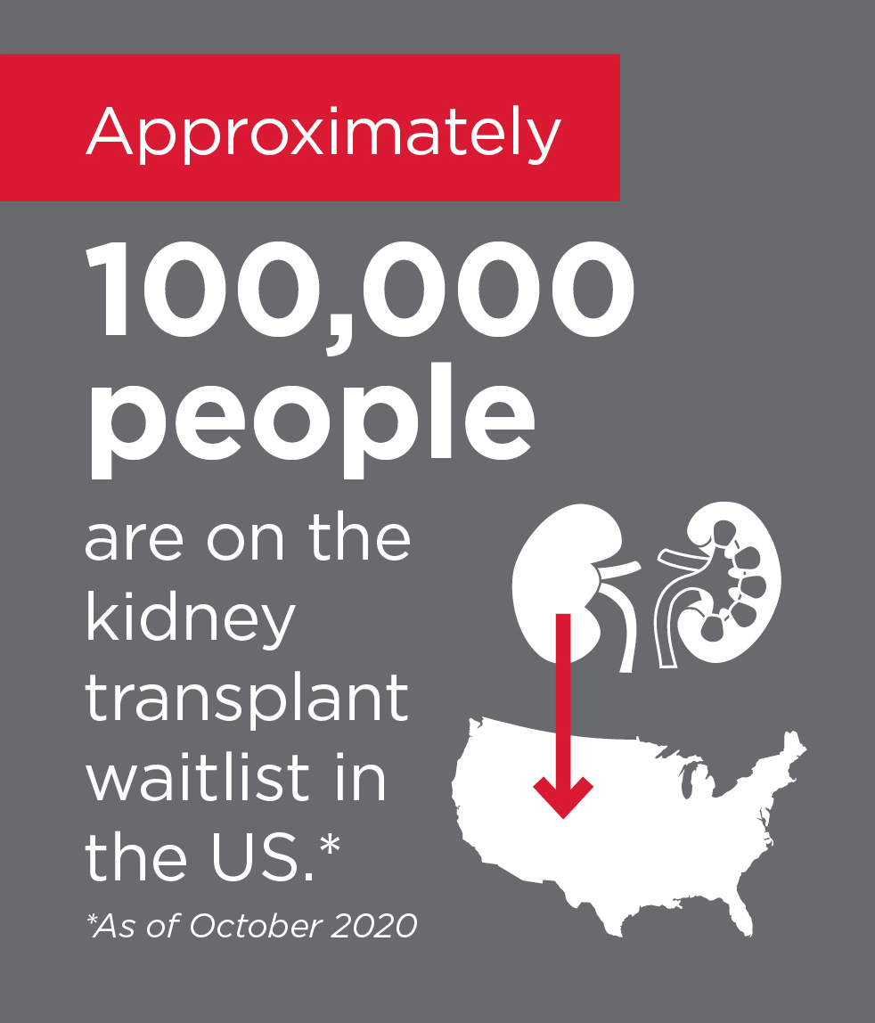
Why Choose Kidney Transplant?
Higher chance of living longer
60 or older
Start dialysis
Life expectancy average is 5 years
5 year survival is 50%
Starting dialysis at age 60 or older means you
would live longer if you had colon cancer instead
With a kidney transplant, 5-year survival is 80%

Slide 20
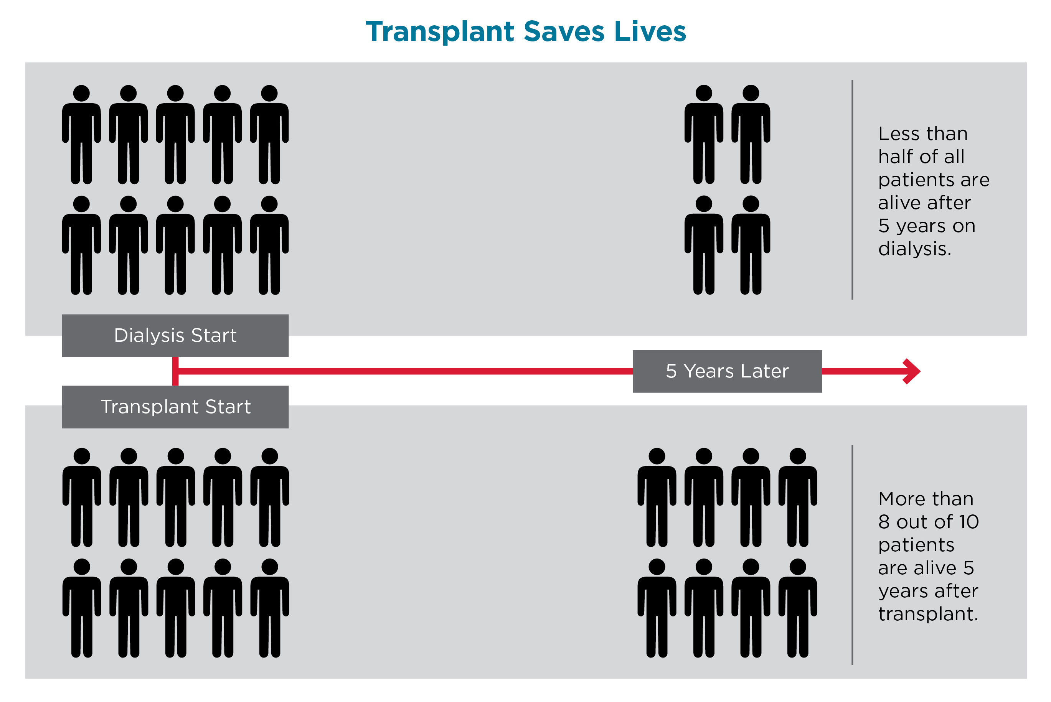
Chances of Survival
Twice as many people are alive with transplant after 5 years

Slide 21
EPTS – Estimated Post-Transplant Survival
https://optn.transplant.hrsa.gov/data/allocation-calculators/epts-calculator/

Slide 22
Allocation System
Candidates are ranked by EPTS
Estimated Post Transplant Survival
Donors are ranked by KDPI
Kidney Donor Profile Index
People with lower life expectancy receive kidneys with a lower life expectancy
Children get the best kidneys available – even if you join the list

Slide 23
Learning Topics
Describe variability in patient experience in the first 3 months after transplant
Follow-up timeline
Experience varies
Describe differences in long-term outcomes by donor organ quality
Live donor v deceased donor
KDPI
Graft survival
EPTS scores
Describe differences between different kidney donor options
Compare different donor options and risks/benefits of each with expected graft survival

Slide 24
What about the Long Waiting Time?
Blood Group O
8-10 years
- Blood Group AB
- 3-5 years
Two Choices:
Living Donor Transplant
Waiting (to be listed)

Slide 25
Donor Options and Risks/Benefits
Donor | Risks | Benefits
Living | Donor’s risk | Earlier transplant = less dialysis Highly selected = immediate, longer (better) kidney function
Deceased, standard | Wait time – could get sicker while waiting | Good kidney
Kidney-Pancreas | Bigger surgery, more bleeding/infection, longer ICU/hospital stay | Fixes diabetes! Good kidney Shorter wait time
High KDPI | Delayed graft function Shorter average graft survival | Shorter waiting time
PHS IR | Infection (HCV, HBV, HIV) | Shorter waiting time
HCV PCR+ | Hepatitis C infection will need treatment; liver problems | Shorter waiting time Possibly younger donor organ
HbcAB+ | Infection (low) May need treatment | Shorter waiting time

Slide 26
The Match (compatibility)
Recipient Donor | O | A | B | AB
O | Yes | Yes | Yes | Yes
A | Maybe | Yes | Maybe | Yes
B | No | No | Yes | Yes
AB | No | No | Maybe | Yes

Slide 27
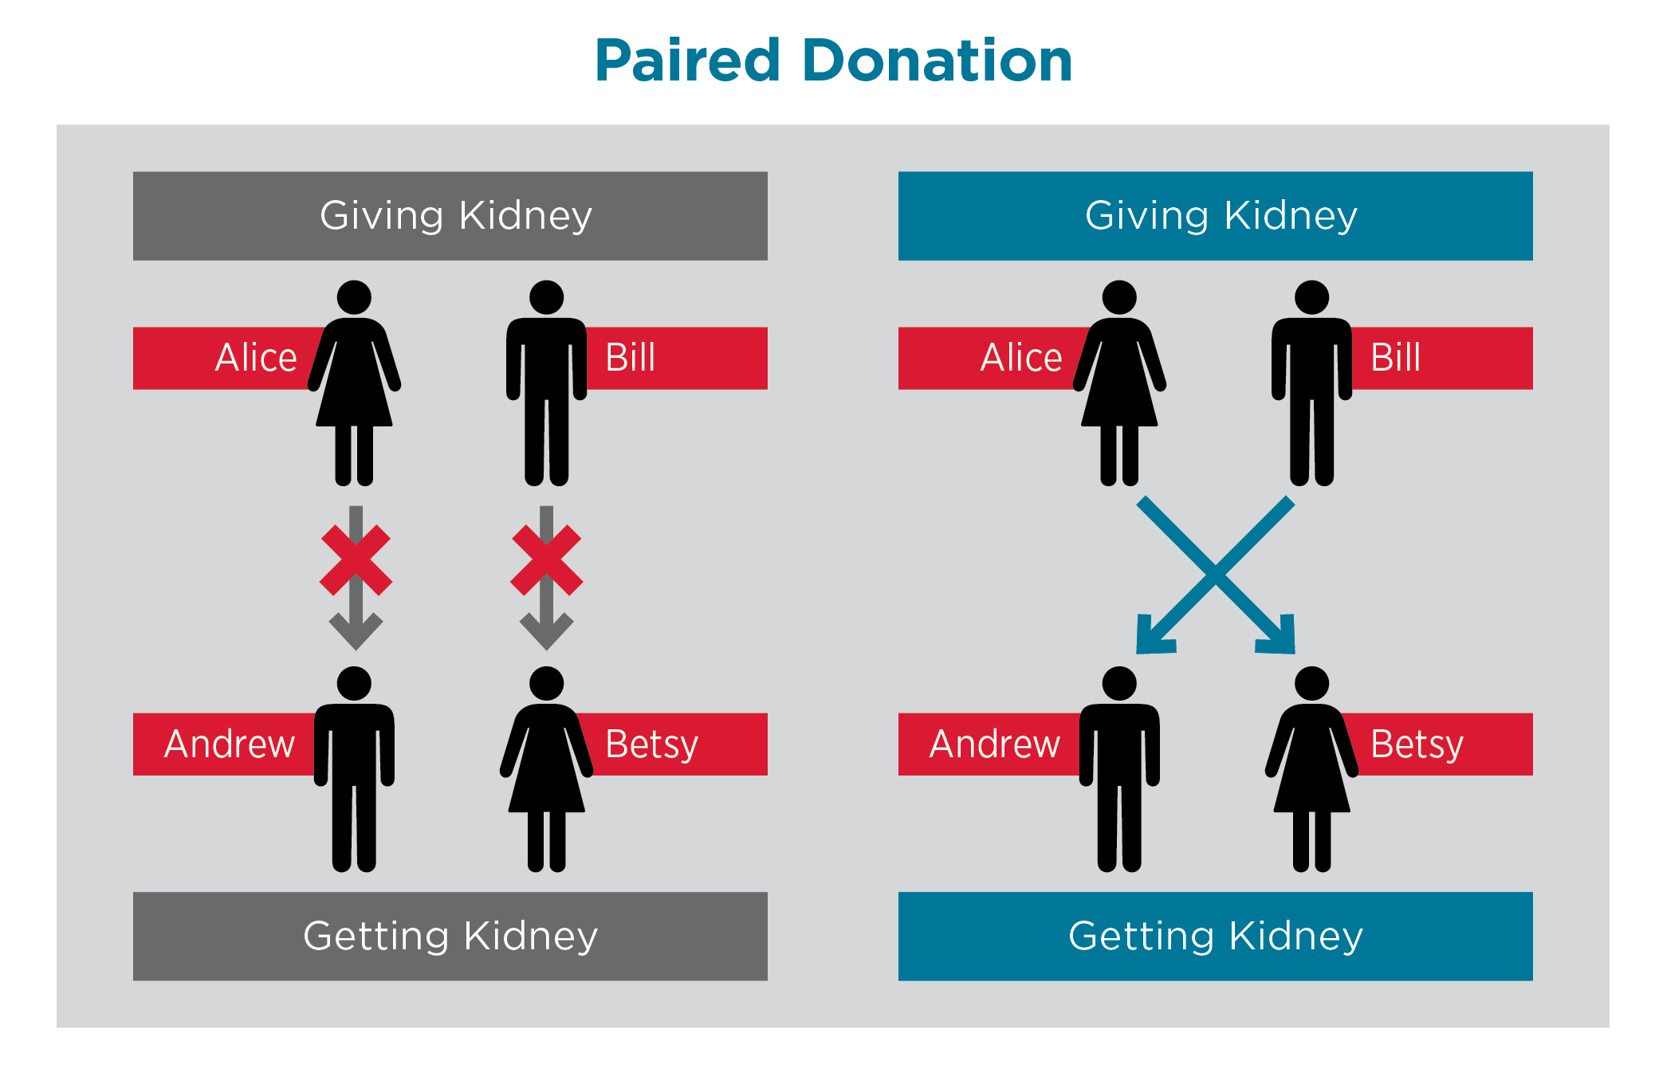
Paired Kidney Exchange (PKE)

Slide 28
The Match (compatibility)
Blood group compatibility is a must
Antibodies
cPRA (calculated panel-reactive antibody)
Tissue typing (HLA match)

Slide 29
Timing
Optimal for living donors
Next door operating room
Schedule surgery around airline flight schedules
Depends on donor health
Ideally less than 24 hours
Over 48 hours rarely

Slide 30
Life After Transplant – Other Considerations
Close to normal
COVID-19 has been an exception
Meds twice a day
Minimum
refills
Labs 4-12x/year
No travel restrictions
But talk to ID before you go…

Slide 31
Life After Transplant – Other Considerations
Masking in public
Gardening
Pets
Diet
Sports
Grandkids/family events

Slide 32
Life After Transplant – Other Considerations
No good thing lasts forever
Infections are more common
Some cancers are more common
Save your veins!
Transplant Dialysis

Slide 33
Questions
Thank You

