Slide 1
Medications
After Transplant
Ian A. Booth, PharmD
Solid Organ Transplant Pharmacist
University of Maryland Medical Center

Slide 2

Overview of organ transplant and the immune system
Determine strategies to take all medications as prescribed after transplant
Describe the common medications to prevent rejection after transplant
Explain what to do if you are experiencing side-effects from your medications
Recognize the importance of medications to prevent infections after transplant

Slide 3
Overview of organ transplant and the immune system
Determine strategies to take all medications as prescribed after transplant
Describe the common medications to prevent rejection after transplant
Explain what to do if you are experiencing side-effects from your medications
Recognize the importance of medications to prevent infections after transplant

Slide 4
History of Organ Transplantation
1954
1966
1967
1968
1983
1987
2005
Kidney
Pancreas
Heart
Lung
Face
Liver
Small bowel
Cyclosporine introduced

Slide 5
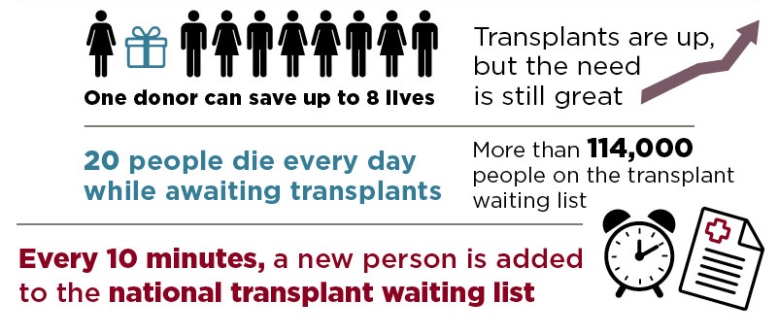
Why become an organ donor?

Slide 6
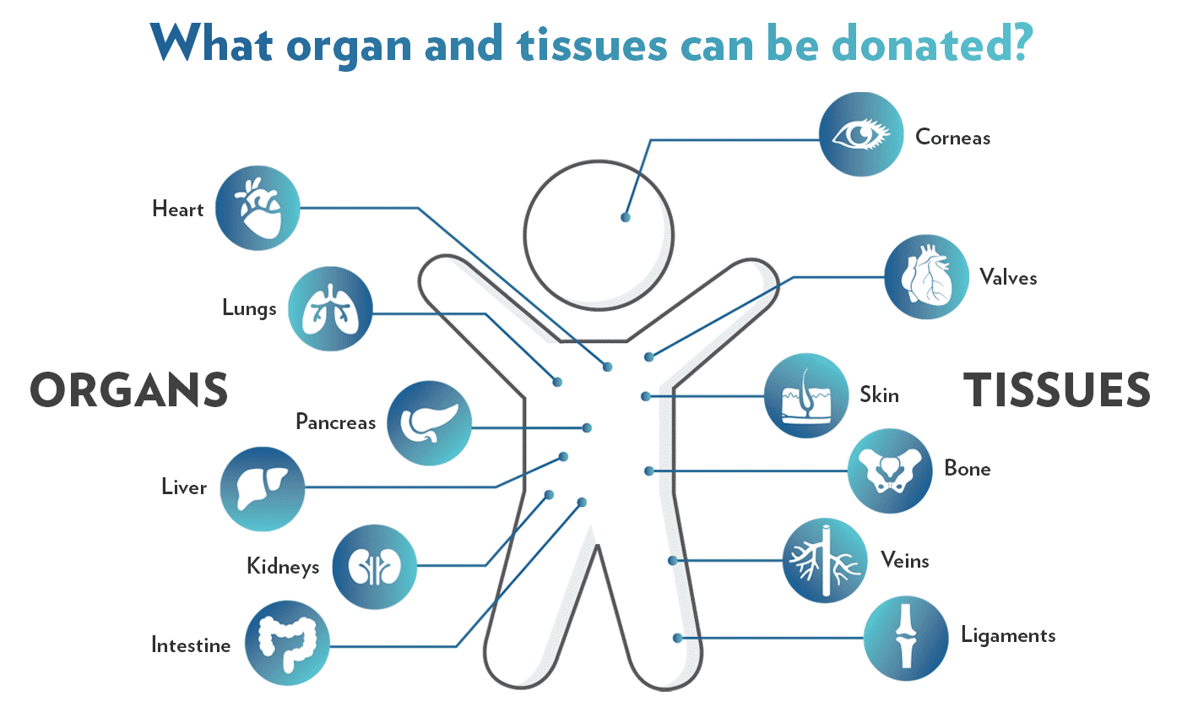
What can be donated?

Slide 7
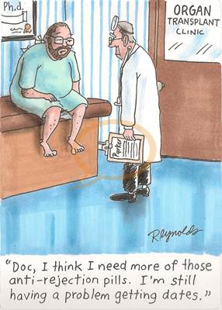

The Immune System
Good
Protection
Bad
Rejection
Destruction

Slide 8
Basics of the Immune System
Immune system protects against foreign material (aka organs in organ transplant)
3 levels of defense:
  Surface barriers
    Skin, mucus linings, acidic stomach environment
  Innate (present from birth, no memory, non-specific, response time = hours)
  Adaptive (specific, memory, response time = days)
    Cellular (T-cells)
    Humoral (B-cells)

Slide 9
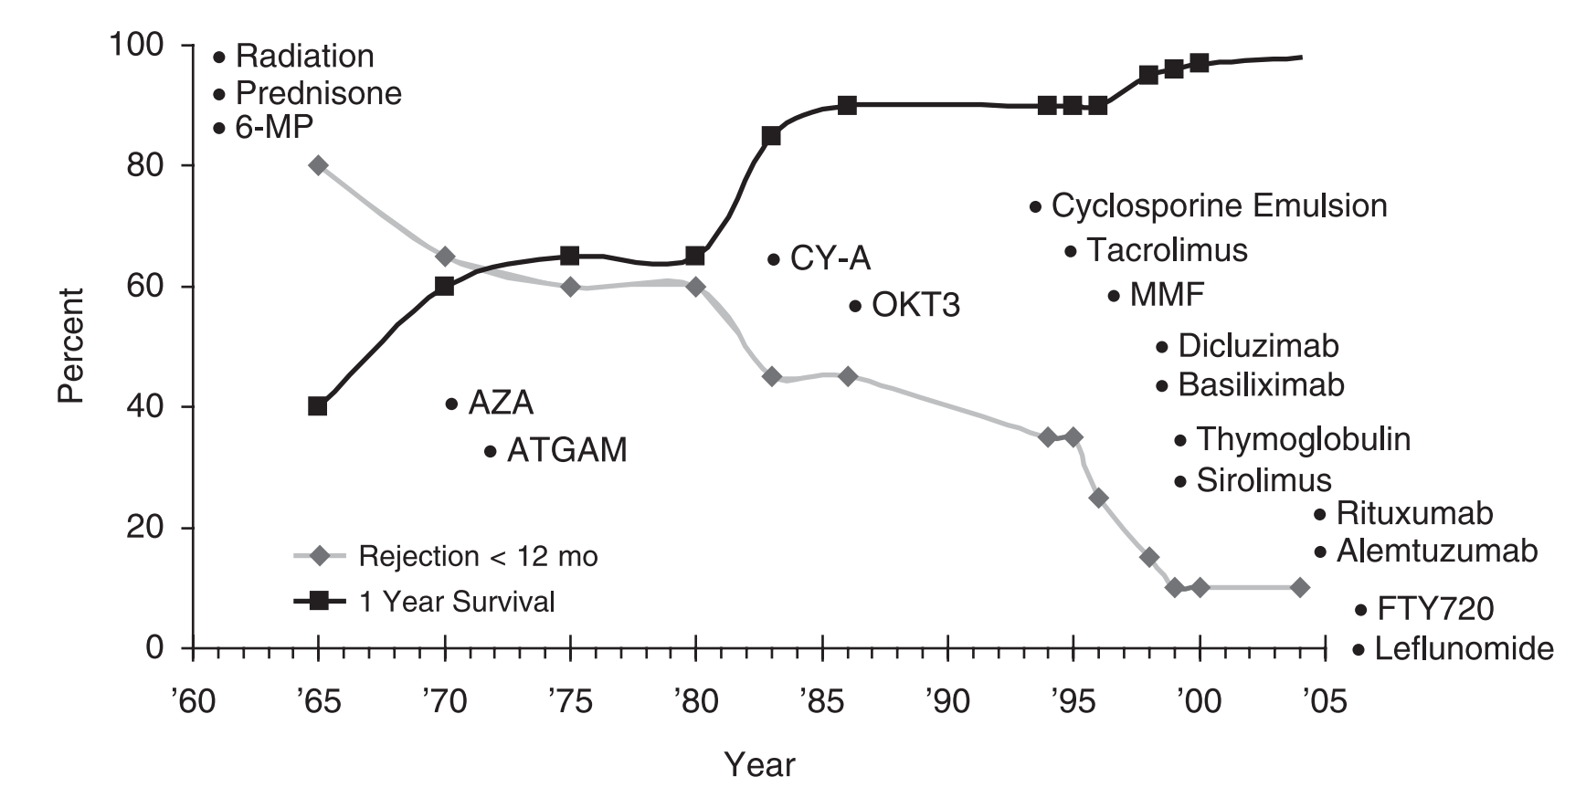
The Effect of Immunosuppression
Prednisone
Azathioprine
Tacrolimus
Mycophenolate
Sirolimus
Tacrolimus XL
Everolimus
Cyclosporine
Notes:
Looking at this graph you can see going up and down on the left hand side we have percentages. And then going across the bottom we have years spanning from the 1960s until around 2005. then we see two lines that seem to cross. Now the black line is the percentage of patients that survived 1 year after their transplant. Thinking about that we want all our patients to survive so the fact that this line is increasing over time is a good thing. Looking at the grey line that shows the percentage of rejection in the first year. Knowing that we want as little rejection as possible we see that we are also doing better at keeping that line down as time has gone on. Now what I as the pharmacist on the team think is really cool is that each time you see big changes in theses lines it centers right around the time a new medication was developed. So here in the 1970s, again in the 1980s you see another big change and finally again in the early 2000s we get even better. Likely in large part to the new medications that were developed.

Slide 10

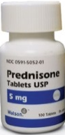
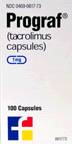
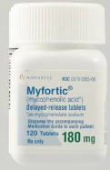
Balance of Immunosuppression
Rejection
Graft Loss
Side Effects
Infection
Malignancy

Slide 11
Considerations for Immunosuppression
Blood type ABO incompatible
African American
Younger age
Infection history
History of malignancy
Donor specific antibodies (DSAs)
More immunosuppression
Less immunosuppression
Human immunodeficiency virus (HIV)
History of organ transplant/rejection
Older age

Slide 12
All Organs Are Not Created Equal
Lung
Heart
Pancreas
Liver
Small Bowel
Kidney
More Rejection = Greater Immunosuppression Needs
Less Rejection = Lower Immunosuppression Needs

Slide 13
Overview of organ transplant and the immune system
Determine strategies to take all medications as prescribed after transplant
Describe the common medications to prevent rejection after transplant
Explain what to do if you are experiencing side-effects from your medications
Recognize the importance of medications to prevent infections after transplant

Slide 14
Overview of organ transplant and the immune system
Determine strategies to take all medications as prescribed after transplant
Describe the common medications to prevent rejection after transplant
Explain what to do if you are experiencing side-effects from your medications
Recognize the importance of medications to prevent infections after transplant

Slide 15

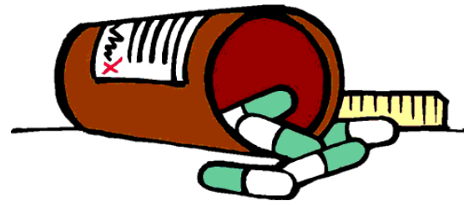
Types of Immunosuppressants
Class of Medication | Generic Names
Calcineurin Inhibitors | Tacrolimus
 | Cyclosporine
Notes:
There are 4 types or classes of immunosuppressants or antirejection medications that are typically used. The first one we will go over are what we call Calcineurin inhibitors the specific medications in this class are tacrolimus and cyclosporine.

Slide 16
Types of Immunosuppressants
Class of Medication | Generic Names
Calcineurin Inhibitors | Tacrolimus
 | Cyclosporine
Anti-Proliferatives | Mycophenolate
 | Azathioprine
Notes:
There are 4 types or classes of immunosuppressants or antirejection medications that are typically used. The first one we will go over are what we call Calcineurin inhibitors the specific medications in this class are tacrolimus and cyclosporine.

Slide 17
Types of Immunosuppressants
Class of Medication | Generic Names
Calcineurin Inhibitors | Tacrolimus
 | Cyclosporine
Anti-Proliferatives | Mycophenolate
 | Azathioprine
Steroids | Prednisone
Notes:
There are 4 types or classes of immunosuppressants or antirejection medications that are typically used. The first one we will go over are what we call Calcineurin inhibitors the specific medications in this class are tacrolimus and cyclosporine.

Slide 18
Types of Immunosuppressants
Class of Medication | Generic Names
Calcineurin Inhibitors | Tacrolimus
 | Cyclosporine
Anti-Proliferatives | Mycophenolate
 | Azathioprine
Steroids | Prednisone
mTOR Inhibitors | Sirolimus
 | Everolimus
Notes:
There are 4 types or classes of immunosuppressants or antirejection medications that are typically used. The first one we will go over are what we call Calcineurin inhibitors the specific medications in this class are tacrolimus and cyclosporine.

Slide 19
Types of Immunosuppressants
Class of Medication | Generic Names
Calcineurin Inhibitors | Tacrolimus
 | Cyclosporine
Anti-Proliferatives | Mycophenolate
 | Azathioprine
Steroids | Prednisone
mTOR Inhibitors | Sirolimus
 | Everolimus
Co-Stimulation Blocker | Belatacept
Notes:
Now before we go any further I will say that terms like calcineurin inhibitor or antiproliferative might seem confusing to you and that’s okay. We just use these names to group similar medications together based on how they work on the immune system. For our purposes today I want you to focus on the names of the medication and think about the medicines that you are on or that your loved one is on instead of the name of the class of medication.

Slide 20
Calcineurin Inhibitors
Most common post-transplant immunosuppressant
Increased survival and decreased rejection
 | Tacrolimus |  | Cyclosporine
Brands | Prograf | Astagraf/ Envarsus XR | Neoral/ Gengraf | Sandimmune
How it works | Prevents the activation of various immune cells
Dosing | Twice Daily | Once Daily | Twice Daily
Monitoring | 12-hour trough | 24-hour trough | 12-hour trough
Special Considerations | NOT INTERCHANGEABLE |  | NOT INTERCHANGEABLE
 | Do NOT crush, cut, chew or open capsule
Notes:
So our first two medications we’ll talk about are Tacrolimus and cyclosporine. These are the most common post-transplant medications used and most combinations will include one of these. The reason most combinations include on these medications is because when cyclosporine first came out in the 1980s we saw the biggest jump in improvement of transplant success.

Slide 21
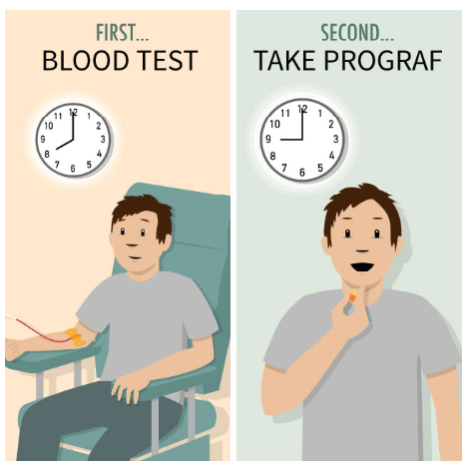
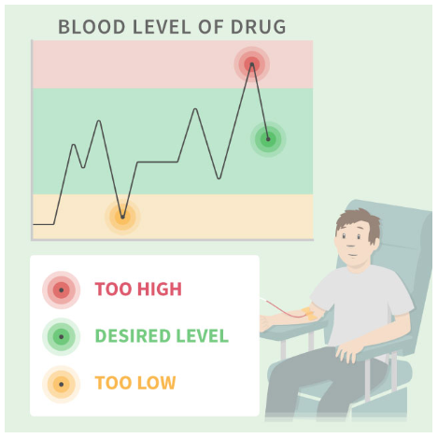
Why do I have to hold calcineurin inhibitors prior to getting labs?
Levels should be drawn before the morning dose

Slide 22
Calcineurin Inhibitor Monitoring
Goal level is dependent on:
  Time since transplant
  Type of transplant
  Transplant center protocols
  Other medical conditions
Higher concentrations during the 1st year
following transplant then lowered depending on
rejection episodes, side effects, and infections

Slide 23

Side-Effects of Tacrolimus and Cyclosporine
Both Medications
Kidney damage ↓ Magnesium ↑ Potassium
Close monitoring of
lab work
Minimizing high levels
Notes:
In terms of specific differences between the two tacrolimus can lead to diabetes and cyclosporine can cause an increase in your cholesterol and blood pressure. One opposite side-effect is tacrolimus can cause some hair loss while cyclosporine can cause hair gain. So how do help prevent these side-effects. Well for diabetes or high blood sugar, high cholesterol and blood pressure we optimize and use medications to prevent or treat those things. And in terms of tremor hair loss or growth or growth of gum tissue we look out for these side-effects and can possibly switch from tacrolimus to cyclosporine or vice-versa if needed. Overall we do a lot of monitoring and we keep a very close eye out for these different side effects.

Slide 24
Side-Effects of Tacrolimus and Cyclosporine
Both Medications
Kidney damage ↓ Magnesium ↑ Potassium
Tacrolimus | Cyclosporine
↑ Blood sugar Hair loss Tremors | ↑ Cholesterol ↑ Blood pressure Hair growth Gum swelling
Close monitoring of
lab work
Minimizing high levels
Optimizing other medications
Switching to the other agent
Notes:
In terms of specific differences between the two tacrolimus can lead to diabetes and cyclosporine can cause an increase in your cholesterol and blood pressure. One opposite side-effect is tacrolimus can cause some hair loss while cyclosporine can cause hair gain. So how do help prevent these side-effects. Well for diabetes or high blood sugar, high cholesterol and blood pressure we optimize and use medications to prevent or treat those things. And in terms of tremor hair loss or growth or growth of gum tissue we look out for these side-effects and can possibly switch from tacrolimus to cyclosporine or vice-versa if needed. Overall we do a lot of monitoring and we keep a very close eye out for these different side effects.

Slide 25
Calcineurin Inhibitor Drug Interactions
There are a LOT!!
Always contact your transplant team/coordinator or local pharmacist before starting any new medication!!

Slide 26
A few to be aware of
Paxlovid (nirmatrelvir & ritonavir)
Use: treats certain viruses, most recently COVID-19
Effect: significant increase in tacrolimus/cyclosporine levels
St. Johns Wart
NSAIDs
Common agents: aspirin, ibuprofen, naproxen, Advil®, Aleve®
Effect: increased risk of kidney damage with tacrolimus/cyclosporine
Effect: decrease in tacrolimus/cyclosporine levels
Use: can help treat depression
Grapefruit Juice
Effect: increase in tacrolimus/cyclosporine levels
AVOID
Baby aspirin okay

Slide 27
Anti-proliferatives
Second most common post-transplant immunosuppressant
 | Mycophenolate |  | Azathioprine
Brands | Cellcept | Myfortic | Imuran
How it works | Prevents the replication of immune cells
Dosing | Twice Daily | Twice Daily (slow release) | Once Daily
Monitoring | Not needed for these medications
Special Considerations | NOT INTERCHANGEABLE Contraindicated in pregnant women |  | NOT INTERCHANGEABLE
 | Do NOT crush, cut or chew |  | CAN cut or crush

Slide 28


For women who may become pregnant
Mycophenolate increases the risk of birth defects and pregnancy loss in the first trimester
Prevention and planning are key!
If you become pregnant or are thinking of becoming pregnant, let your transplant team/coordinator know immediately!

Slide 29
Side-Effects of Anti-proliferatives
Both Medications
Low White Blood Cells Low Platelets
dose

Slide 30
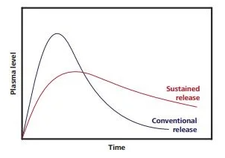
Side-Effects of Anti-proliferatives
Both Medications
Low White Blood Cells Low Platelets
Mycophenolate | Azathioprine
Diarrhea Nausea & Vomiting | Hair loss Upset stomach
dose
Change to slow release tablets (Myfortic)
Take smaller doses more frequently
            - Ex: 360 mg 2x/day → 180 mg 4x/day
Decrease dose
Change to azathioprine
Notes:
Azathiaprine can cause some hair loss and also some upset stomach which can sometimes be helped by taking it with food. But overall aside from the upset stomach these two medications are generally well tolerated

Slide 31

Side-Effects of Anti-proliferatives
Both Medications
Low White Blood Cells Low Platelets
Mycophenolate | Azathioprine
Diarrhea Nausea & Vomiting | Hair loss Upset stomach
dose
Take with food
Decrease dose
Change to slow release tablets (Myfortic)
Take smaller doses more frequently
            - Ex: 360 mg 2x/day → 180 mg 4x/day
Decrease dose
Change to azathioprine
Notes:
Azathiaprine can cause some hair loss and also some upset stomach which can sometimes be helped by taking it with food. But overall aside from the upset stomach these two medications are generally well tolerated

Slide 32
Steroids
The first used immunosuppressant in organ transplant
A part of most immunosuppression regimens
Prednisone, Prednisolone, Methylprednisolone
How they work | Affects almost every part of the immune system
Dosing | Once Daily High doses post-surgery and then decreased over time
Monitoring | Not needed for these medications
Special Considerations | CAN crush or cut tablets Taking with food can help prevent stomach upset

Slide 33

Side-Effects of Steroids
Notes:
Over time as you are on steroids they can cause your cholesterol to increase, they can decrease your bone growth and cause some weight gain. To prevent these we add medications to lower your cholesterol, help your bones grow and stay strong by adding calcium and vitamin D, and reduce the dose the further out from transplant you are.

Slide 34
Side-Effects of Steroids
Short-term
↑ Blood pressure ↑ Blood sugar Trouble sleeping Confusion Face swelling Stomach ulcer
Long-term
↑ Cholesterol Growth suppression ↓ Bone growth Weight gain
Remove excess fluid
Insulin therapy
Optimize other medications
Reduce dose if able
Acid reducing medications
Cholesterol lowering medications
Vitamin D + Calcium
Reduce dose or stop medication
Notes:
Over time as you are on steroids they can cause your cholesterol to increase, they can decrease your bone growth and cause some weight gain. To prevent these we add medications to lower your cholesterol, help your bones grow and stay strong by adding calcium and vitamin D, and reduce the dose the further out from transplant you are.

Slide 35
mTOR Inhibitors
Primarily used to decrease the kidney effects of calcineurin inhibitors
 | Sirolimus | Everolimus
Brands | Rapamune | Zortress
How it works | Prevents the replication of the immune cells
Dosing | Once Daily | Twice Daily
Monitoring | 24-hour trough | 12-hour trough
Special Considerations | Do NOT crush, cut or chew May reduce the risk of certain cancers
Notes:
Simlar to tacrolimus and cyclosporine these medications can not be crushed cut or chewed.

Slide 36
mTOR Inhibitor Monitoring
Goal level is dependent on:
  Time since transplant
  Type of transplant
  Transplant center protocols
  Other immunosuppression medications being used
  Other medical conditions

Slide 37
mTOR Inhibitor Drug Interactions
There are a LOT!!
Always contact your transplant team/coordinator or local pharmacist before starting any new medication!!

Slide 38
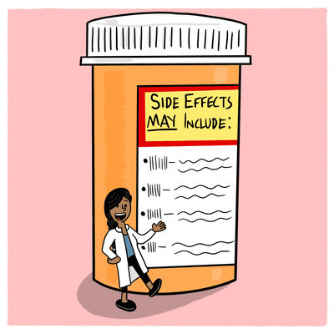
Side-Effects of mTOR Inhibitors
Both Medications
↑ Cholesterol Impaired wound healing Mouth sores Acne Swelling/Edema ↑ Protein in the urine ↓ White Blood Cells/Platelets
Cholesterol lowering medications
Decrease dose
Decrease goal level
Limit use in patients that already have protein in the urine
Switch to alternate medication
Notes:
In addition to those precautions sirolimus and everolimus can cause increased cholesterol which we’ve seen before, mouth sores or ulcers, acne, increased protein in the urine and some lung damage. we help prevent these side-effects by prescribing medications that lower cholesterol, we monitor the dosing using levels and we don’t use them in patients that already have protein in the urine or lung damage.

Slide 39
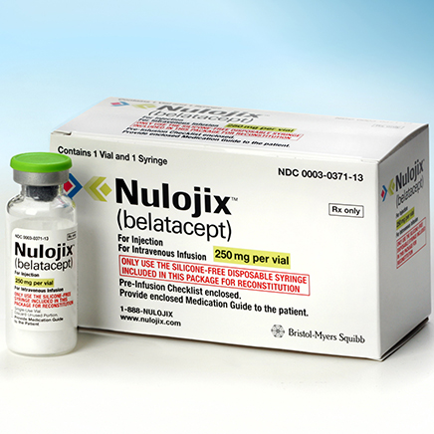
Co-Stimulation Blocker
Newest immunosuppressant on the market
Also used to decrease the kidney effects of calcineurin inhibitors
 | Belatacept
Brands | Nulojix
How it works | Prevents the activation of various immune cells
Dosing | Once Monthly infusion (after initial loading doses)
Monitoring | Not needed for this medication
Side Effects | Very well tolerated
Special Considerations | Increased risk of certain cancers Helps improve adherence
Notes:
Simlar to tacrolimus and cyclosporine these medications can not be crushed cut or chewed.

Slide 40
Final Reminders on Immunosuppression
Talk with your transplant team or pharmacist if you are experiencing any side-effects
NEVER stop taking your medications on your own!!
Immunosuppressive medications have increased the life of the organ and patient
Notes:
If you are experiencing side-effects and having trouble tolerating your medications please talk with your transplant team and let us know so we can adjust your medications. And finally please please please never stop taking any of these medications on your own. Always talk to a transplant coordinator, pharmacist, or doctor when having issues with any of your medicines.

Slide 41
Overview of organ transplant and the immune system
Determine strategies to take all medications as prescribed after transplant
Describe the common medications to prevent rejection after transplant
Explain what to do if you are experiencing side-effects from your medications
Recognize the importance of medications to prevent infections after transplant

Slide 42

Overview of organ transplant and the immune system
Determine strategies to take all medications as prescribed after transplant
Describe the common medications to prevent rejection after transplant
Explain what to do if you are experiencing side-effects from your medications
Recognize the importance of medications to prevent infections after transplant

Slide 43
Infection Prevention
Weakened immune system
  More likely to get infections
  Fewer signs and symptoms of infection
  Longer time to heal and recover
Anti-infective medications used after transplant when infection risk is highest
Rejection Risk
Infection Risk

Slide 44
Types of Infections
Bacteria
Viruses
Fungus

Slide 45

Bacteria Prevention
Sulfamethoxazole/trimethoprim (Bactrim®)
Helps prevent pneumonia and urinary tract infections
Duration: depends on organ type/transplant center protocol
Side effects:
  Rash
  Hematologic effects (Low white blood cells/platelets)
  High potassium
Alternatives in case of allergy/intolerance:
  Dapsone
  Atovaquone (Mepron)
  Inhaled pentamidine

Slide 46



Virus Prevention
Valganciclovir (Valcyte)
Helps prevent cytomegalovirus (CMV)
Duration: depends on CMV risk status and organ type
Side effects:
  Hematologic effects (Low white blood cells/platelets)
Alternatives in case of intolerance:
  Valacyclovir (Valtrex)
  Acyclovir (Zovirax)

Slide 47

Fungal Prevention
Common medications used:
  Nystatin suspension
    Do not eat or drink for 30 minutes after taking
  Clotrimazole lozenge
  Fluconazole (Diflucan)
  Voriconazole (Vfend), posaconazole (Noxafil, Posanol), isavuconazole (Cresemba)
    Side effects: blurred vision, hallucinations, increased liver enzymes
Helps prevent thrush and other fungal infections
Medication used/duration: depends on organ type/transplant center protocol

Slide 48
Overview of organ transplant and the immune system
Determine strategies to take all medications as prescribed after transplant
Describe the common medications to prevent rejection after transplant
Explain what to do if you are experiencing side-effects from your medications
Recognize the importance of medications to prevent infections after transplant

Slide 49

Overview of organ transplant and the immune system
Determine strategies to take all medications as prescribed after transplant
Describe the common medications to prevent rejection after transplant
Explain what to do if you are experiencing side-effects from your medications
Recognize the importance of medications to prevent infections after transplant

Slide 50
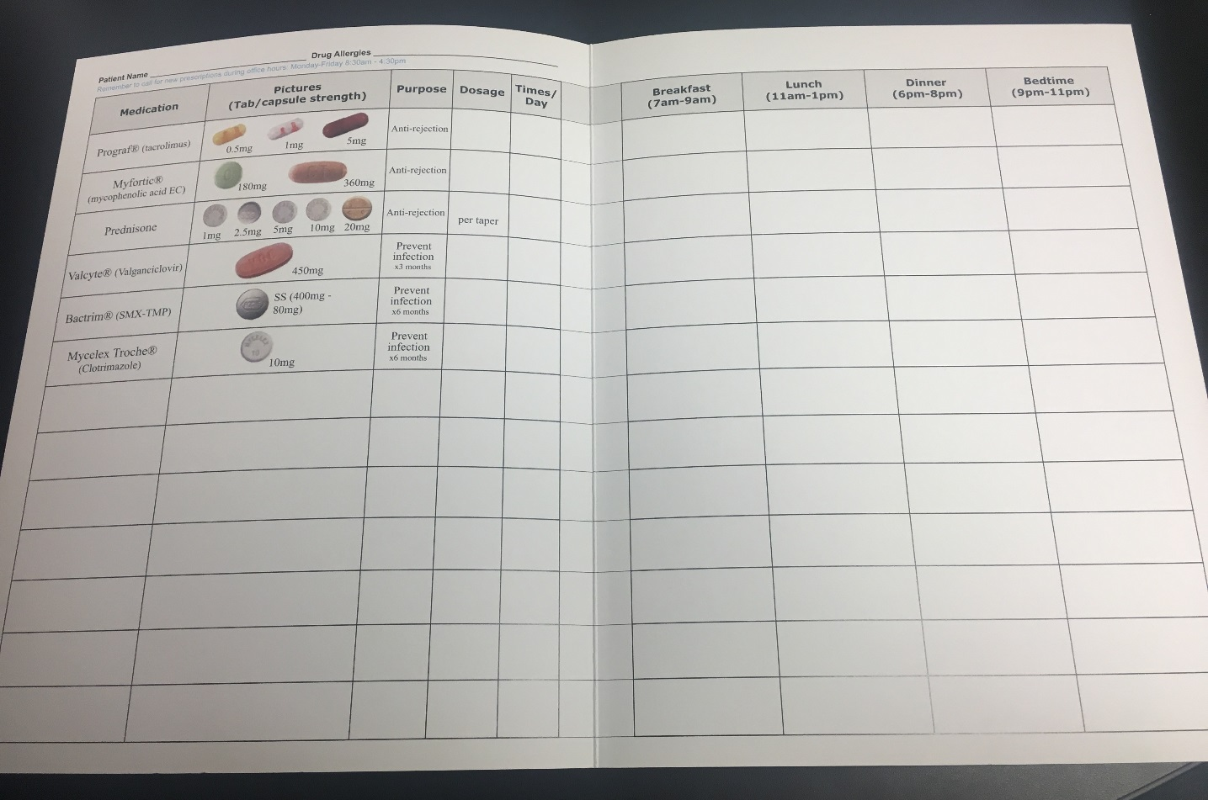
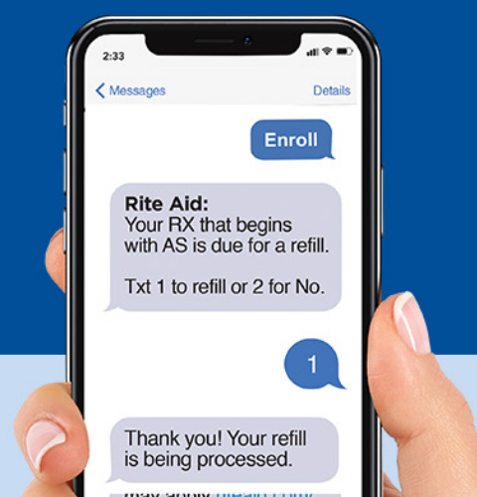

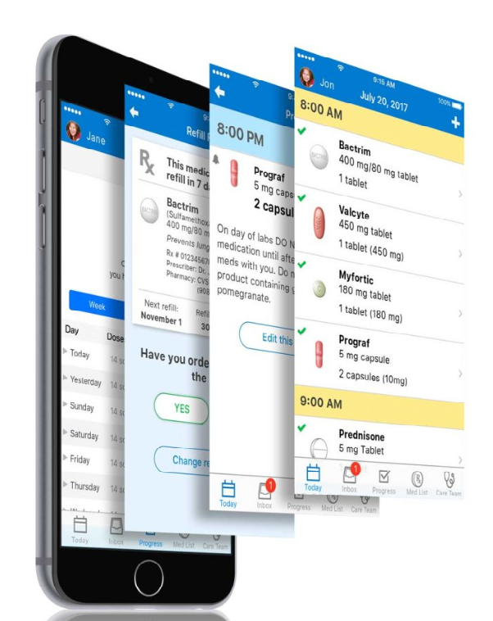
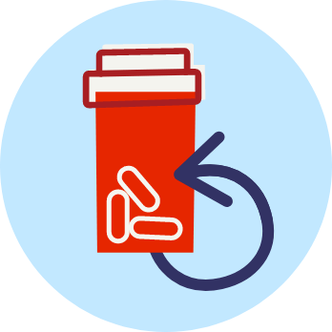
Tools to Help You Succeed

Slide 51
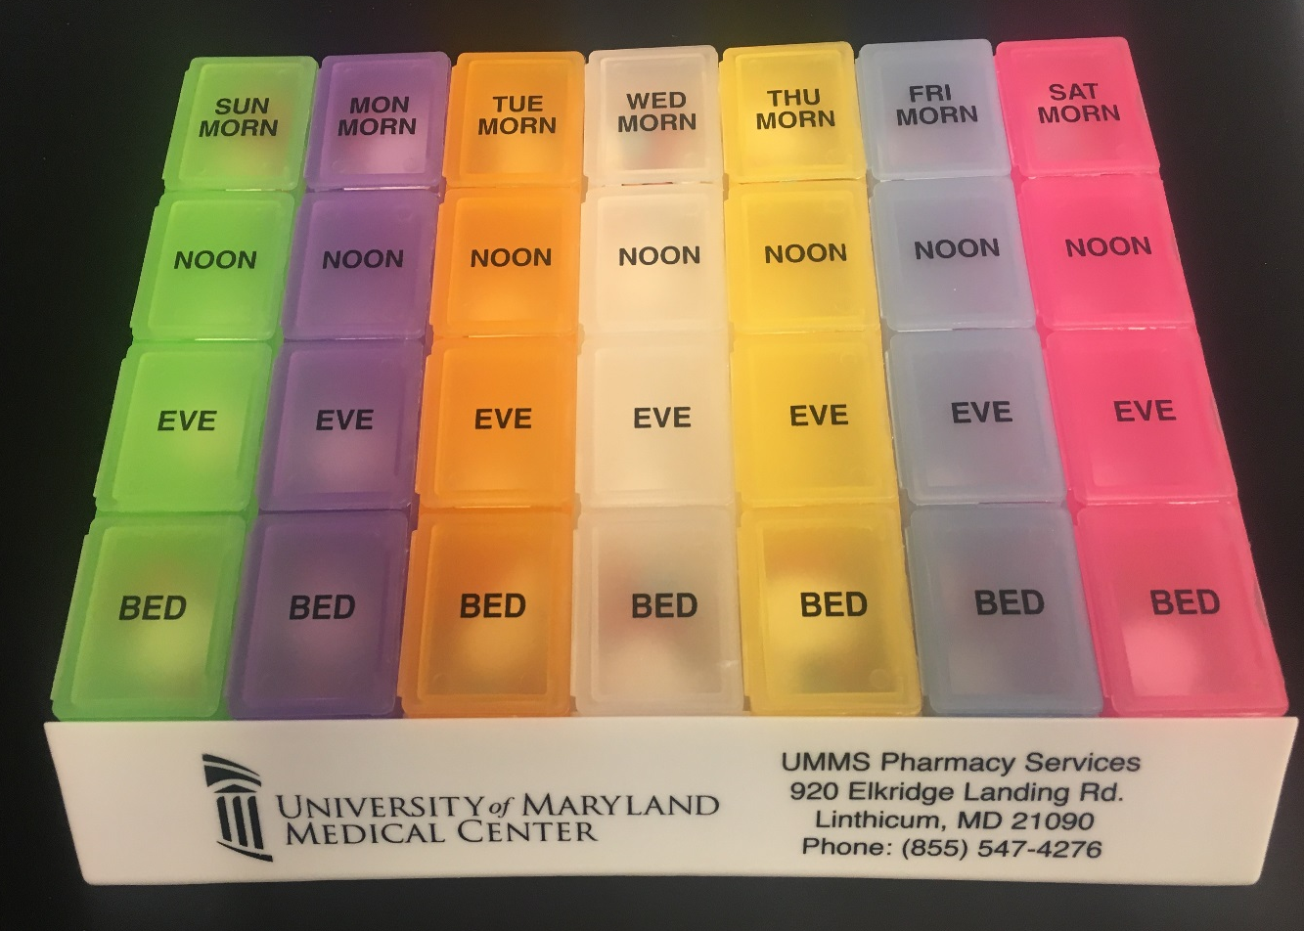
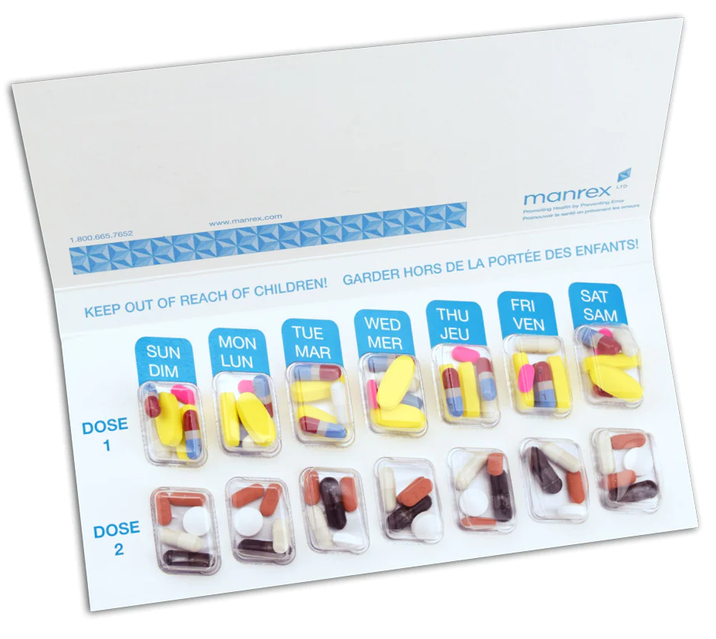
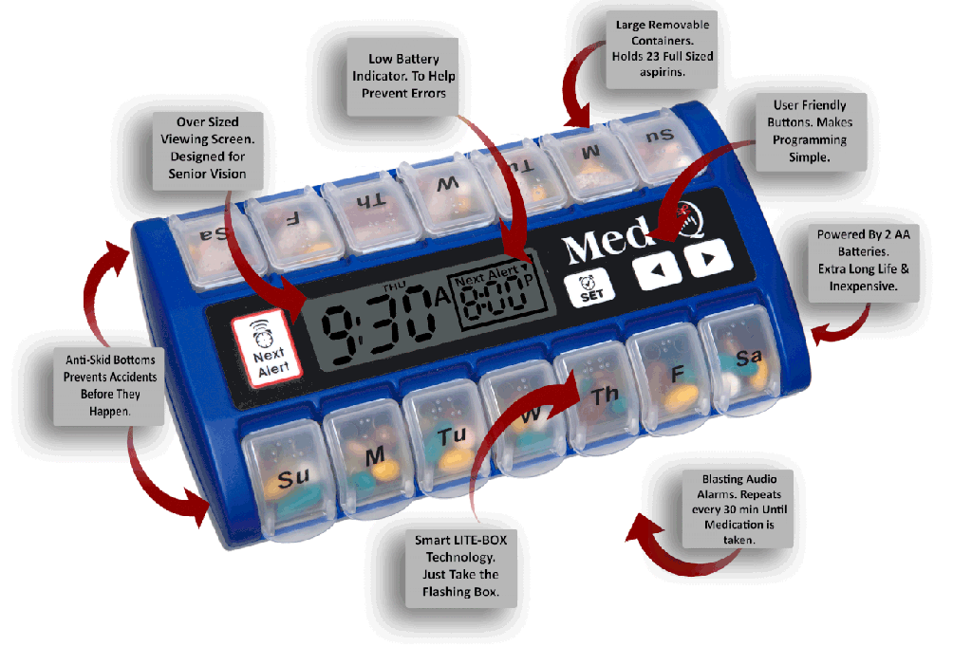
More Tools to Help You Succeed

Slide 52


Take an Active Role
KNOW your medications
  Names, doses, indication
  Common side effects
  Questions to ask about your medicines:
    Do I take it with or without food?
    What if I forget to take a dose?
    What happens if I run out of my medication?
    What if I cannot afford my medication?
    Can I take certain medicines at the same time?

Slide 53
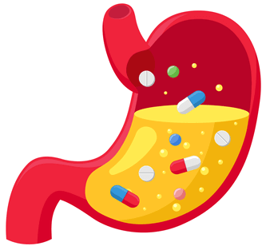


Do I take my medication with or without food?
Why??
  Lower/Slowed absorption: Food can lower the amount/delay the time it takes for certain medications to be absorbed by your body
  Faster or slower break down: Some food/juices can cause certain medications to get broken down faster in your body
If an empty stomach is needed, take medication 1 hour before or 2 hours after a meal
Always check with your local pharmacist!!

Slide 54
What happens if I forget to take a dose?
Take the missed dose as soon as you remember, unless the next dose is due within a few hours
    If medication is taken once a day: forgotten dose should be taken as soon as you remember
    If medication taken twice a day: forgotten dose can be taken if it is within 6 hours after it was due
General rule: Do not double up a dose!

Slide 55

What happens if I run out of medication?
Contact your pharmacy and transplant team immediately so that they can help!
Prevent this from happening by requesting refills in advance

Slide 56
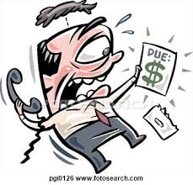
What if I cannot afford my medication?
Pharmacy and social work can help!
  Patient assistance programs
  Copay cards
  Grants to help pay for medications
  Generic medications may be available
Your transplant team may be
able to change your medication
to a similar alternative

Slide 57
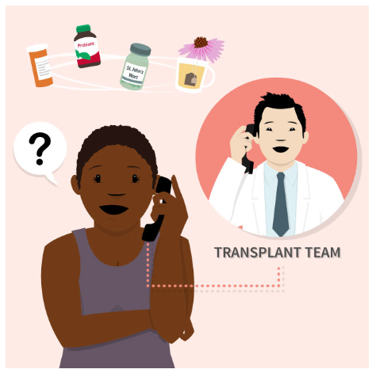
Are other medications safe with my transplant medications?
Contact your transplant team with questions
Ask your local pharmacist - make sure they know you have a history of transplant!
Let your doctor know if your symptoms last longer than 48 hours

Slide 58

Other Medications After Transplant
Pain control
Blood pressure
Blood sugar
Cholesterol
Acid reducer
Multivitamins
Keep your team informed if you are starting or stopping any medications
  New medication prescribed by another doctor
  Herbals/supplements
  Over the counter medications

Slide 59
Key Points
A successful transplant is highly dependent on YOU!!
Immunosuppressant medications have increased the life of organ transplants and patients
Talk with your transplant doctor or pharmacist about side effects
Know your medications and ask questions
Take your medications as prescribed to protect your new organ

Slide 60


Slide 61
Medications
After Transplant
Ian A. Booth, PharmD
Solid Organ Transplant Pharmacist
University of Maryland Medical Center

Slide 62
References
VectorStock. Stop bacterium sign with cute cartoon germs in flat vector image. Published 2019. Accessed April 9, 2019. https://www.vectorstock.com/royalty-free-vector/stop-bacterium-sign-with-cute-cartoon-gems-in-flat-vector-10554156.
Open Clipart. Bacteria. https://openclipart.org/detail/284321/bacteria. Published 2017. Accessed April 5, 2019.
UnixTitan. Virus Clipart #9. https://unixtitan.net/explore/virus-clipart-black-and-white/#gal_post_3303_virus-clipart-black-and-white-9.png. Published 2018. Accessed April 5, 2019.
UnixTitan. Virus Clipart #1. https://unixtitan.net/explore/virus-clipart-black-and-white/#gal_post_267_virus-clipart-black-and-white.png. Published 2018. Accessed April 5, 2019.
UnixTitan. Virus Clipart #2. https://unixtitan.net/explore/virus-clipart-black-and-white/#gal_post_267_virus-clipart-black-and-white-2.png. Published 2018. Accessed April 5, 2019.
UHN Research. http://pie.uhnresearch.ca/~michaelcorrin/TMITT.
MyMedSchedule Plus. Phone. https://secure.medactionplan.com/mymedschedule/images/phone-today.png. Published 2018. Accessed April 5, 2019.
Masters, M. Prevention. The best alarm clocks for heavy sleepers. https://www.prevention.com/health/a20485882/loudest-alarm-clocks-for-heavy-sleepers. Published November 4, 2018. Accessed April 5, 2019.

