Slide 1
Changing the Rules in Transplantation:
Separating Science from Stigma
Liver Transplant for AUD
Andrew M. Cameron, MD/PhD
Chief, Division of Transplantation, JHU
5/14/22

Slide 2
Case: Severe Alcoholic Hepatitis
61 yo female, school teacher, admitted to Northern Maine medical center with SAH.
  Heavy alcohol use, but didn’t interfere with work, no DUIs or negative consequences
  Failed steroids, Transferred to hospice
PCP advocated and found Hopkins publication, initiated transfer to JHH for work-up
Excellent social support, husband at bedside - Transplant?

Slide 3
Disease Definition: Alcoholic Hepatitis (AH)
AH: acute onset of jaundice due to excessive alcohol intake
Spectrum of disease: severity by Maddrey’s discriminant function
  If severe: DF>32, 6 month mortality is 40%
  increases to 70% in those refractory to medical treatment by Lille score
Treatment options: US transplant centers typically require 6m sober

Slide 4
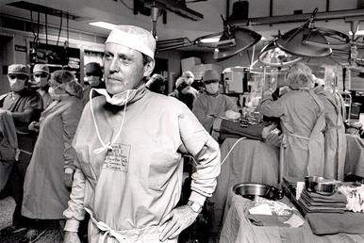
Liver Transplant and EtOH
“Liver transplant is the cure for alcoholism”
-T. Starzl
-6 month sobriety?

Slide 5
LT for AH: rescue therapy for AH is controversial
6m abstinence criteria:
-select patients with ALD who will abstain after LT
-exclude patients who might improve and not require LT
-this length of time is arbitrary, unreliable predictor of relapse
-not realistic in severe AH, where majority (75-90%) of patient deaths occur within 2m
    UNOS-never adopted the 6m policy after concerns it was a legally indefensible position
French report (2011, NEJM), US report (2015, AJT)
JHU experience

Slide 6
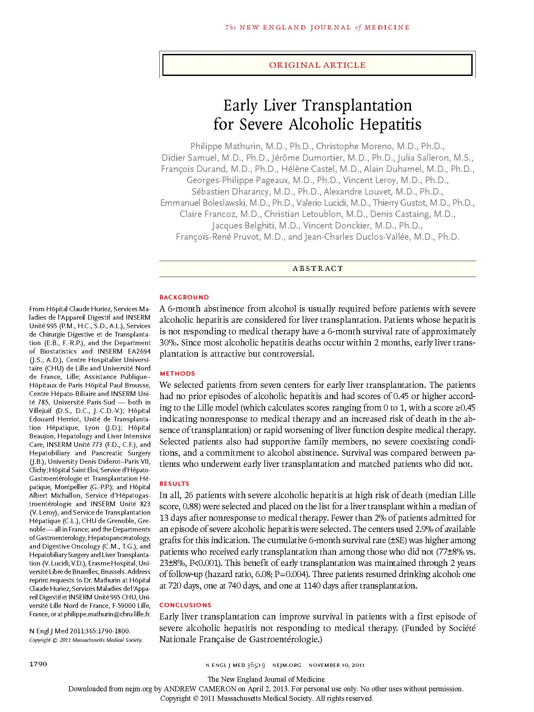
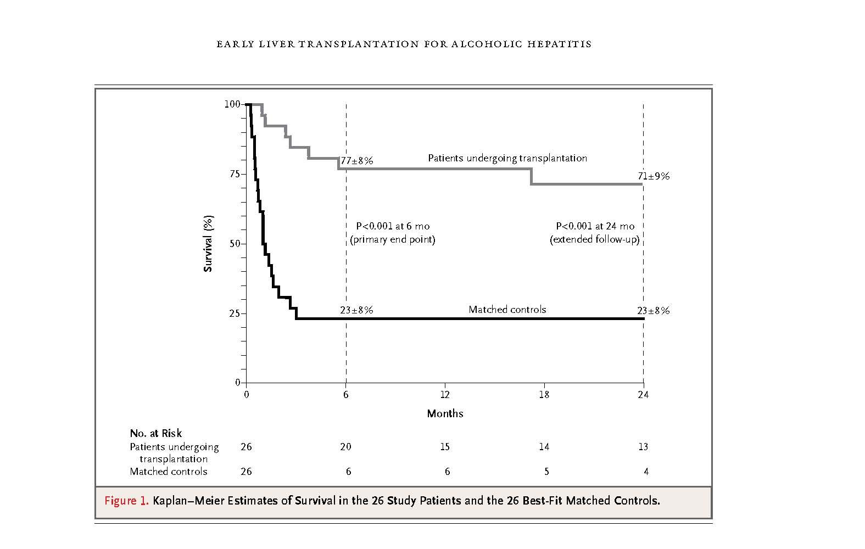
-26 patients with AH
-77% 6m survival
-12% recidivism

Slide 7
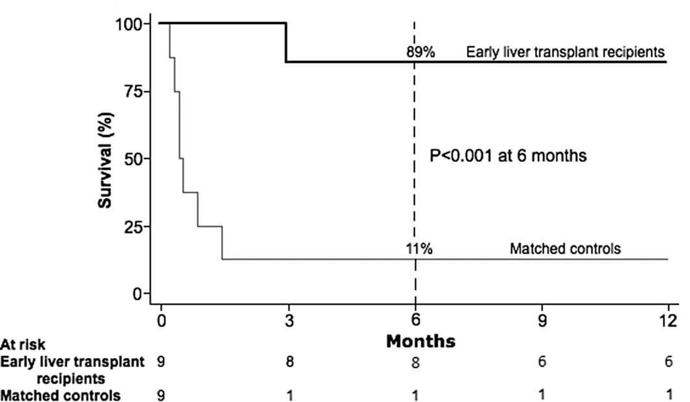
-9 patients with AH
-89% 6m survival
-11% recidivism

Slide 8
LT for AH at JHU
Patients required all of the following to be selected for our pilot program: Severe alcoholic hepatitis (Discriminant Function ≥32) as first liver-decompensation (i.e. patient not aware of liver disease prior). Failure of medical management, guided by Lille Score >0.45, continuous increase in MELD, or consensus by fellow, transplant surgeon, and medical hepatologist. Commitment to lifelong adherence to alcohol abstinence, evaluated by substance abuse specialist, with rigorous assessment and classification of alcohol history and dependency. Strong social support by family and friends, evaluated by transplant social worker. Rigorous assessment of possible risk factors for alcohol relapse, by substance abuse specialist and social worker. Absence of severe comorbid medical issues, evaluated by hepatologists, transplant surgeon, and other medical specialists when appropriate. If history of psychiatric disease, evaluated by transplant psychologist, with required assessment of stable psychiatric disease. Full consensus agreement by transplant committee, comprised of social worker, hepatologist, transplant surgeon.
Origins of program
(10/12-7/17)
Results
Details

Slide 9
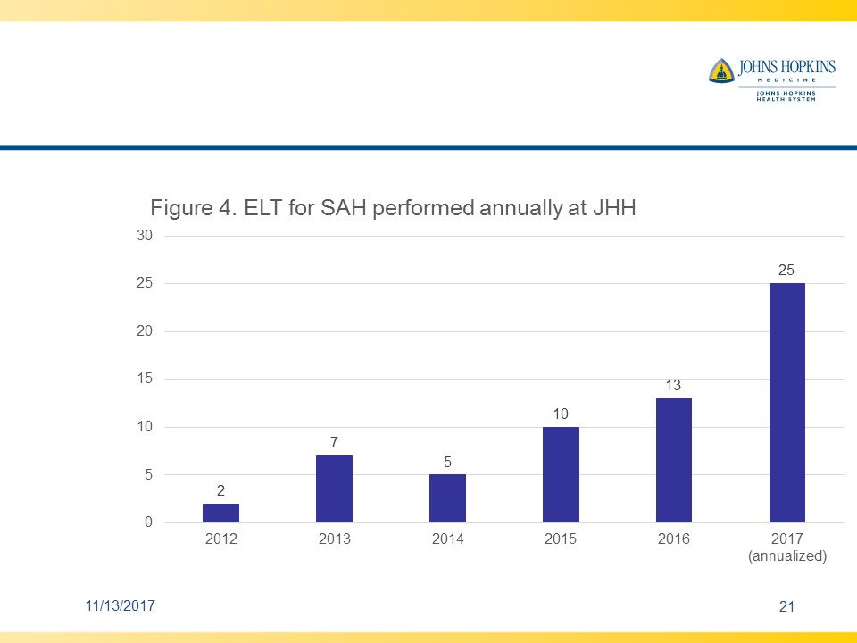
Results and Growth of Program
-1 year survival: 97%
-Recidivism
-Growth of program

Slide 10
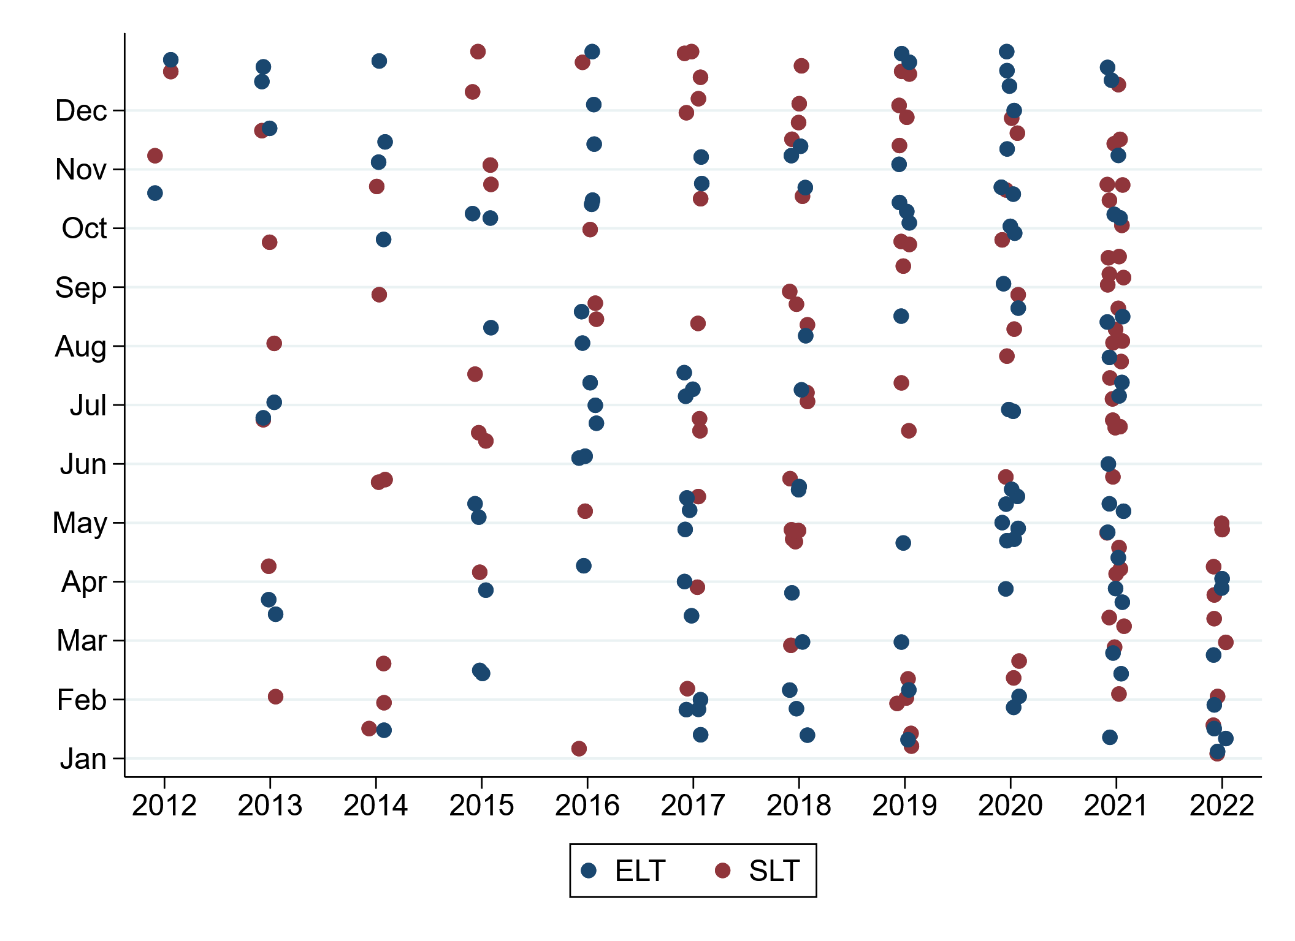
Liver Transplants for ALD at Johns Hopkins
Start of P50
 | 2012 | 2013 | 2014 | 2015 | 2016 | 2017 | 2018 | 2019 | 2020 | 2021 | 2022 | Total
ELT | 2 | 7 | 5 | 8 | 13 | 14 | 12 | 11 | 23 | 20 | 7 | 122
SLT | 2 | 6 | 7 | 8 | 6 | 12 | 16 | 15 | 10 | 31 | 9 | 122

Slide 11
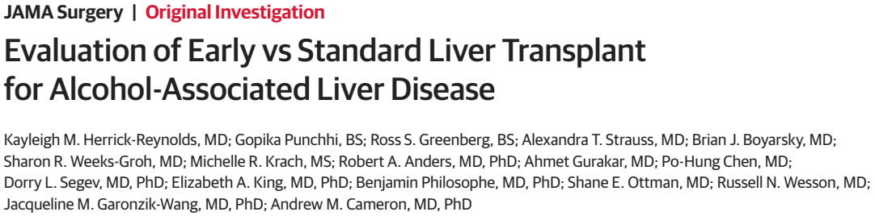
JAMA Surgery, 2021
Cohort from October 1, 2012 – November 13, 2020:
ELT 88, SLT 75

Slide 12
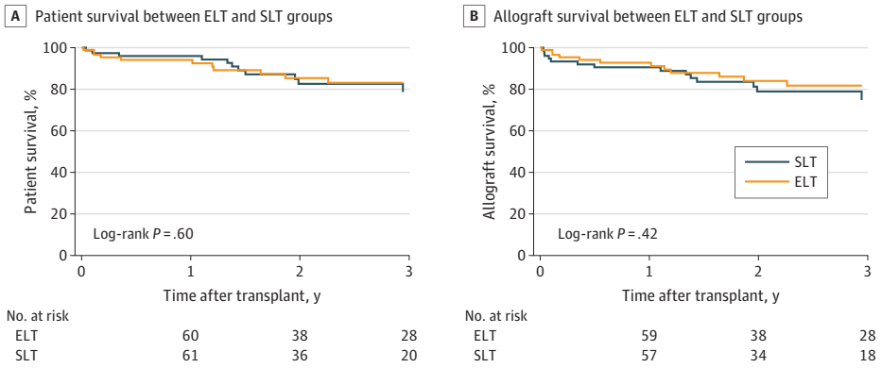
Patient & Allograft Survival
Notes:
Outstanding 1- and 3-year patient and graft survival. No difference between ELT and SLT.
Patient survival – 1yr ELT 94%, SLT 96% || 3yr ELT 83%, SLT 79%
Graft survival – 1yr ELT 93%, SLT 91% || 3yr ELT 82%, SLT 75%

Slide 13
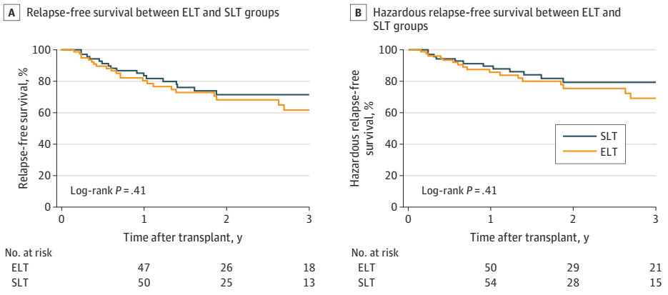
Relapse-free & Hazardous Relapse-Free Survival
Notes:
Hazardous relapse was defined by binge drinking (≥5 drinks for men or ≥4 drinks for women per occasion), at-risk drinking (≥14 drinks for men or ≥7 drinks for women per week), or frequent drinking (≥4 days of drinking per week) using NIAAA’s standard drink definitions.
Relapse-free – 1yr ELT 80%, SLT 84% || 3yr ELT 62%, SLT 72%
Hazardous relapse-free – 1yr ELT 86%, SLT 90% || 3yr 69%, SLT 79%

Slide 14
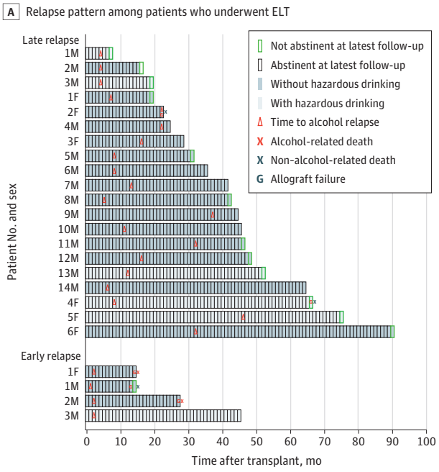
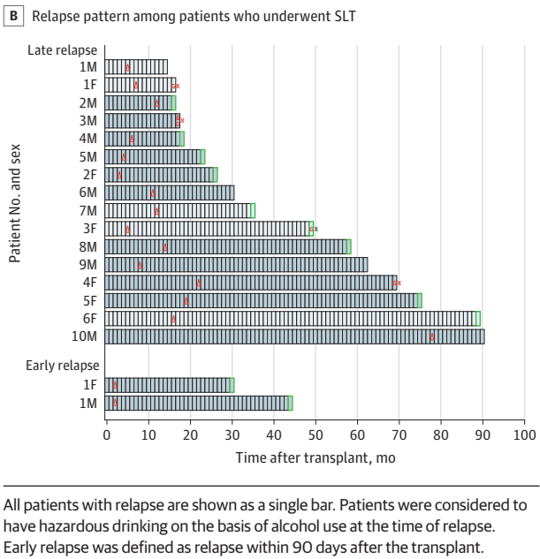
Post-LT Alcohol Relapse
Patterns
Notes:
Abstinent defined as no suspicion for alcohol use for at least 1 month
Relapse numbers: ELT 24, SLT 18
Regained abstinence: ELT 13, SLT 11
Early relapse (6 total) was associated with hazardous drinking (5) and a high risk of death (3)

Slide 15
Case: Severe Alcoholic Hepatitis
Transplanted, d/c’d POD 12
No relapse
Now retired - volunteering for church

Slide 16
Multidisciplinary Approach to Study of Patients with Severe Alcoholic Hepatitis
Undergoing Liver Transplantation
P50AA027054
Specialized Alcohol Research Center at JHU (DELTA Center)
Presented by: Andrew M. Cameron, MD/PhD

Slide 17
Conclusions: ELT for SAH at JHU
Life Saving therapy for patients with no other option
Outcomes similar to patients with ongoing sobriety (95%)
Ability to predict who will do well: HPSS
Need for biologic investigation is just as great (NIAAA R24)
Calls into question the value of the 6 month wait rule

Slide 18

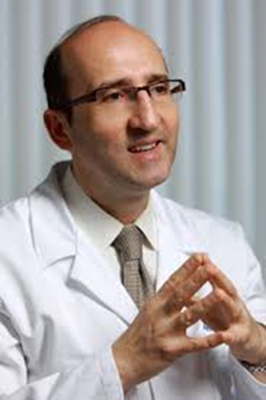
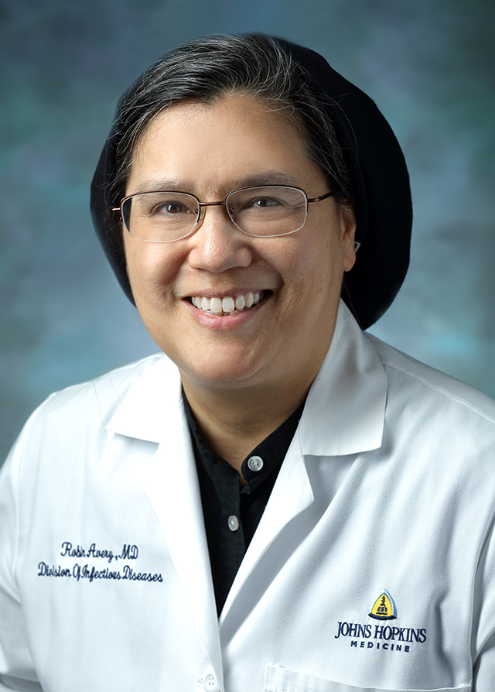



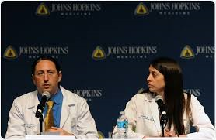
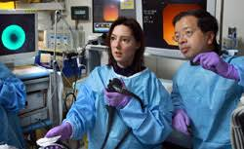
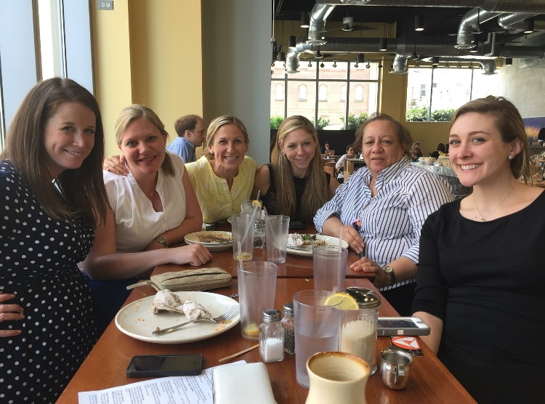
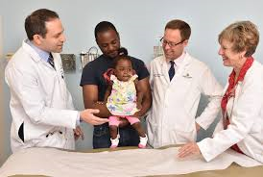
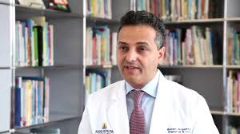
The team

Slide 19
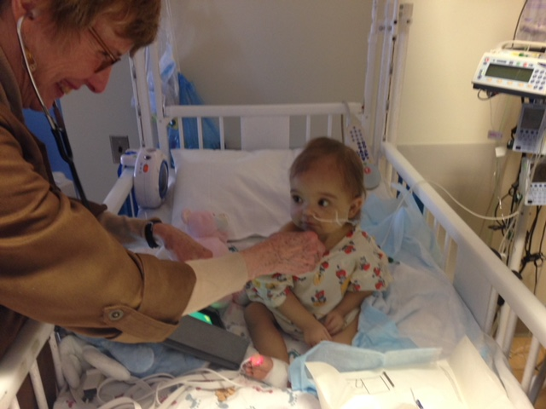
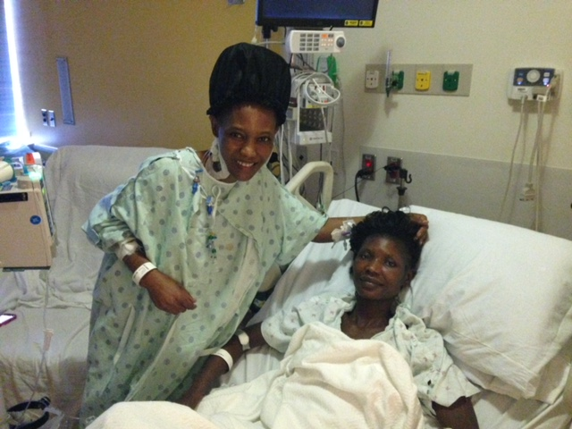
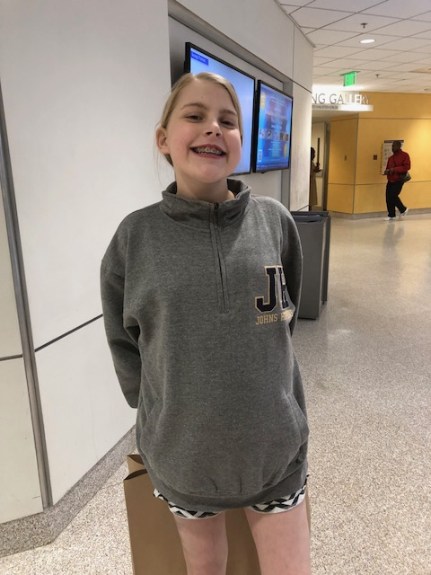
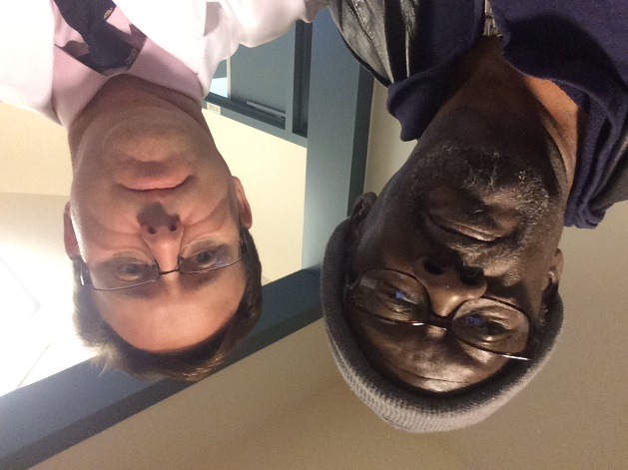
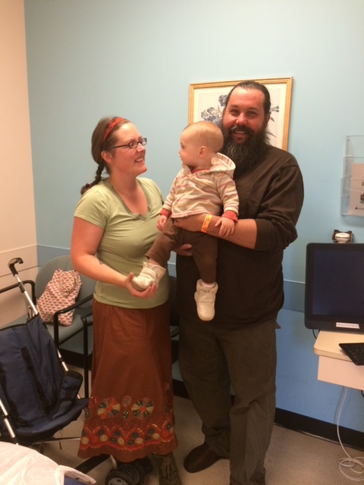
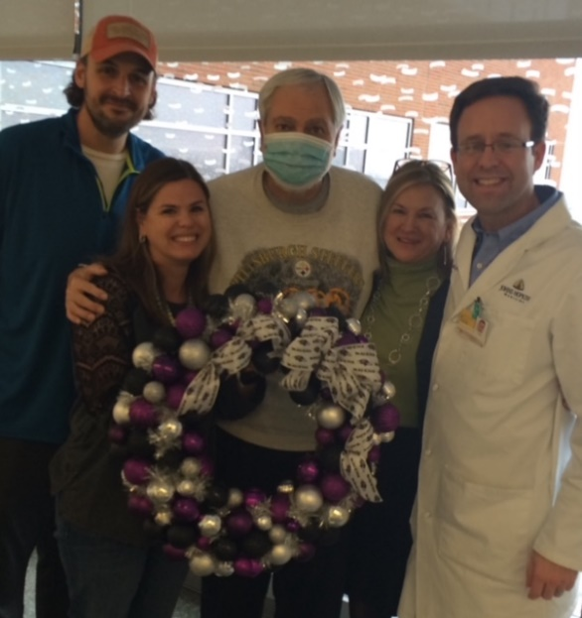
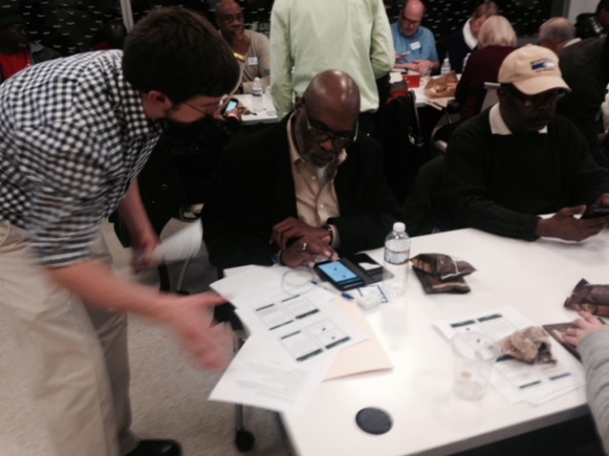
The patients

