Slide 1
Preparing for a Kidney Transplant:
Five Things To Know and Do
Niraj M Desai, MD
Director of the Kidney and Pancreas Transplant Program
Johns Hopkins Hospital

Slide 2
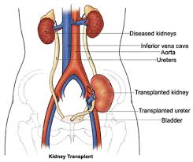
#1 - Transplant is the Best Treatment Option for Kidney Failure
Quality of life
Longevity
On average a kidney transplant will double life expectancy compared to dialysis
Not a cure, but beats dialysis!

Slide 3
#2 - Kidney Allocation System (12/2014)
Kidneys: KDPI scoring system (1-100)
KDPI > 85 requires additional consent
Recipients: EPTS scoring system (1-100)
Kidneys and Recipients are matched
Increase priority for sensitized patients (cPRA of 98,99, and 100)
Include pre-registration dialysis time
Waiting times remain long

Slide 4
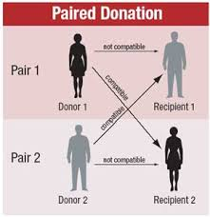
#3 - Find a Living Donor
Family, friend, neighbor, church member, co-worker, former classmate
Importance of social media (Facebook)
Donor Champion Program
Do not worry about the match
Do not worry about blood types

Slide 5
#4 – Prehab
“a proactive approach to avoiding pain and injury”
Orthopedics, Oncology, General Surgery fileds all have supporting studies
Physical and mental aspects of Prehab
Renal failure patients – walking, stationary bicycle

Slide 6
#5 – Maintain medical condition
Stay up-to-date with medical screening
Work towards an optimal weight
Smoking cessation
Keep testing up-to-date (especially heart)
Keep an active medication list
Have a care plan

Slide 7
#6 – Baltimore is a great place to be
Johns Hopkins and University of Maryland
Two of the busiest kidney programs in the country (500/y)
Both have robust living donor programs
Import deceased donor kidneys from outside our area to give them a second look
Shortest waiting times
Specialized programs

