Slide 1
Adjustment to transplant:
Coping with Depression and Anxiety
Erin M. Gillard, LCSW-C
Family Services Coordinator
Living Legacy Foundation

Slide 2
OBJECTIVES
Discuss the wide range of feelings related to transplant.
Examine how expectations can impact coping.
Consider how finding a new “normal” and shifting roles can impact self image and feelings about identity.
Explore ways to cope with the emotional impact of illness/transplant.

Slide 3
5 Phases of Transplant
Evaluation
Wait List Management
Transplant Event
Discharge Planning
Post Transplant
Psychosocial risk in all stages, including depression, anxiety, Post Traumatic Stress Disorder, the experience of guilt and feelings of anxiety about dependence on others

Slide 4
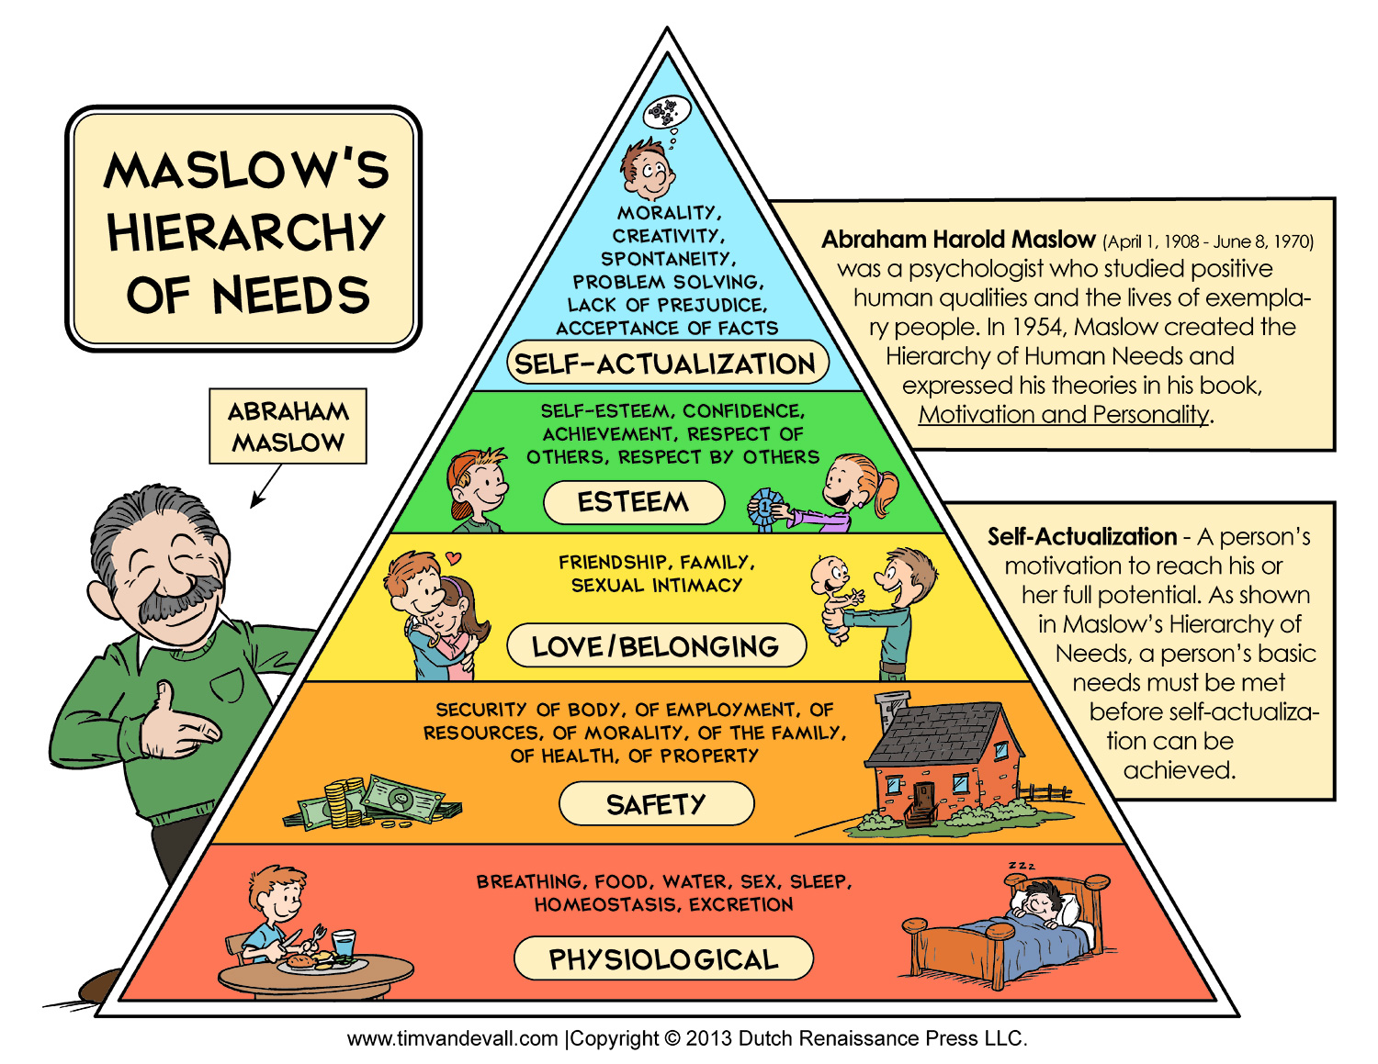
Maslow’s Hierarchy of Needs
Notes:
It simply makes the point that being ill is
very difficult, but we can adapt to it. We are capable of adjusting
and still feeling happy, even when we’re sick.

Slide 5
“You are down to the floor of who you are in the presence of illness.” - Rita Charon
Romantic
Relationships/
Sexuality
Exercise/Physical Activities
Completing Daily Errands and Activities
Working
Participating in Social Activities/Friendships
Sleep/Pain/Appetite
Spirituality
Independence

Slide 6
The Dance of Expectations And reality
Notes:
Having a transplant does not mean a recipient is cured, which the
average person may not understand. For that reason, friends, family and
co-workers may think recipients are now good-as-new, and all their
health problems are solved. It will take time for people to understand
that recipients have a new set of challenges
Expected a Better Quality of Life Post Transplant
▪May Expect a Complete Cure

Slide 7
Emotions That Come With Transplant
Sadness
Guilt
Anger
Anxiety
Loneliness
Joy
Happiness
Excited
Hopeful
Lucky
Numbness
Relief
Helplessness
Shame
Fear
Responsibility
Vulnerability
Optimistic
Fortunate
Blessed
Excited
Amazed

Slide 8
Grief
Layers of Loss:
Organ Failure
Life prior to life before illness
Expectations for how life is “supposed” to be
Change in roles
Loss/Change of relationships
Loss of involvement in activities

Slide 9
Hope lives here.
Notes:
It possible to be hopeful and worried at the same time.
How does it feel when people tell you to stay positive?
What if you can allow yourself to feel whatever you need to feel?

Slide 10
AM I Good Enough?
“I also felt some pressure, knowing that I was carrying someone else’s organ inside of me. I knew the circumstances of my donor, who was a 15-year old boy, because my mother’s cousin worked with his father. When I received his heart, I felt pressure to try to live this boy’s life for him. I wanted to do something really meaningful and impressive to make something great come out of his death and have his gift be worthwhile. But that was a very tall order, impossible to fill. The first year after my transplant, I spent a lot of time trying to figure out how I could win a Nobel Peace Prize.”
-Molly, Heart Recipient

Slide 11
Depression and Anxiety
Transplant recipients are at an increased risk of experiencing clinical depression, particularly in the first year after transplant.
Transplant recipients are also at an increased risk of developing Post Traumatic Stress Disorder.
Transplant recipients experience heightened levels anxiety.

Slide 12
“I’d like to say that having a transplant positions you precariously on a cliff, looking over the edge. If nothing else goes wrong in your life, you can turn around and walk back to safety. But if something does go wrong, it’s very easy to fall off. Whether or not you do depends on how you respond to what happens.”
- David, Kidney Recipient

Slide 13
Symptoms of Depression
Feeling depressed for most of the day, almost every day.
Lack of enjoyment of activities you once enjoyed, such as going to work or visiting friends.
Weight changes (gaining or losing).
Sleep problems (too much or too little).
Feeling restless.
Lacking energy, feeling easily fatigued.
Feeling worthless or guilty.
Trouble concentrating.
Frequent thoughts of suicide

Slide 14
Symptoms of Anxiety
Feelings of panic, fear, and uneasiness
Uncontrollable, obsessive thoughts
Repeated thoughts or flashbacks of traumatic experiences
Nightmares
Ritualistic behaviors, such as repeated hand washing
Problems sleeping
Cold or sweaty hands and/or feet
Shortness of breath
Palpitations
An inability to be still and calm
Dry mouth
Numbness or tingling in the hands or feet
Nausea
Muscle tension
Dizziness

Slide 15
Symptoms of PTSD
Symptoms of PTSD often are grouped into three main categories, including:
Reliving: People with PTSD repeatedly relive the ordeal through thoughts and memories of the trauma. These may include flashbacks, hallucinations, and nightmares. They also may feel great distress when certain things remind them of the trauma, such as the anniversary date of the event.
Avoiding: The person may avoid people, places, thoughts, or situations that may remind him or her of the trauma. This can lead to feelings of detachment and isolation from family and friends, as well as a loss of interest in activities that the person once enjoyed.
Increased arousal: These include excessive emotions; problems relating to others, including feeling or showing affection; difficulty falling or staying asleep; irritability; outbursts of anger; difficulty concentrating; and being "jumpy" or easily startled. The person may also suffer physical symptoms, such as increased blood pressure and heart rate, rapid breathing, muscle tension, nausea, and diarrhea.

Slide 16
Medication Effects on Mood
Euphoria
Difficulty Sleeping
Anxiety
Agitation
Difficulty Concentrating
Mood Swings
Personality Changes
Depression
Difficulty with memory

Slide 17
Who Am I now?
Notes:
Some recipients may also find it hard to accept that they are more
dependent on their families. They may feel like their illness disrupts
their families’ lives, and they are dependent on them emotionally and
sometimes financially. For recipients who are used to being the sole
providers for their families, that can be really tough.

Slide 18
Acknowledging Emotions
N – notice
A – acknowledge it by name
M – make room
E – expand awareness
This is technique is not about “feeling better,” but rather just allowing yourself to experience whatever emotion arises without critcizing/judging yourself, or trying to hold it back.

Slide 19
Sitting with thoughts and emotion

Slide 20
Noticing Thought Patterns

Slide 21
Be gentle with yourself.
Self-Esteem is a judgment about oneself usually contingent on something outside of us, and this judgment has the potential to be harmful, both if it is high and if it is low. We are in danger of not feeling good enough, or of putting down others when the focus is feeling some how “better” than those around us so we can feel good about ourselves.
Self-compassion is the act of accepting yourself, just as you are, flaws and all, with no judgment.
-Kristin Neff- Ted Talk, The Space Between Self-Esteem and Self-Compassion

Slide 22
Practicing self Compassion
Self Compassion Exercise:
Place Hands over Heart
This is a moment of suffering.
Suffering is a part of life, and others feel this way. I’m not alone.
May I be kind to myself.

Slide 23
Relationships
Pay attention to your social relationships.
Identify supportive relationships.
Notice where you find energy.
Notice where you feel like you give more energy than you receive.
Give yourself permission to say no.
Self-care is not selfish.

Slide 24
The Five Gifts- Jill Sklar
Relationships: Old friendships, new friendships, relationship to higher being, relationship to self
Time and Being: Concept of Time and Body Changes, more vigilant to both
Altruism: Increased Empathy and Support for Others
Living life in Balance: Less anger, less fears of past, more joy and more humor
Goals: Resetting the Future

Slide 25
Express Yourself
Find outlets to express feelings:
Conversations with spouse/partner
Conversations with friends
Journaling
Support groups (online, in person)
Blogs
Art (Painting, drawing, clay)
Physical outlets (Walking, Gentle Yoga, Dance)

Slide 26
You have choices…
“But you do know how to live in an uncertain world – you’ve done it all your life. You have not built your life around certainty; you have built it around values, priorities, and purpose. You look both ways before crossing the street. You button up your overcoat when the weather is cold. You give advice, hoping others will learn from your mistakes. Every day is a series of choices, a series of questions that you answer by going to work, by taking out the garbage, by hugging or kissing or fighting or walking away.
You cannot know for certain the answer to these questions, but you can live without those answers.
Coping with fear does not mean never being afraid. It means acting with integrity even when you are afraid. It means that your fear does not make the decision for you. You choose.” – John Wynn, MD

Slide 27
Resources
Coping with an Organ Transplant: A Practical Guide
by Elizabeth Parr
Issues for Today’s Transplant Recipients, The National Kidney Foundation
http://passthrough.fw-notify.net/download/934327/http://www.kidney.org/transplantation/transAction/pdf/UnderstandingDepression.pdf
Coping after a Lung Transplant
http://my.clevelandclinic.org/services/lung_transplantation/hic_how_to_cope_after__lung_transplant.aspx

Slide 28
Questions? Comments?
Thank you for attending!!!

